Slide 1
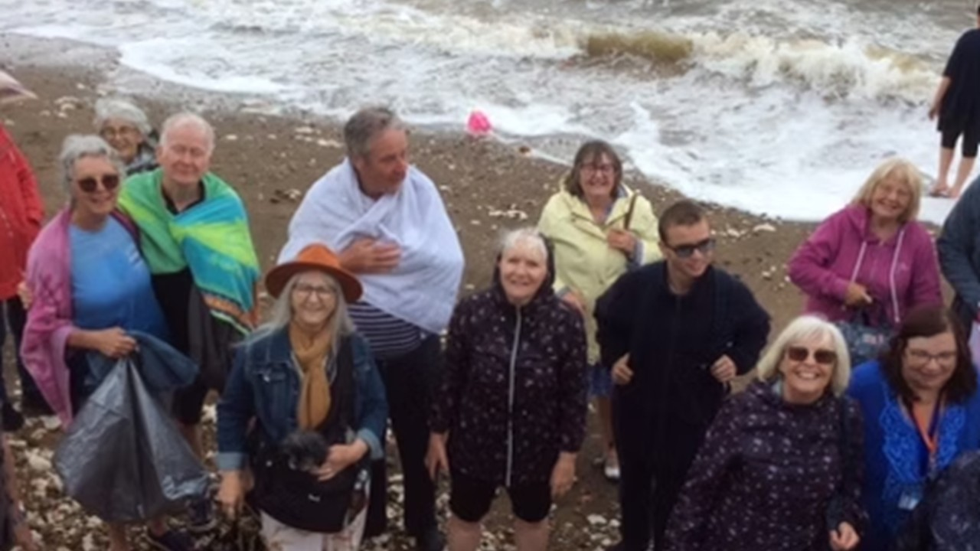
The Church is a union of Baptist and U.R.C and is being by led Revd. Chris Collict with some very capable Deacons. Union has 24 active, mature members, with 40 people in regular attendance, along with some four-legged friends, as the church is dog-friendly! The Summer months bring in many Tourists. The church runs two Bible Study groups; one follows a more traditional approach, and one uses creative ways to approach God’s word. The ladies meet for Afternoon Tea, while the men meet for breakfast. Part of the church’s ministry is joining up with the other churches in the area on a regular basis to celebrate major dates on the Christian calendar such as Easter and Christmas but also to bring “church” outdoors through Songs of Praise-style worship. Baptisms have been held in the summer months on the beach as a public witness of how God transforms lives.
Prayer Focus: Union Church, Hunstanton, Norfolk

Slide 2
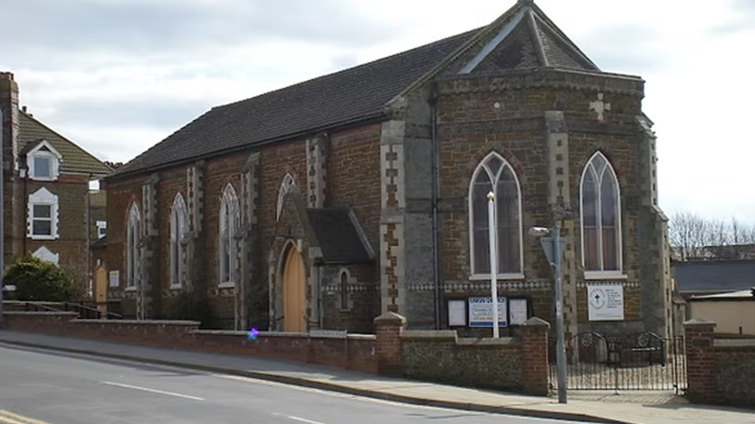
The church hosts Guides, Brownies, and Rainbows, with Parade Services being held twice a year. Following a long period of pastoral vacancy, the church is keen to welcome new people (and their dogs) and hopes for willing people to take up leadership roles. Please pray for: • Growth within the fellowship, the church looks forward to welcoming more residents of Hunstanton. • That God will prompt members to consider leadership roles within the church. • For continuing links with the local United Reformed Church. • For Togetherness and Gods love to spread within the fellowship and spill out into the community.
Prayer Focus: Union Church

