Slide 1
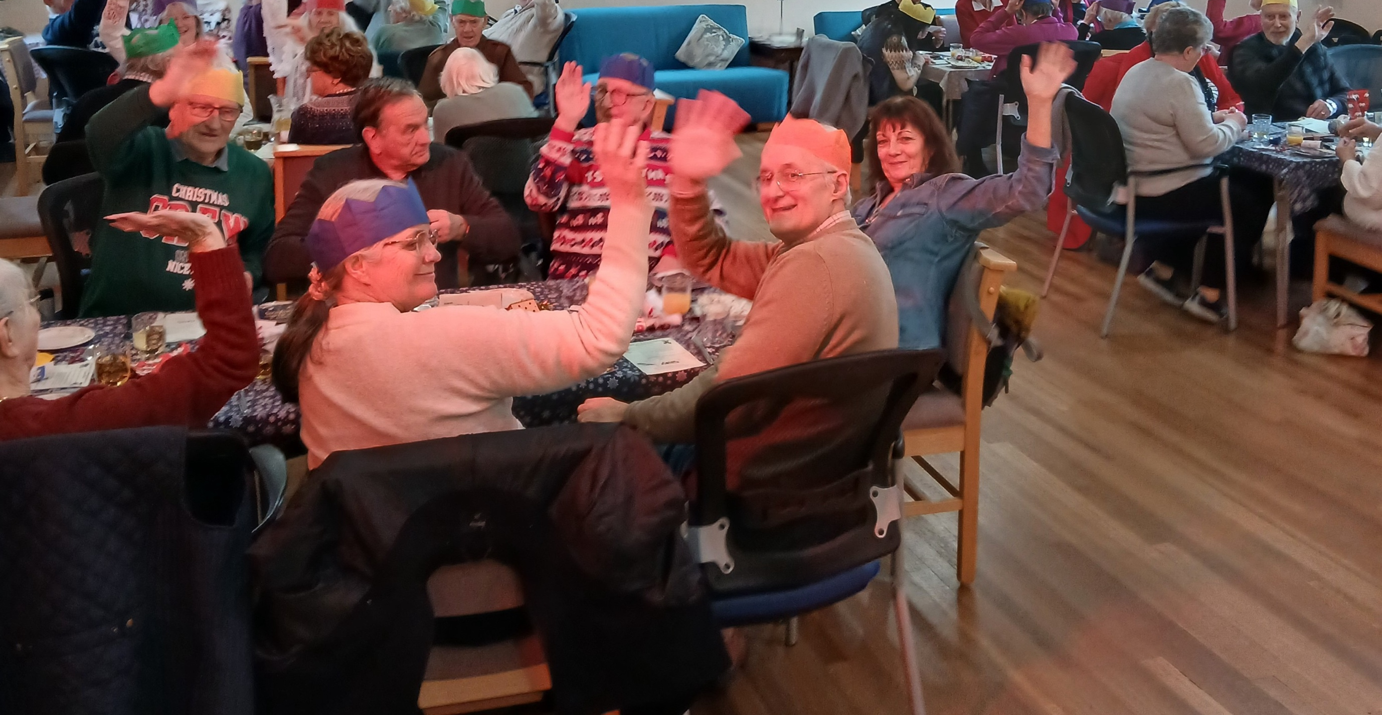
Prayer Focus: Stradbroke Baptist Church, Mid-Sufolk
SBC has a local friendly congregation in an expanding village. Due to its rural location most work in agriculture relating industries. Many of the elderly folk have spent a lifetime in the village and church. Their minister, Bruce Francis, has witnessed the congregation steadily grow to 40+/- precious souls. The fellowship remains greatly encouraged through worship and its outreach in the village. The church hosts a monthly singalong supper and a weekly ‘prayer and share’ time that is also growing in numbers. Wellbeing Wednesdays attract up to 40 villagers who enjoy a warm space, a meal and afternoon games

Slide 2
Prayer Focus: Stradbroke Baptist Church
The fellowship continues to be excited and thankful in what the Lord has been doing and is expectant in what He will do among them, through them, and in them, in the days ahead as they commit their way to Him and His Word. Please pray with us:
• Please rejoice with us in Lord’s goodness toward us
• That the Name of Jesus would be lifted up in Stradbroke and in all we do
• That He would guide us as we love and minister around the village
• That we may grow in holiness and devotion toward our Lord
• For a gifted person to set up a simple website or social media page/platform

