Slide 1
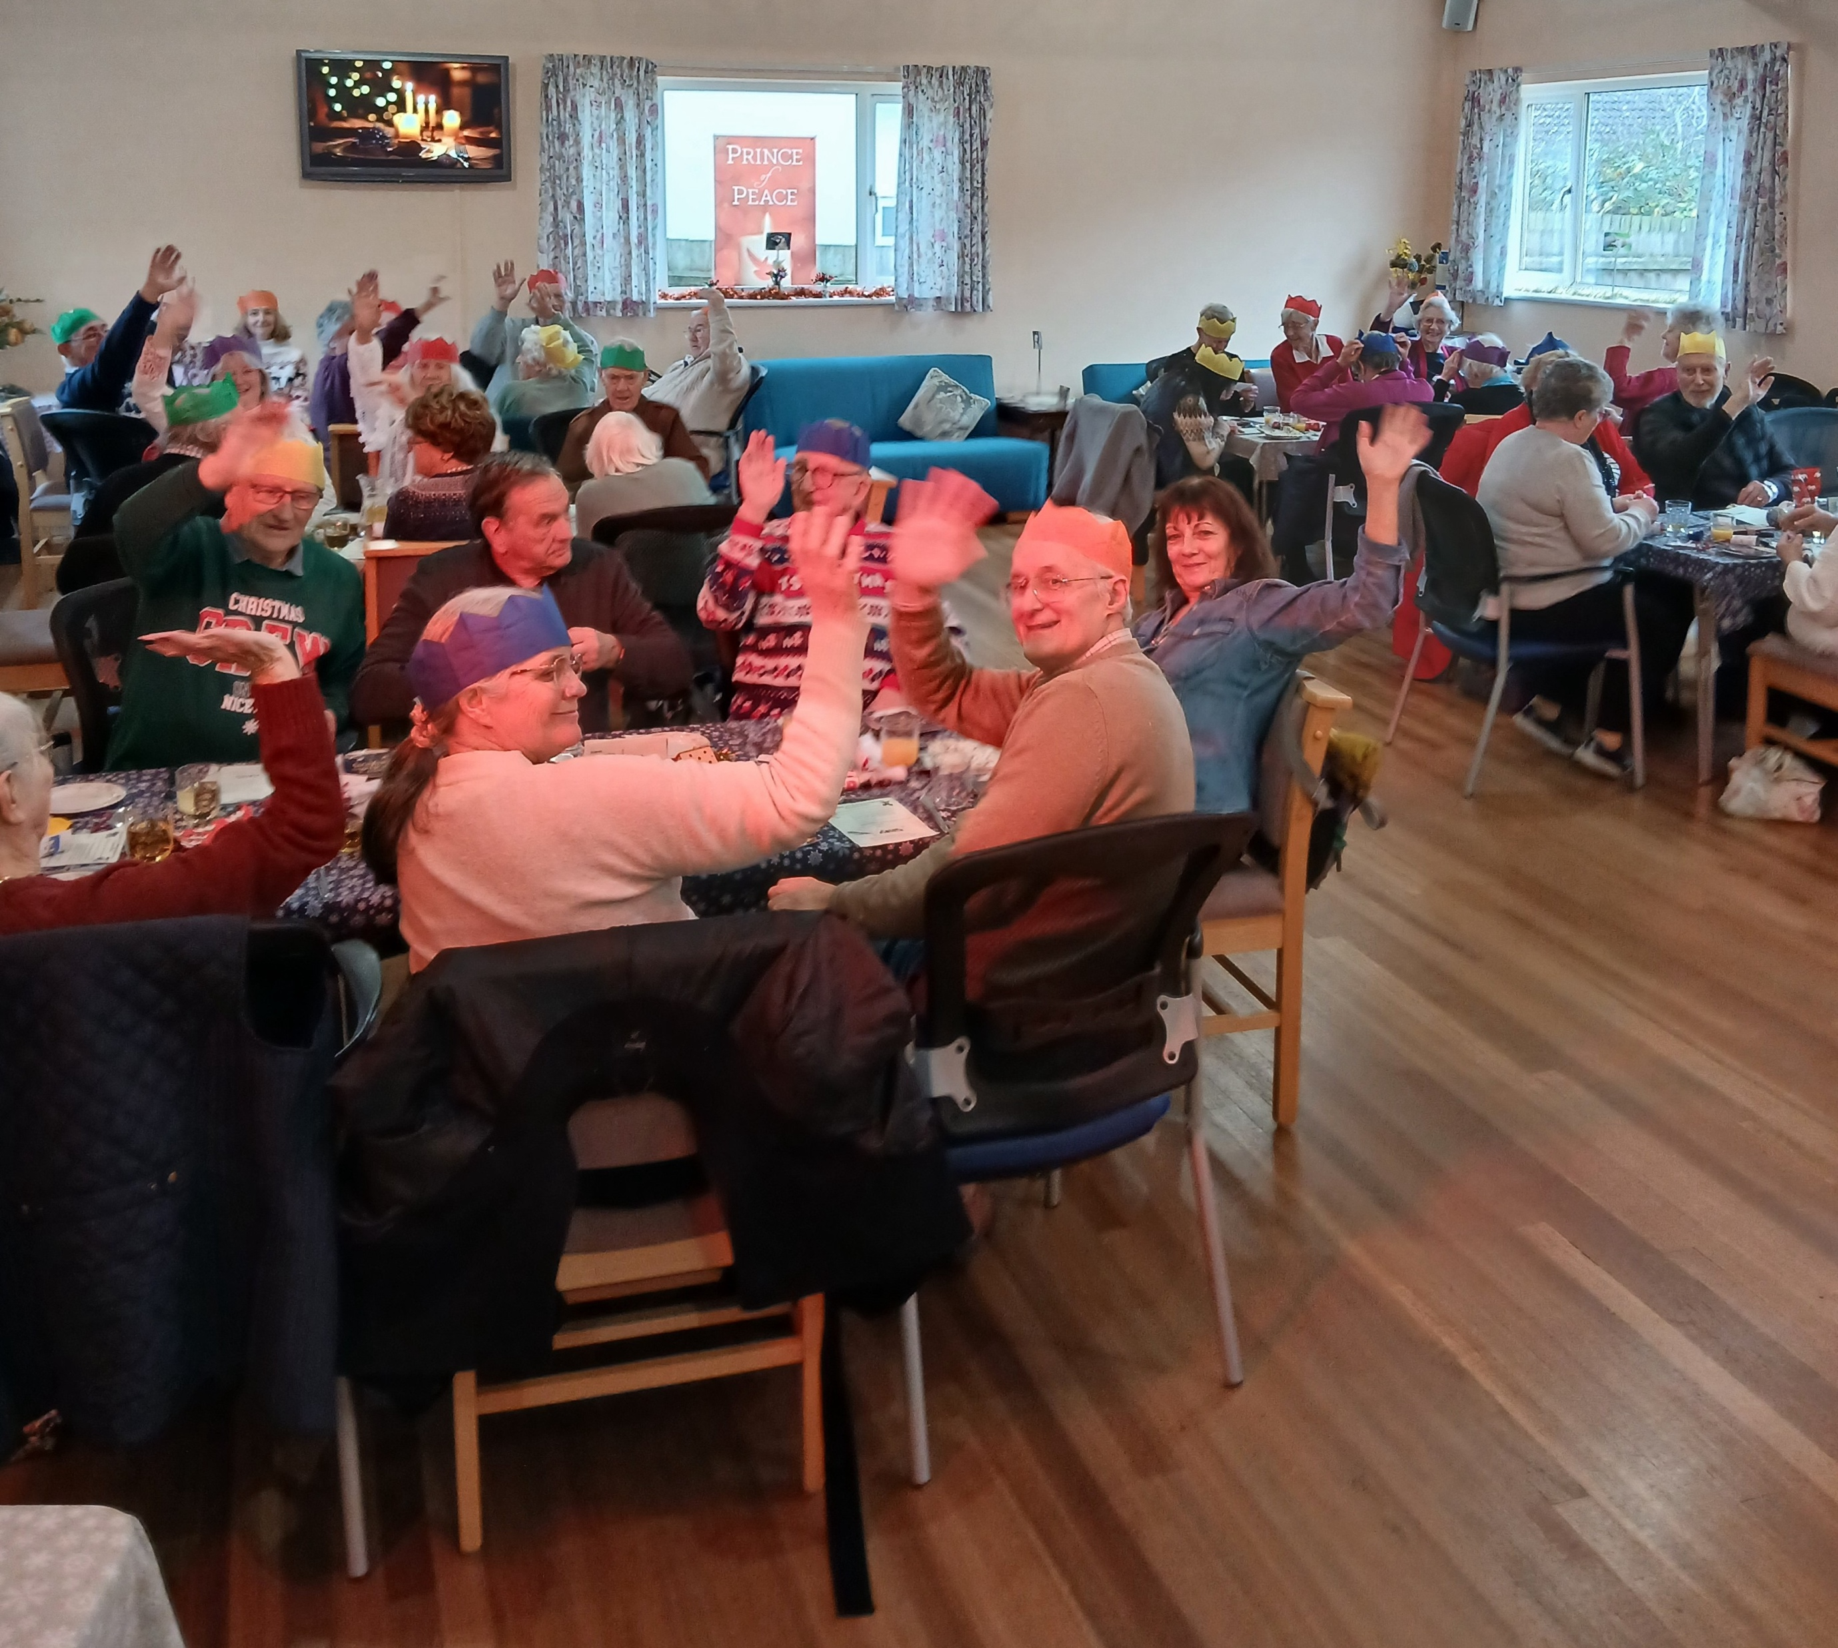
Stradbroke Baptist Church has a local friendly congregation in an expanding village in Mid-Suffolk. Due to its rural location most folk tend to work in local industries that support or relate to agriculture. Many of the elderly folk have spent a near lifetime in the village and are surrounded by three generations of family folk – most of the elderly folk recall Sunday School days at the chapel.
Bruce Francis has been the minister since April 2018 and has witnessed the congregation steadily grow from a faithful few to a regular gathering of 40+/- precious souls. The fellowship remains greatly encouraged through worship and its outreach in the village. The church hosts a monthly singalong supper and a weekly ‘prayer and share’ time that is also growing in numbers. Wellbeing Wednesdays attract up to 40 villagers who enjoy a warm space, a meal and afternoon games
Prayer Focus: Stradbroke Baptist Church

Slide 2
The fellowship continues to be excited and thankful in what the Lord has been doing over the past few months and is expectant in what He will do among them, through them, and in them, in the days ahead as they commit their way to Him and His Word.
Please pray with us in the following matters:
• Please rejoice with us in Lord’s goodness toward us
• That the Name of Jesus would be lifted up in Stradbroke and in all we do
• That He would guide us as we love and minister around the village
• That we may grow in holiness and devotion toward our Lord
• For a gifted person to help the church set up a simple website or social media page/platform for future publicity
Prayer Focus: Stradbroke Baptist Church

