Slide 1
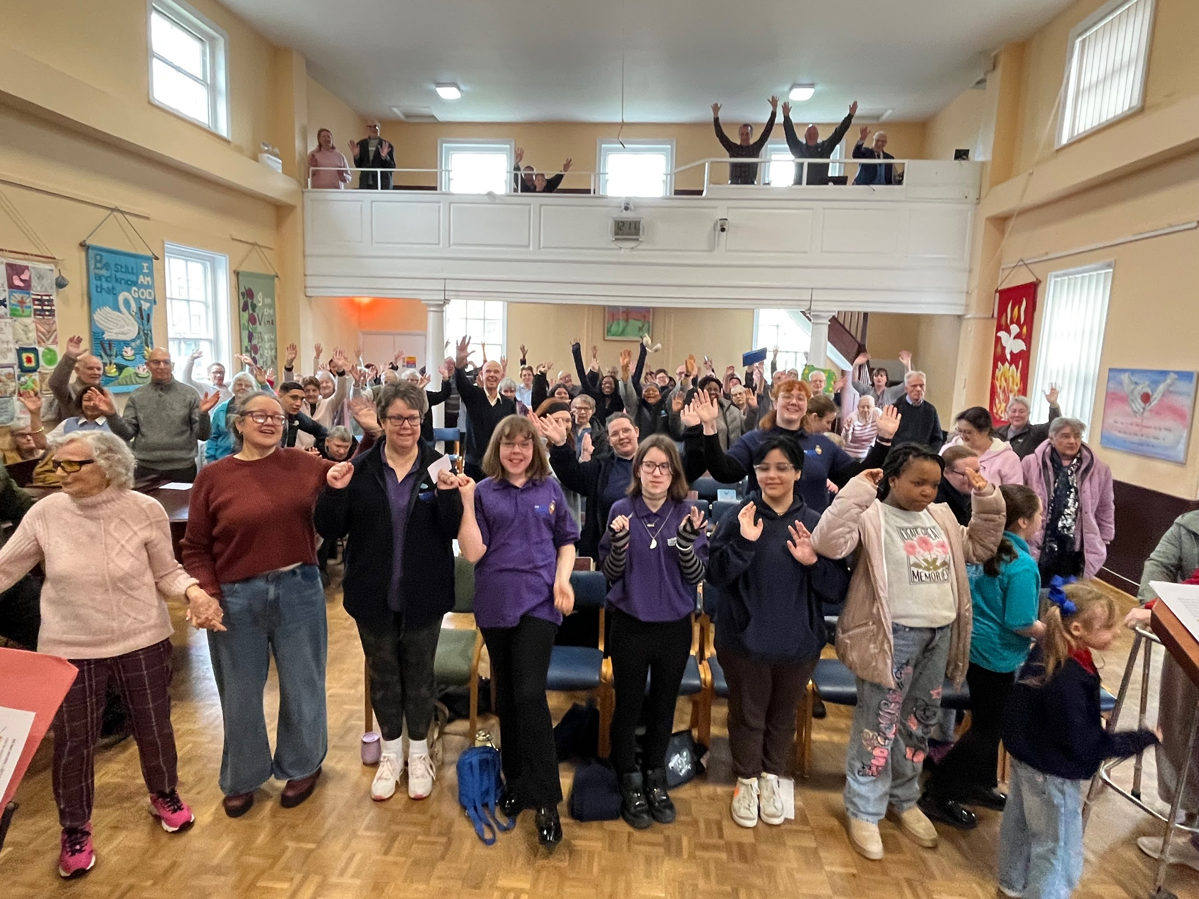
Prayer Focus: Potter Street Baptist Church
Potter Street Baptist Church has council estates all around. Alison Taylor, their minister, has a passion for the community and is leading a vision to double the congregation. Alison sees pastoring as being a constant presence to the church and community and is aided by a team of leaders and Sarah Mitchell, their Children’s, Youth and Family Worker and MIT. The church has a full programme of activities for church and community, and they are seeking to work in partnership with Mind

Slide 2
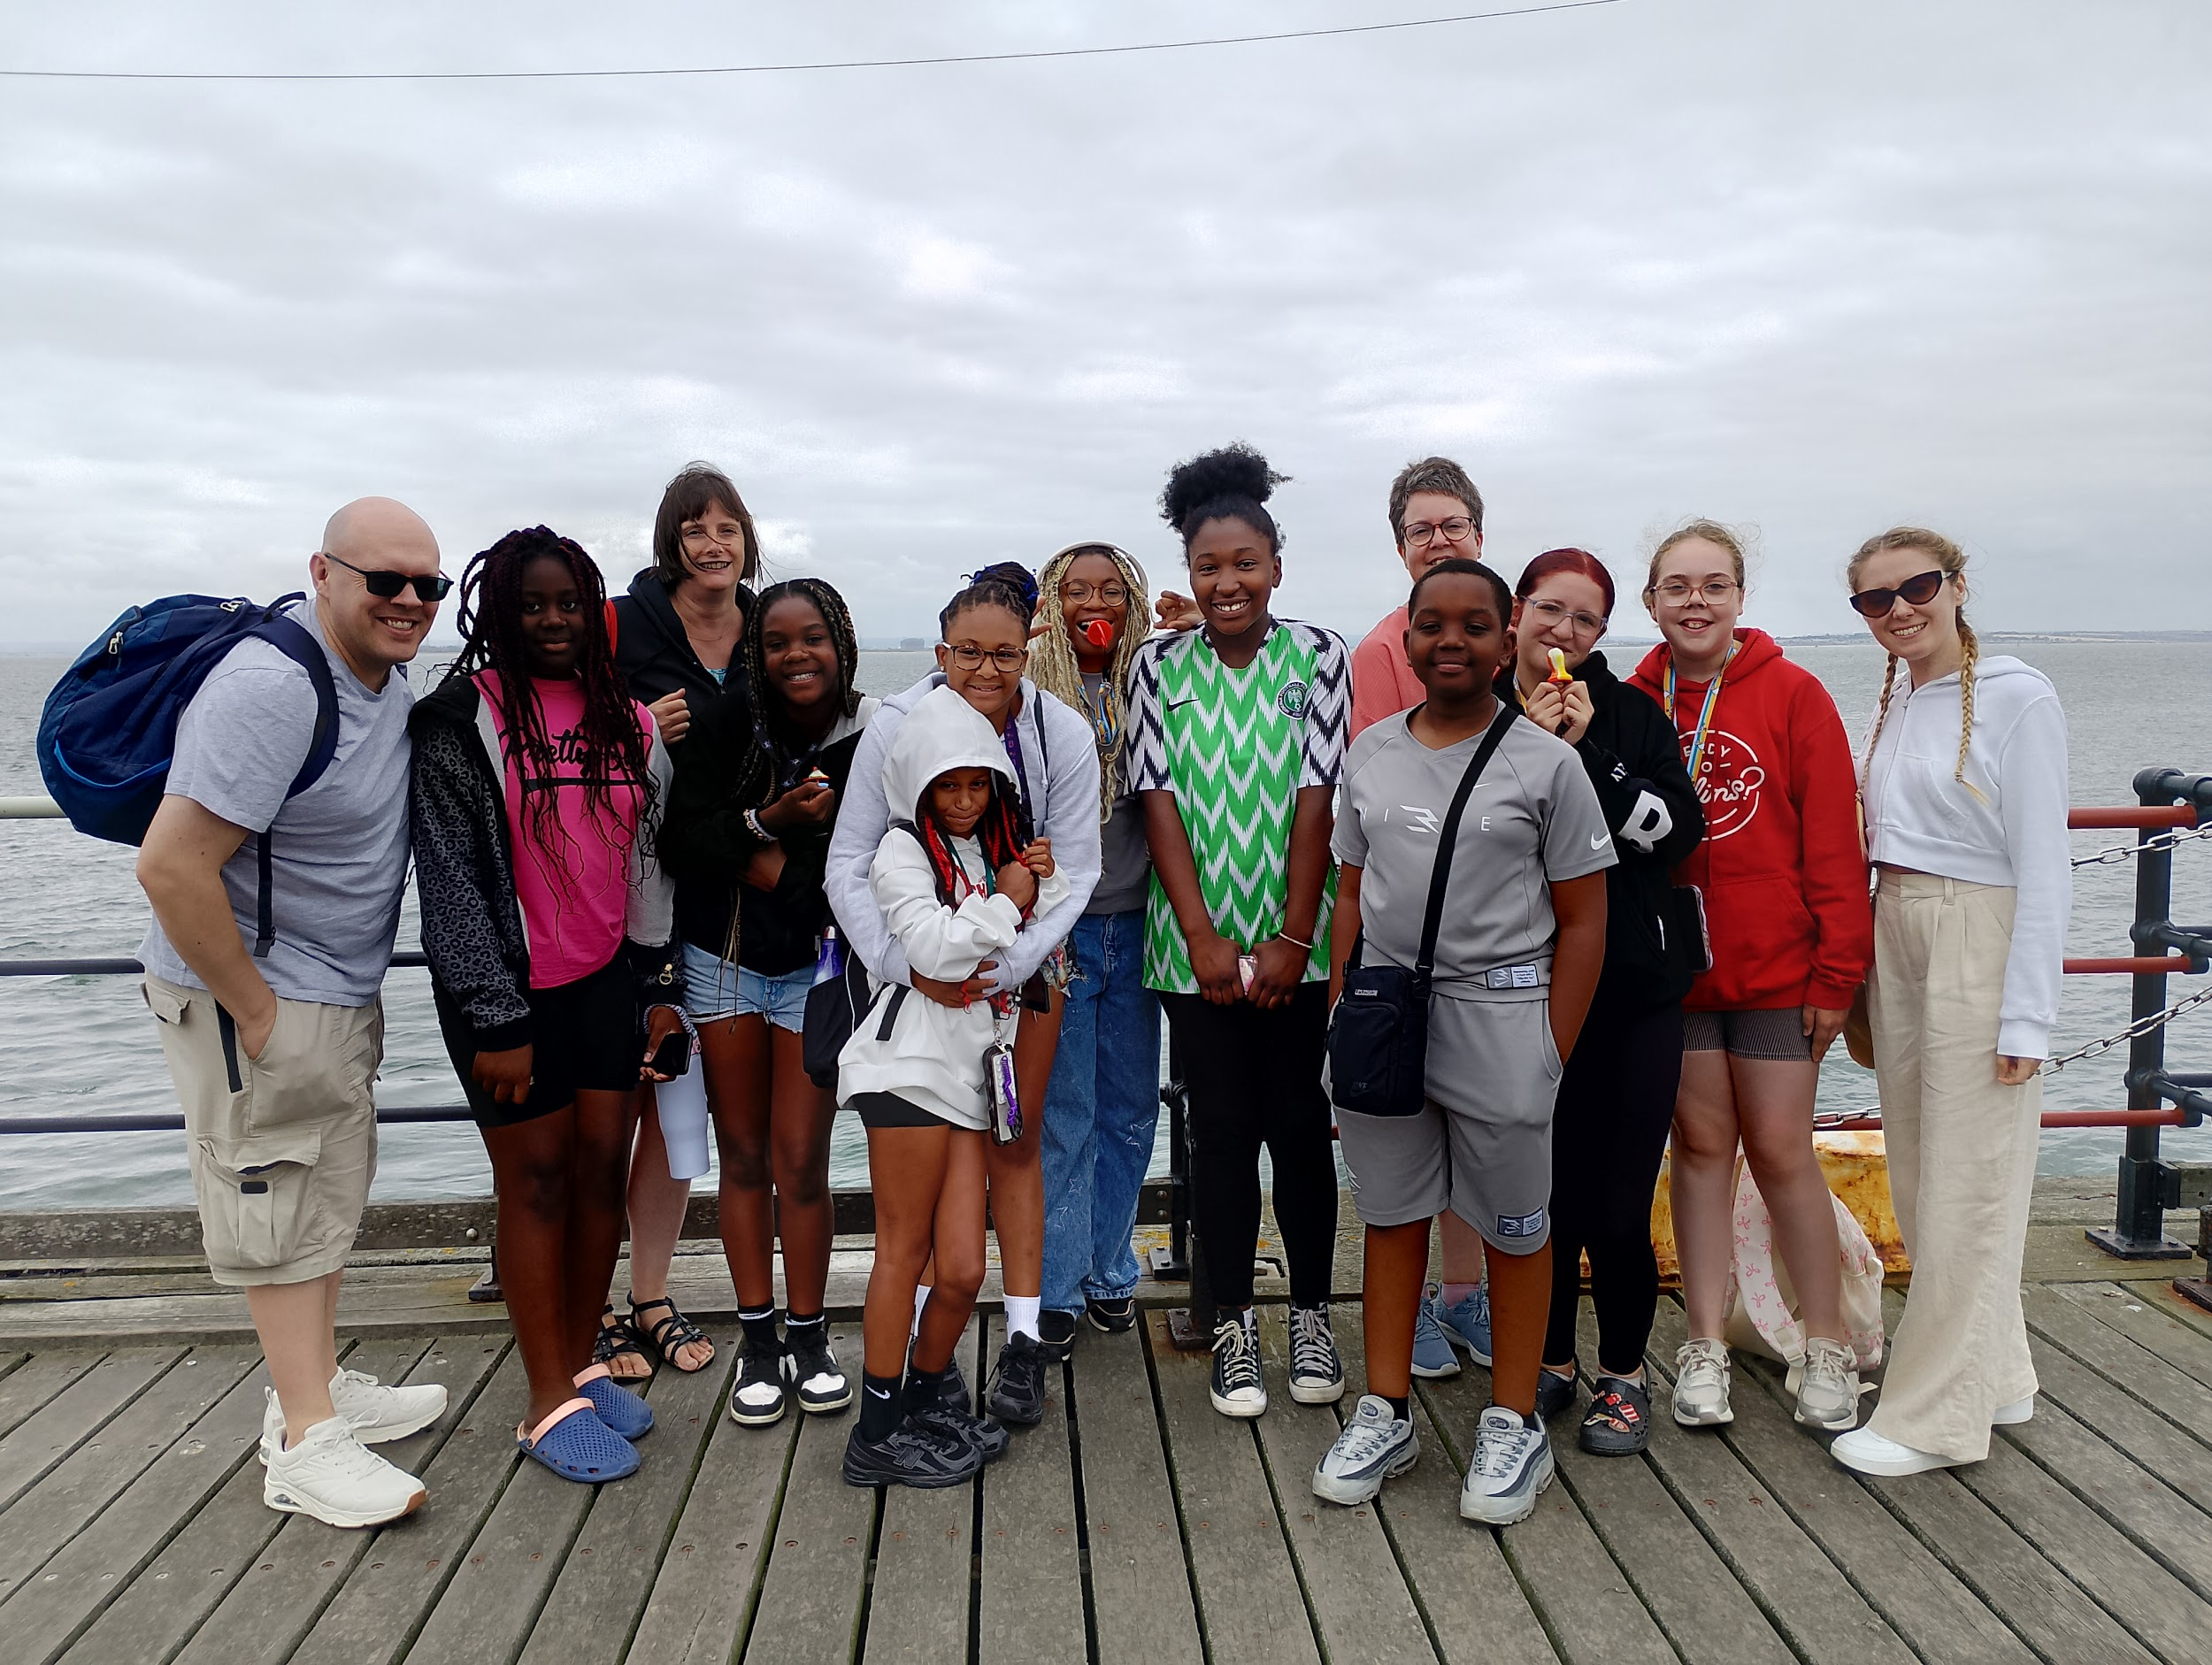
Prayer Focus: Potter Street Baptist Church
As outreach is a massive part of church life and this is a 270 anniversary year an event is being planned. A summer outreach event is also planned for the children in the summer to coincide with the Commonwealth Games. Please pray:
The community to discover a curiosity for Jesus that helps them discover all the church offers.
For the collaboration between themselves and Mind to take shape and grow.
For the young people who meet regularly to develop a faith of their own.
The church gives thanks for all the volunteers who work so hard.

