Slide 1
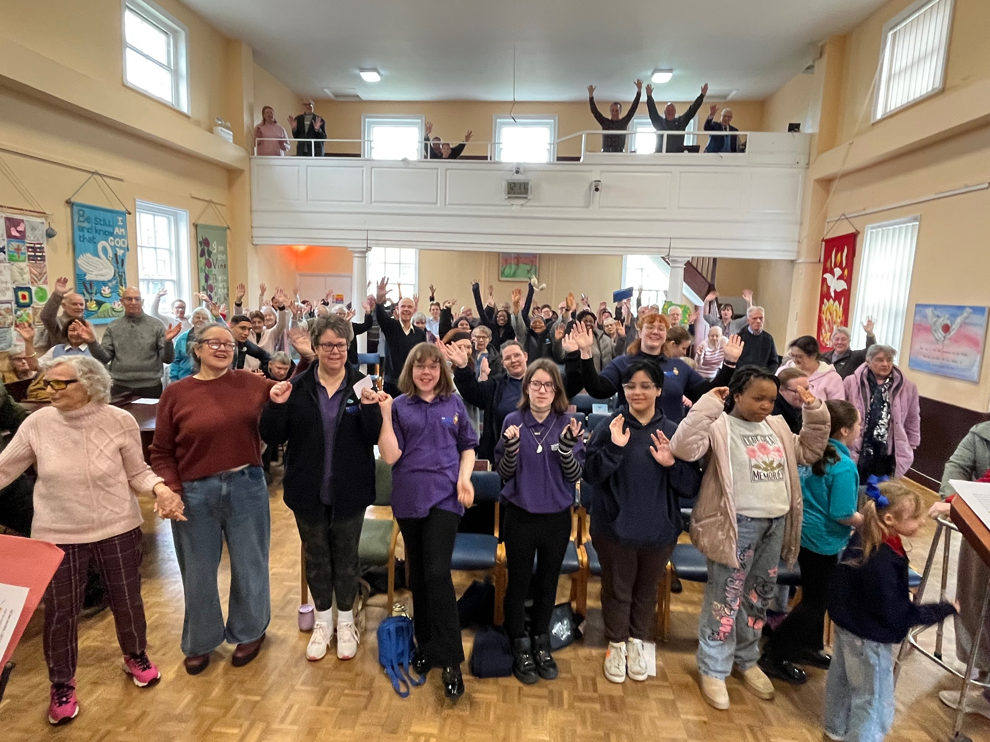
Potter Street Baptist Church has council estates all around. Alison Taylor, their minister, has a passion for the community and is leading a vision to double the congregation over the next 10 years. Alison very much sees pastoring as being a constant presence to the church and community and is aided by a team of leaders and also by Sarah Mitchell who is their Children’s, Youth and Family Worker and MIT.
As part of their vision they have a full programme of activities for both church and community and have a very good relationship with the local community. Mind have just opened opposite the church, and they are seeking to work in partnership to create a space between the two and serve the community together.
Prayer Focus: Potter Street Baptist Church, Harlow Essex

Slide 2
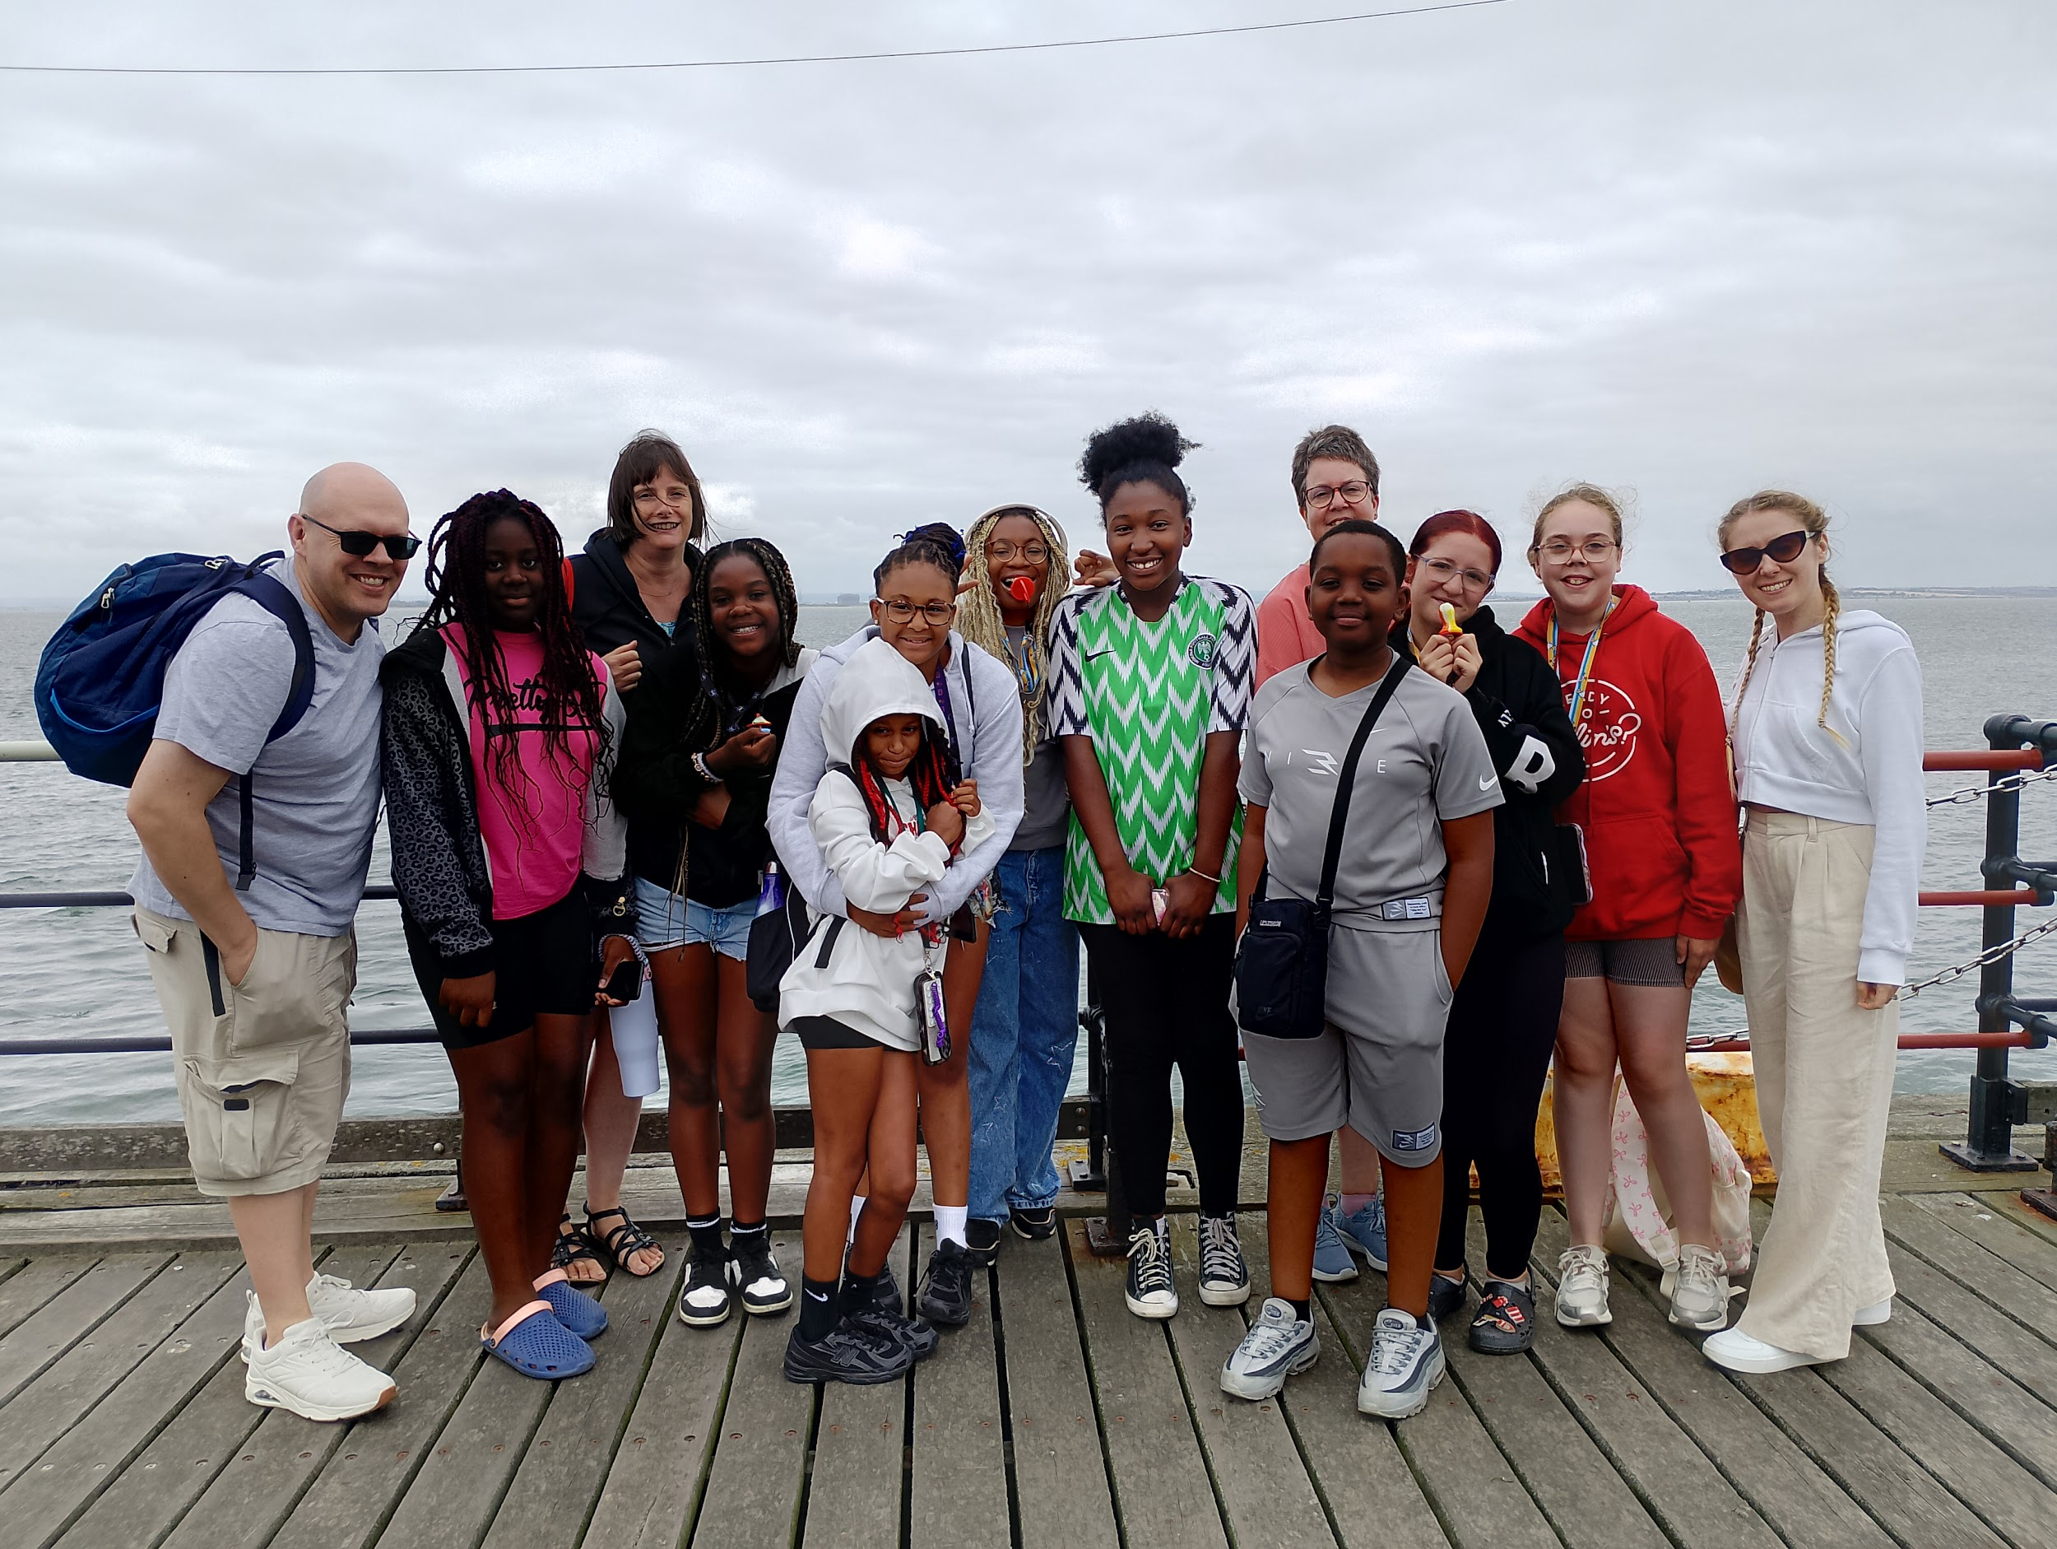
As outreach is a massive part of church life and this is a 270 anniversary year for the church an event is being planned. A summer outreach event is also planned for the children in the summer to coincide with the Commonwealth Games. Please pray:
The community to discover a curiosity for Jesus that helps them discover all the church offers.
For the collaboration between themselves and Mind to take shape and grow.
For the young people who meet regularly to develop a faith of their own.
The church gives thanks for all the volunteers who work so hard to keep all the diverse groups thriving.
Prayer Focus: Potter Street Baptist Church

