Slide 1
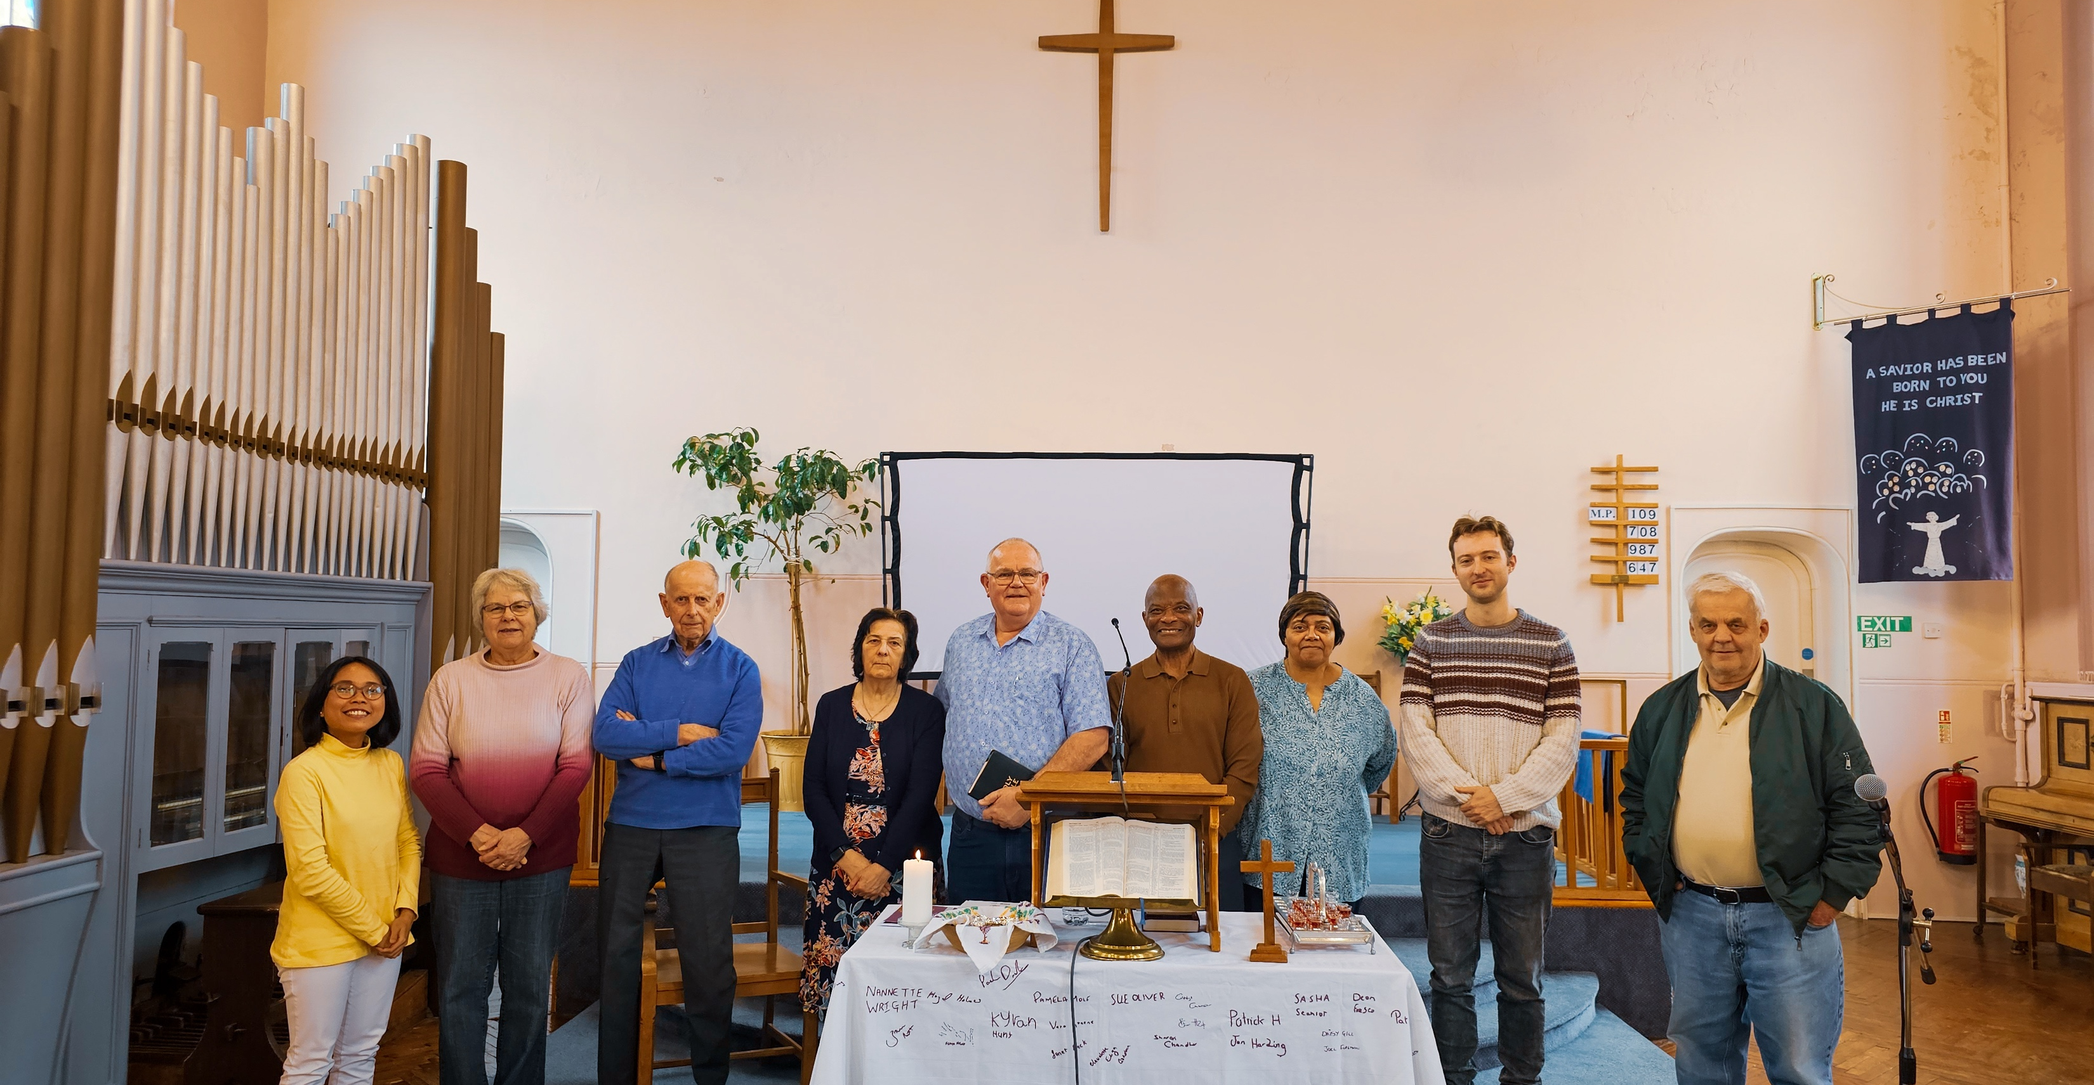
Prayer Focus: Mill Road Baptist Church, Cambridge
Mill Road Baptist Church is in a busy and diverse, continually changing multicultural community. Students and young families often come and go, brining challenges and opportunities for the church, which is a faithful presence in the area.
The church is currently in a pastoral vacancy and is led by its Deacons, who are thankful for regular visiting speakers. They have a Sunday morning service and Bible study, with the church also used by other organisations. The mostly elderly congregation is faithful and prayerful. The church is grateful for God’s provision in guiding them through recent financial difficulties.

Slide 2
Prayer Focus: Mill Road Baptist Church
Please pray for:
* God’s guidance as they convert their manse into two flats: for a Minister and rental.
* The health and encouragement of the elderly congregation as they seek to know and experience more of God.
* To be able to call a Minister and to reach out more effectively into the community.
Finally, we thank God for the faithful witness of the church over many years and ask for prayer as they look to the future.

