Slide 1
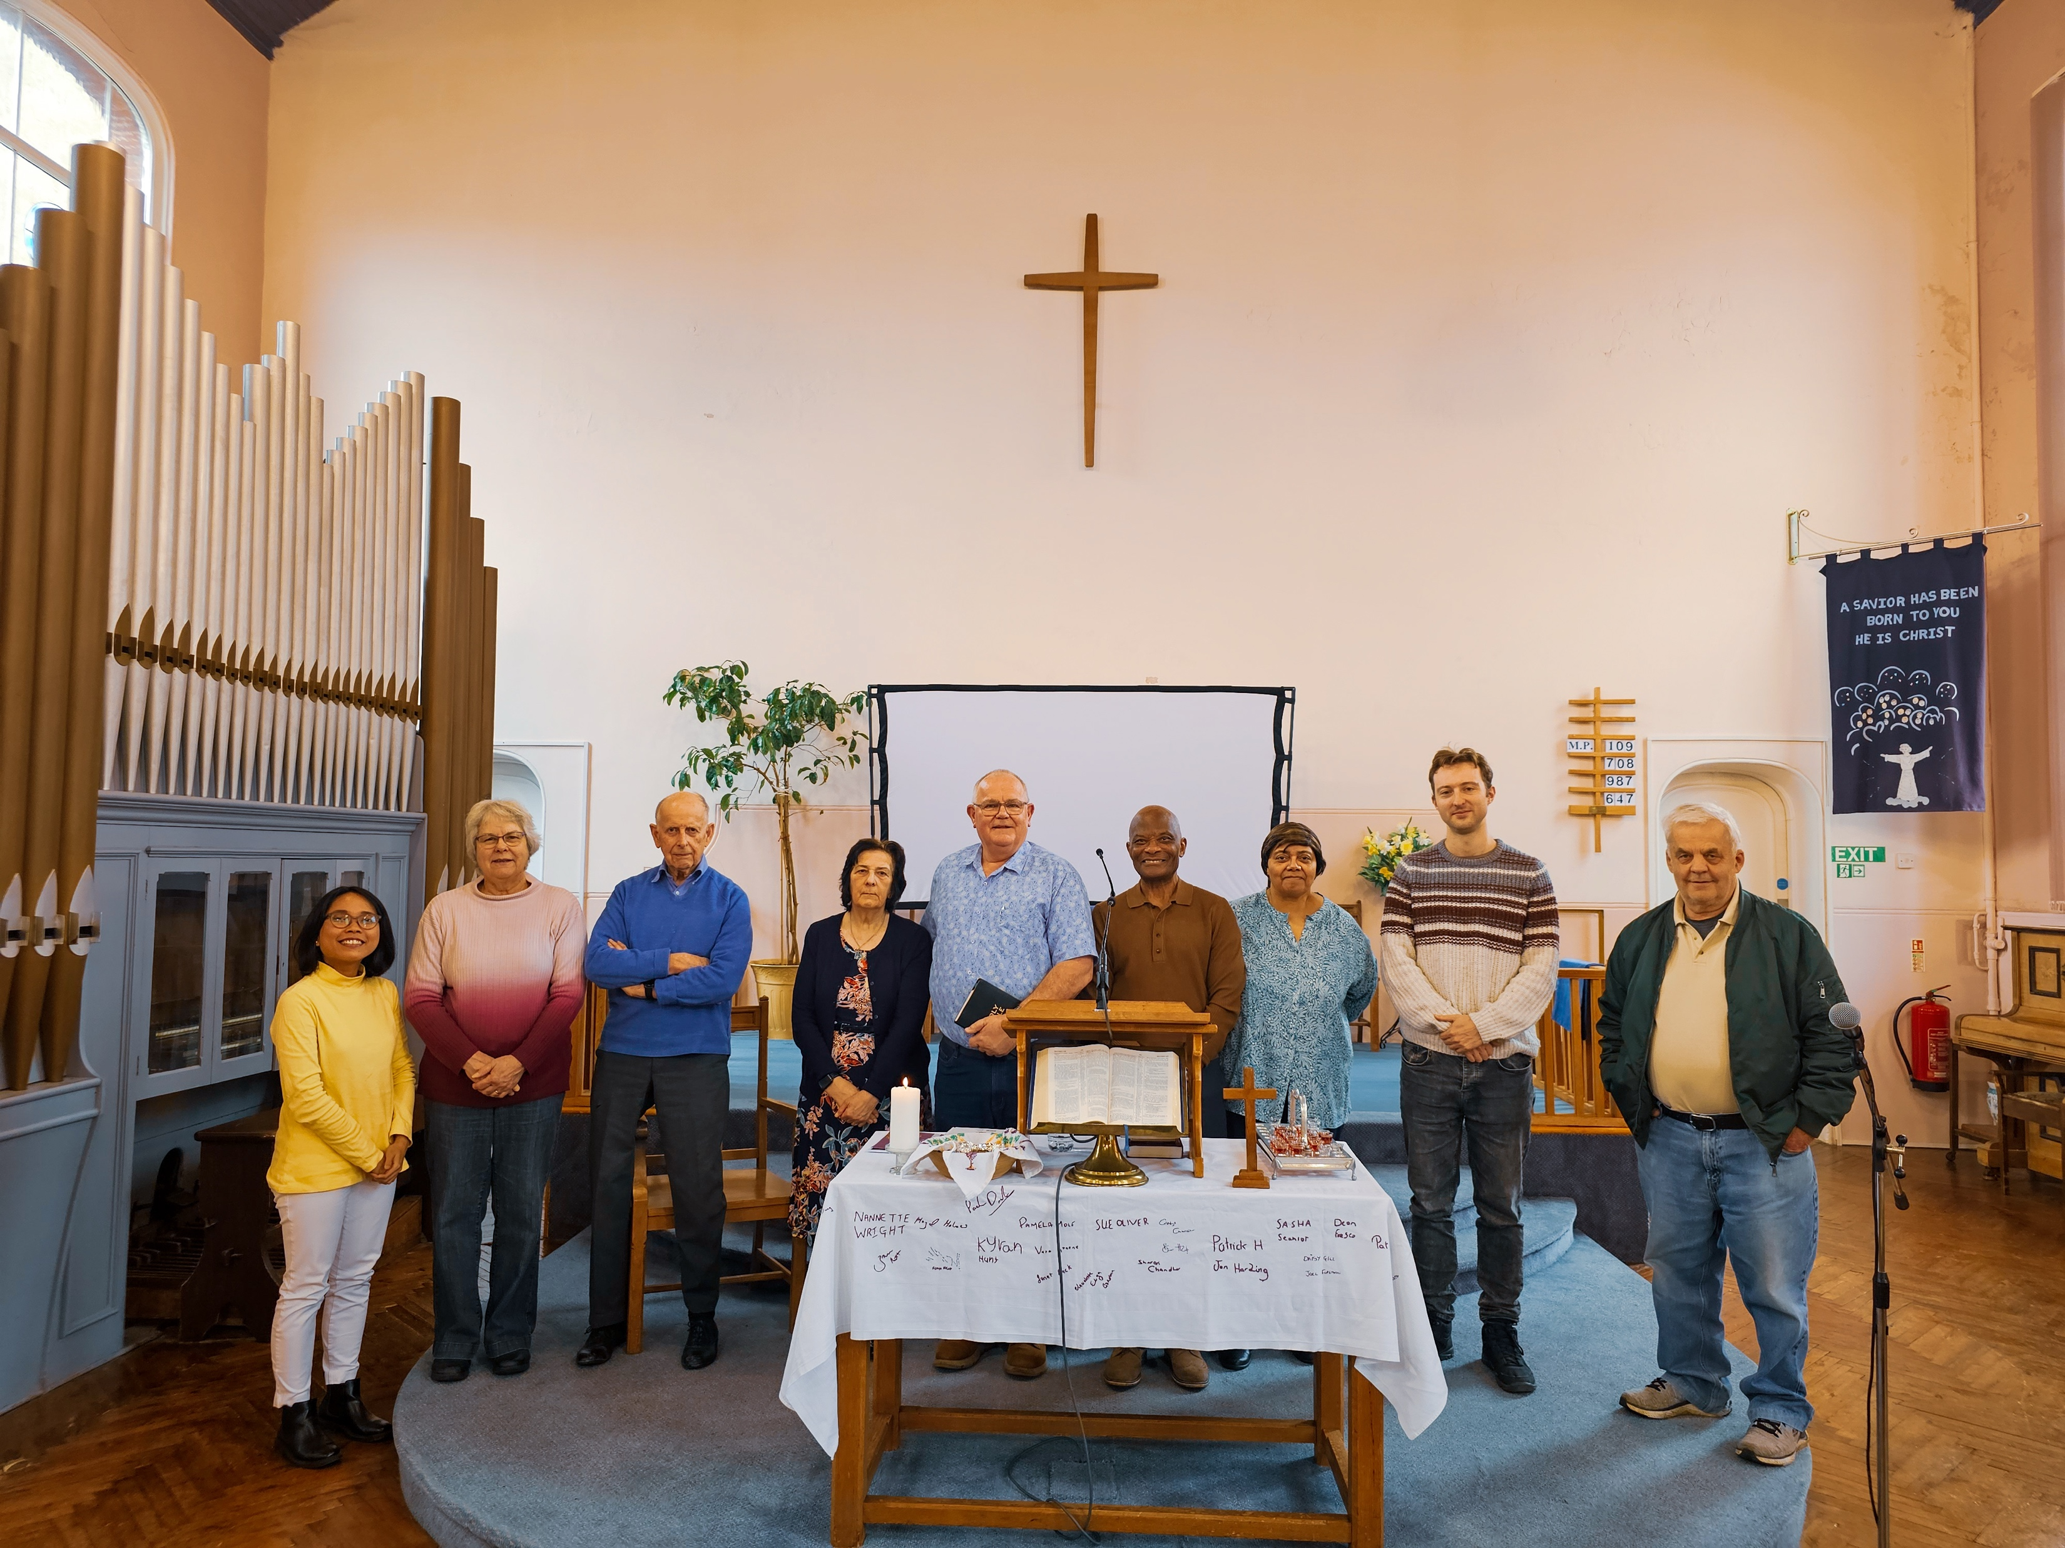
Mill Road Baptist Church is located in a busy and diverse area, where there is continual change within the multicultural community. Students and young families often come and go, which brings both challenges and opportunities for the church, which has been a faithful presence in the area for many years. The church is currently in a pastoral vacancy and is led by its Deacons, Brother Andrew Adekunle and Taiwo Oladokun. They are thankful for the teaching and ministry of regular visiting speakers and ministers. They have a Sunday morning service and Bible study once a fortnight, with the church also used by other organisations. The mostly elderly congregation is faithful and prayerful. The church is grateful to God for His provision in guiding them through financial difficulties in recent years. They are now considering how to afford to call a Minister.
Prayer Focus: Mill Road Baptist Church, Cambridge

Slide 2
Please pray for: * God’s clear guidance and wisdom as they take steps to convert their manse into two flats, one for a Minister and one to rent out to help provide income towards supporting a Minister. * The health and encouragement of the elderly congregation as they seek to know and experience more of God. * The church to be able to call a Minister and to reach out more effectively into the community. Finally, we thank God for the faithful witness of the church over many years and ask for prayer as they look to the future.
Prayer Focus: Mill Road Baptist Church

