Slide 1
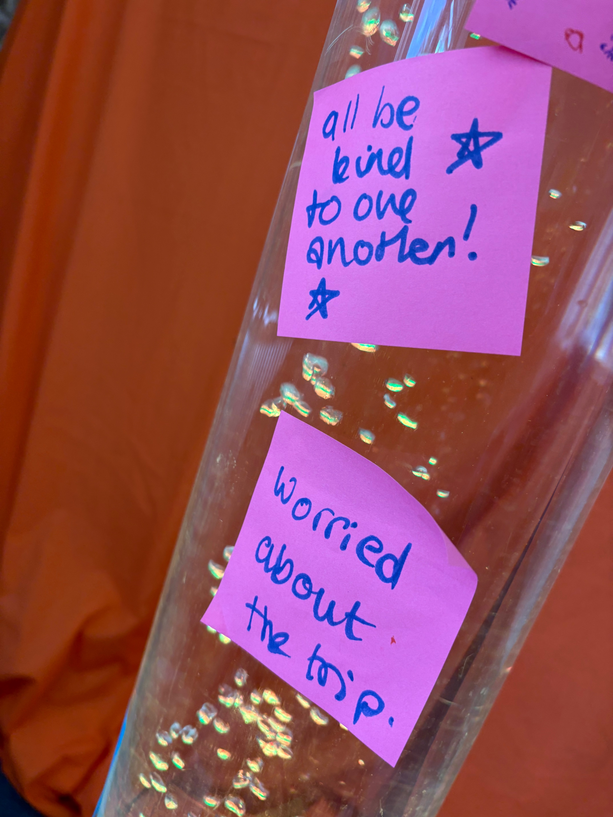
P
Prayer Focus: Chaplaincy in Education
Within EBA a number of our ministers and churches are actively involved in chaplaincy. We spoke with Cherie from Cambridgeshire and Liz from Suffolk. Cherie provides Pastoral Support Work, mentoring and pastoral support to students individually and in groups. Her Spiritual Support Work includes Christian Union groups, lessons and assemblies. She also support staffs. Liz focuses on being "present and available" to whoever needs a hand or kind word. Schools can be very busy and pressured environments for staff and students.

Slide 2
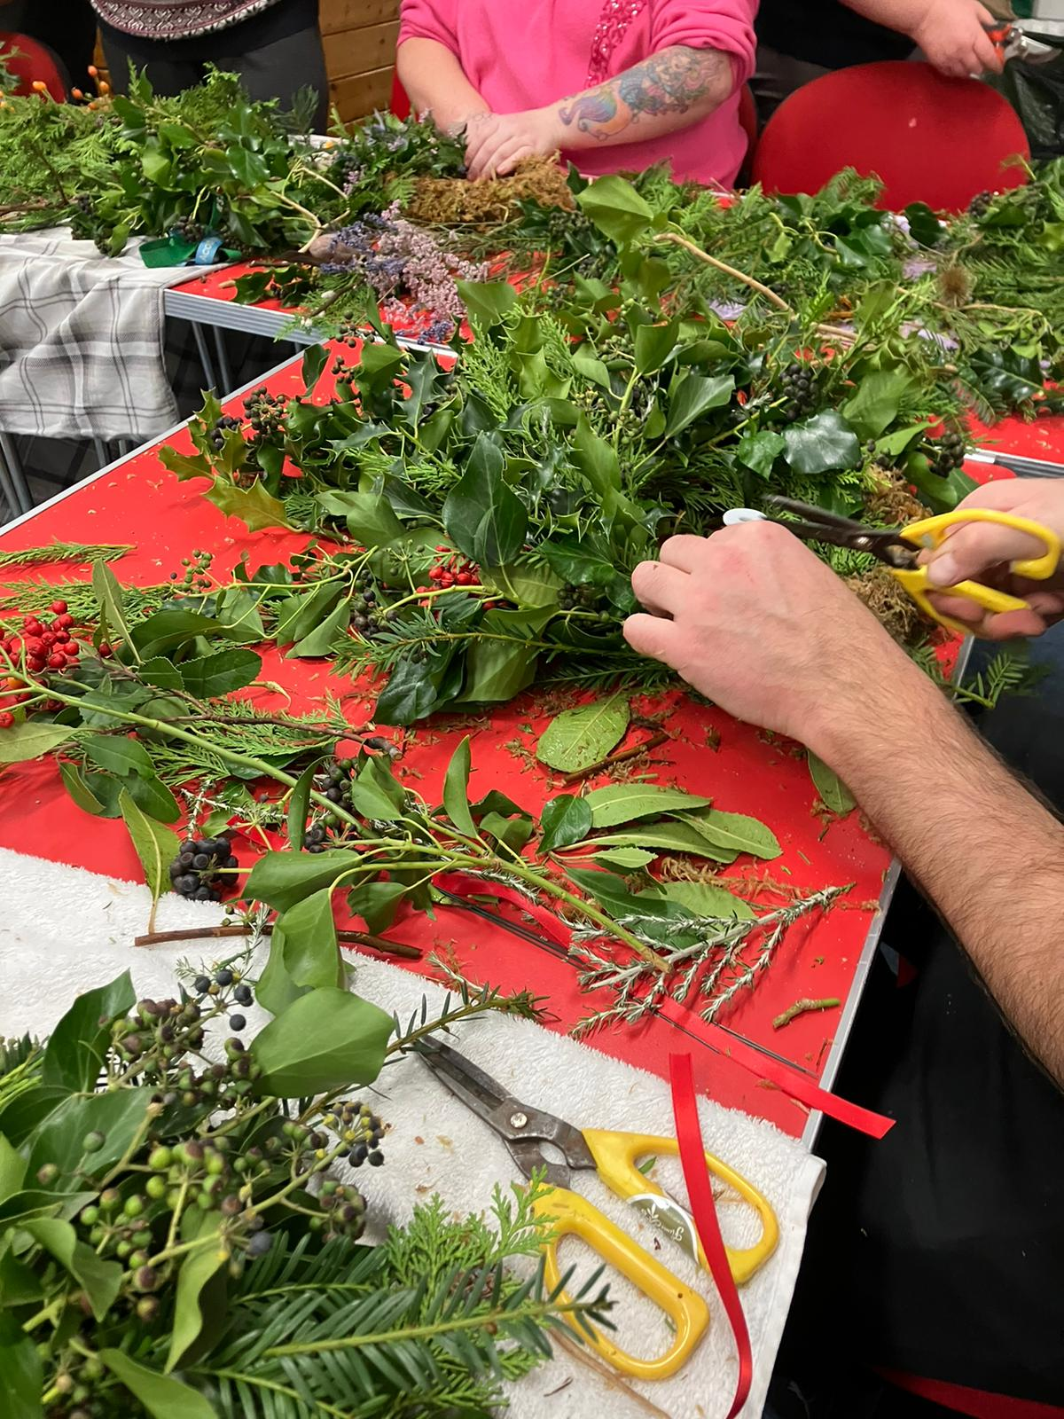
We can be a calm, silently praying presence when a student is overwhelmed, helping them process anxiety, stress, friendship issues, family breakdown or bereavement. We run assemblies, after-school clubs and prayer-spaces - relying on churches for volunteers. We make tea, laugh in staff rooms and corridors, return lost PE kits, go on school trips, support a class who've lost one of their own to cancer and meet with those who say "I think I heard God speak to me" and "I want to become a Christian” • Please pray for God’s blessing on both Cherie and Liz and others serving in this way • For all the staff, students, and student support teams in local schools • For those curious about God – for good, healthy places to learn more about Jesus.
P
Prayer Focus: Chaplaincy in Education

