Slide 1
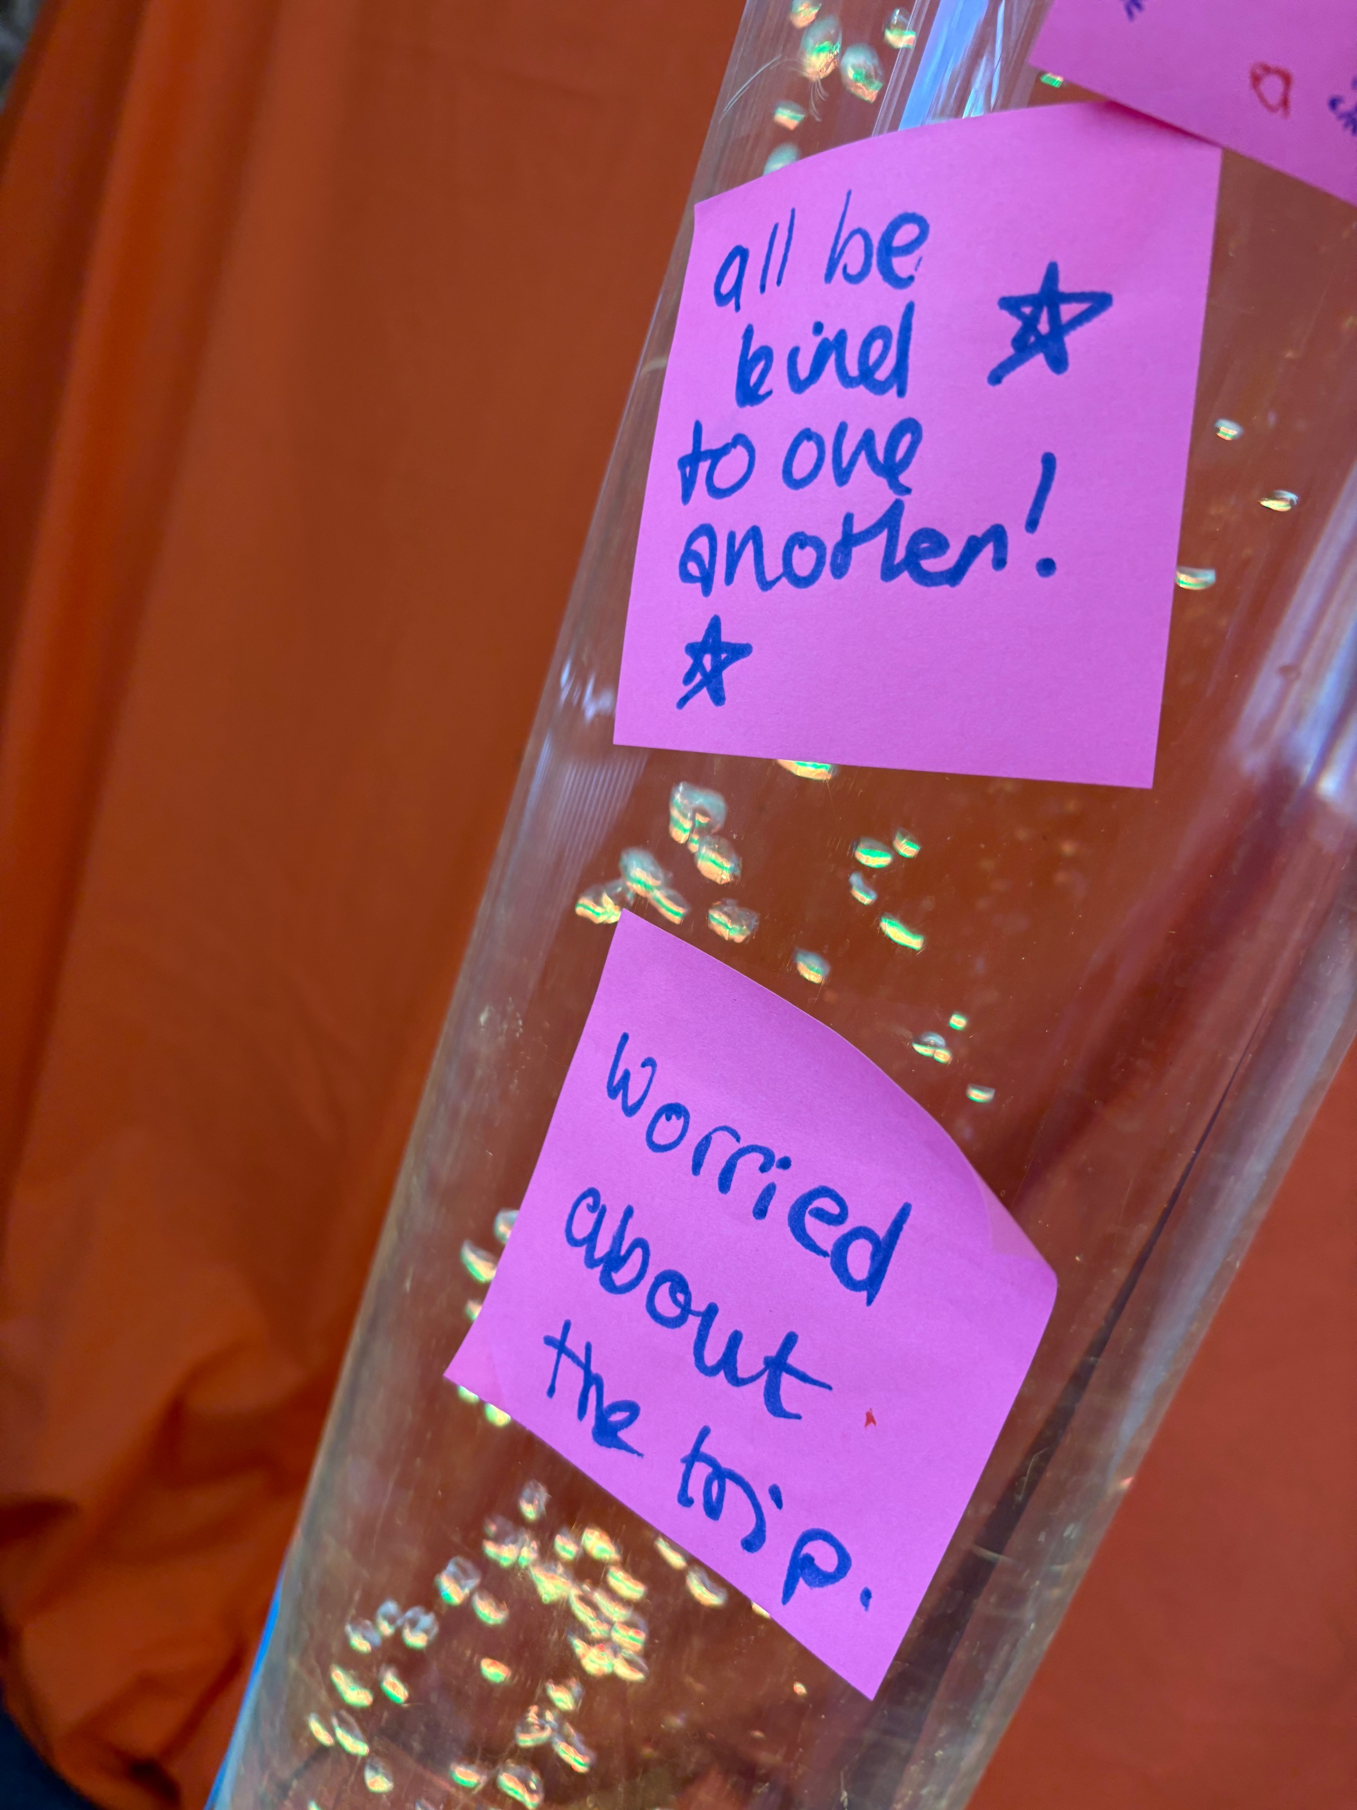
Within EBA a number of our ministers and churches are actively involved in chaplaincy. We spoke with Cherie from Cambridgeshire and Liz from Suffolk. Cherie says Pastoral Support Work provides mentoring and pastoral support to students individually and in groups looking at resilience, self-esteem and relationships. The Spiritual Support Work includes Christian Union groups, lessons and assemblies. We also support staff, providing space for conversations, to reflect, as well as 1-2-1 support. Liz focuses her time on being "present and available" to whoever needs a helping hand or a kind word. Schools can be very busy and pressured environments, so noticing that a staff member has a lot going on, seeing them and giving them space is appreciated We can be a calm, silently praying presence when a student is overwhelmed.
Prayer Focus: Chaplaincy in Education

Slide 2
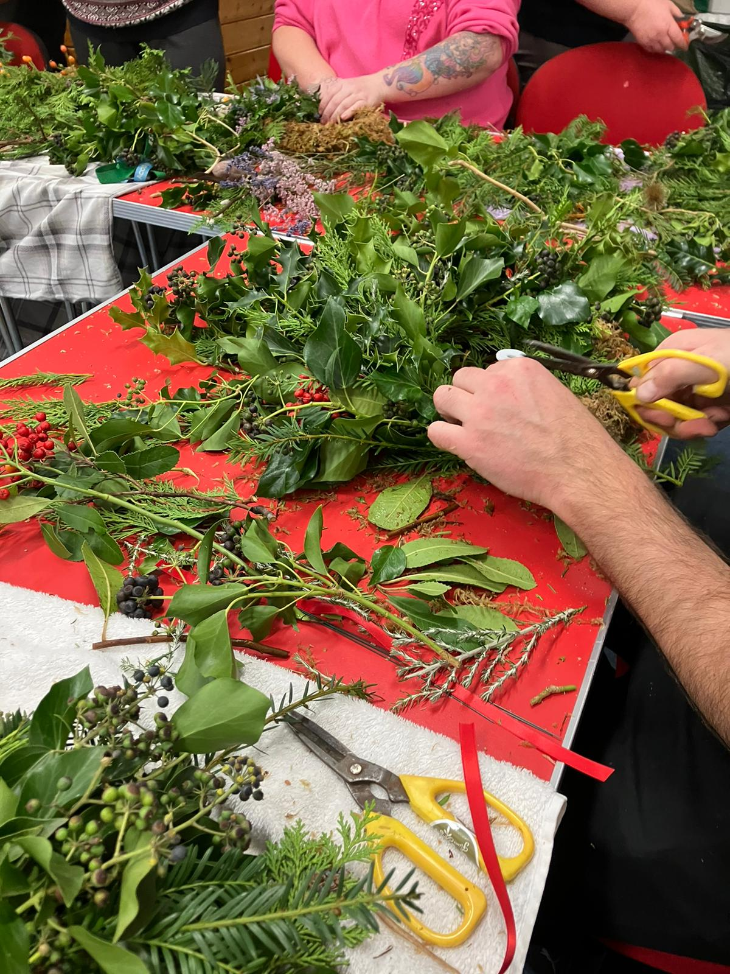
We meet with individual students to help them process anxiety, stress, friendship issues, family breakdown or bereavement. We run assemblies, after-school clubs and an annual interactive prayer-space - relying on support of many churches for volunteers. We make tea, laugh in staff rooms and corridors, return lost PE kits, are an "extra body" on school trips, support a class who've lost one of their own to cancer and meet with those who say "I think I heard God speak to me" and "I want to become a Christian” • Please pray for God’s blessing on both Cherie and Liz and others serving in this way • Please pray for all the staff, students, and student support teams in local schools • Please pray for the young people who are curious about faith and God - that they would find good, healthy places to learn more about Jesus.
Prayer Focus: Chaplaincy in Education

