Slide 1
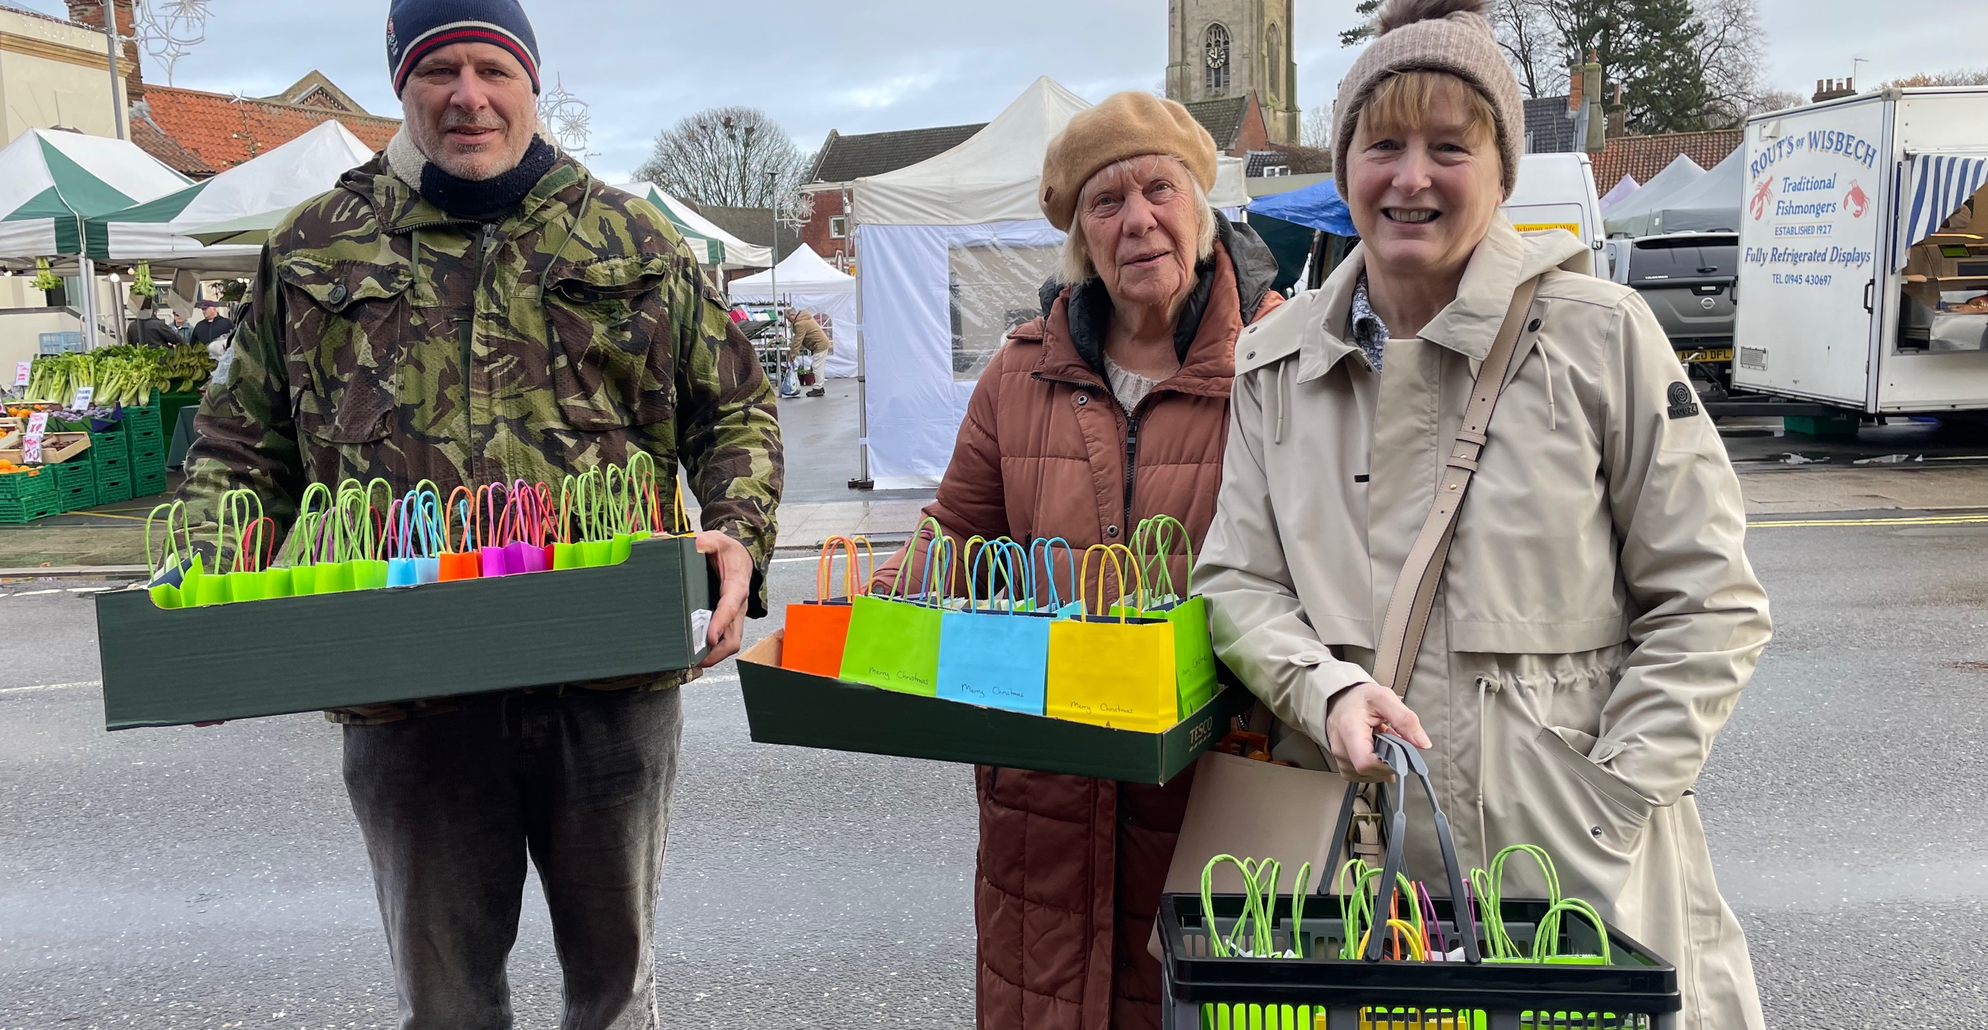
P
Prayer Focus: Swaffham Baptist Church, West Norfolk
Swaffham is a growing market town. In the heart of the town is the Baptist Church, with a fellowship of around 30. The leadership team consists of Barry, Tim, Chris and Barb (Deacons), Jo (Secretary) and Simon (Moderator). The church is currently going through a period of increasing stability, with new members of the congregation brining new skills and gifts.

Slide 2
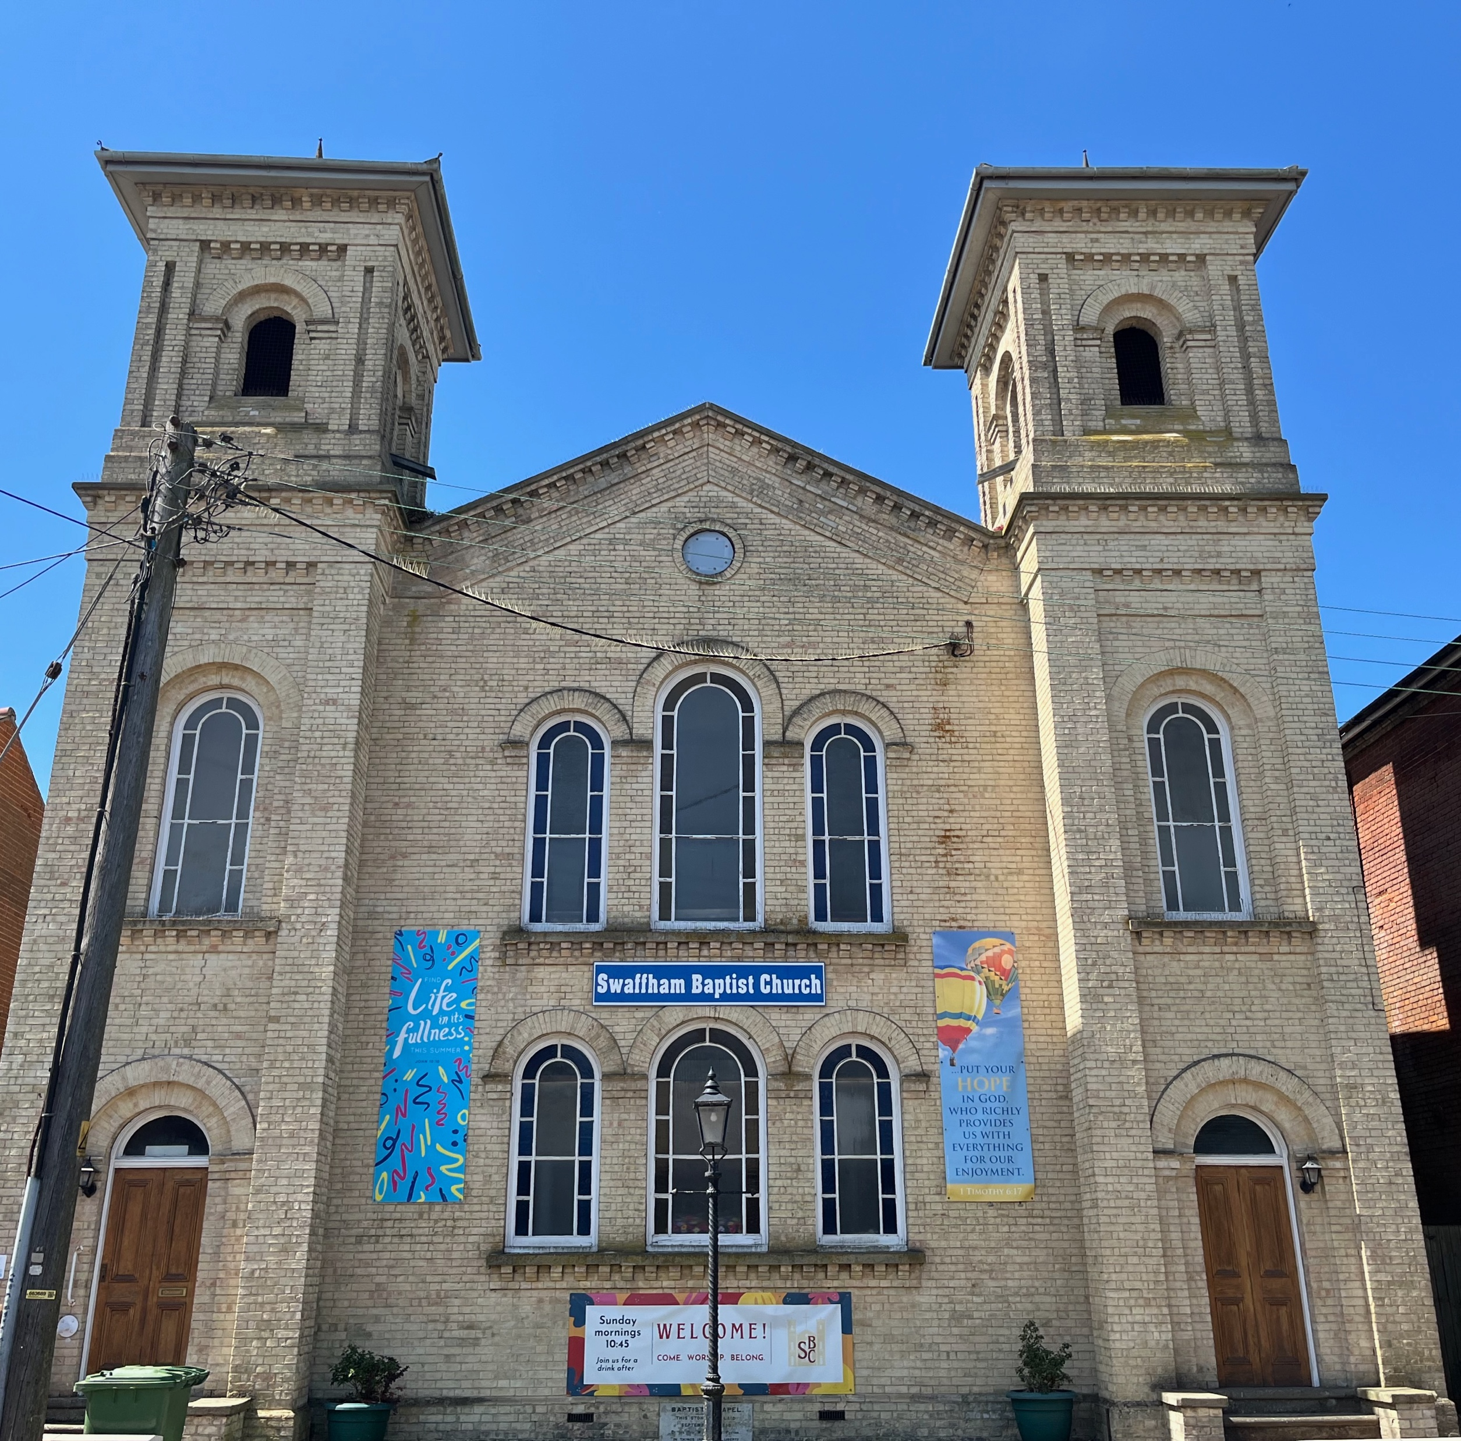
The church runs a Craft Group for outreach into the community, and a Prayer and Soup Meeting. In addition to their traditional Sunday services they have a monthly Café service. A Bible study group meets bi-weekly. Please pray for: • Continued stability and growth as new members of the church settle into the fellowship and share their gifts. • A number of the church family who are currently facing challenges. • Continued positive response to outreach events as the fellowship seek to the bless their local community, particularly the weekly market traders.
P
Prayer Focus: Swaffham Baptist Church

