Slide 1
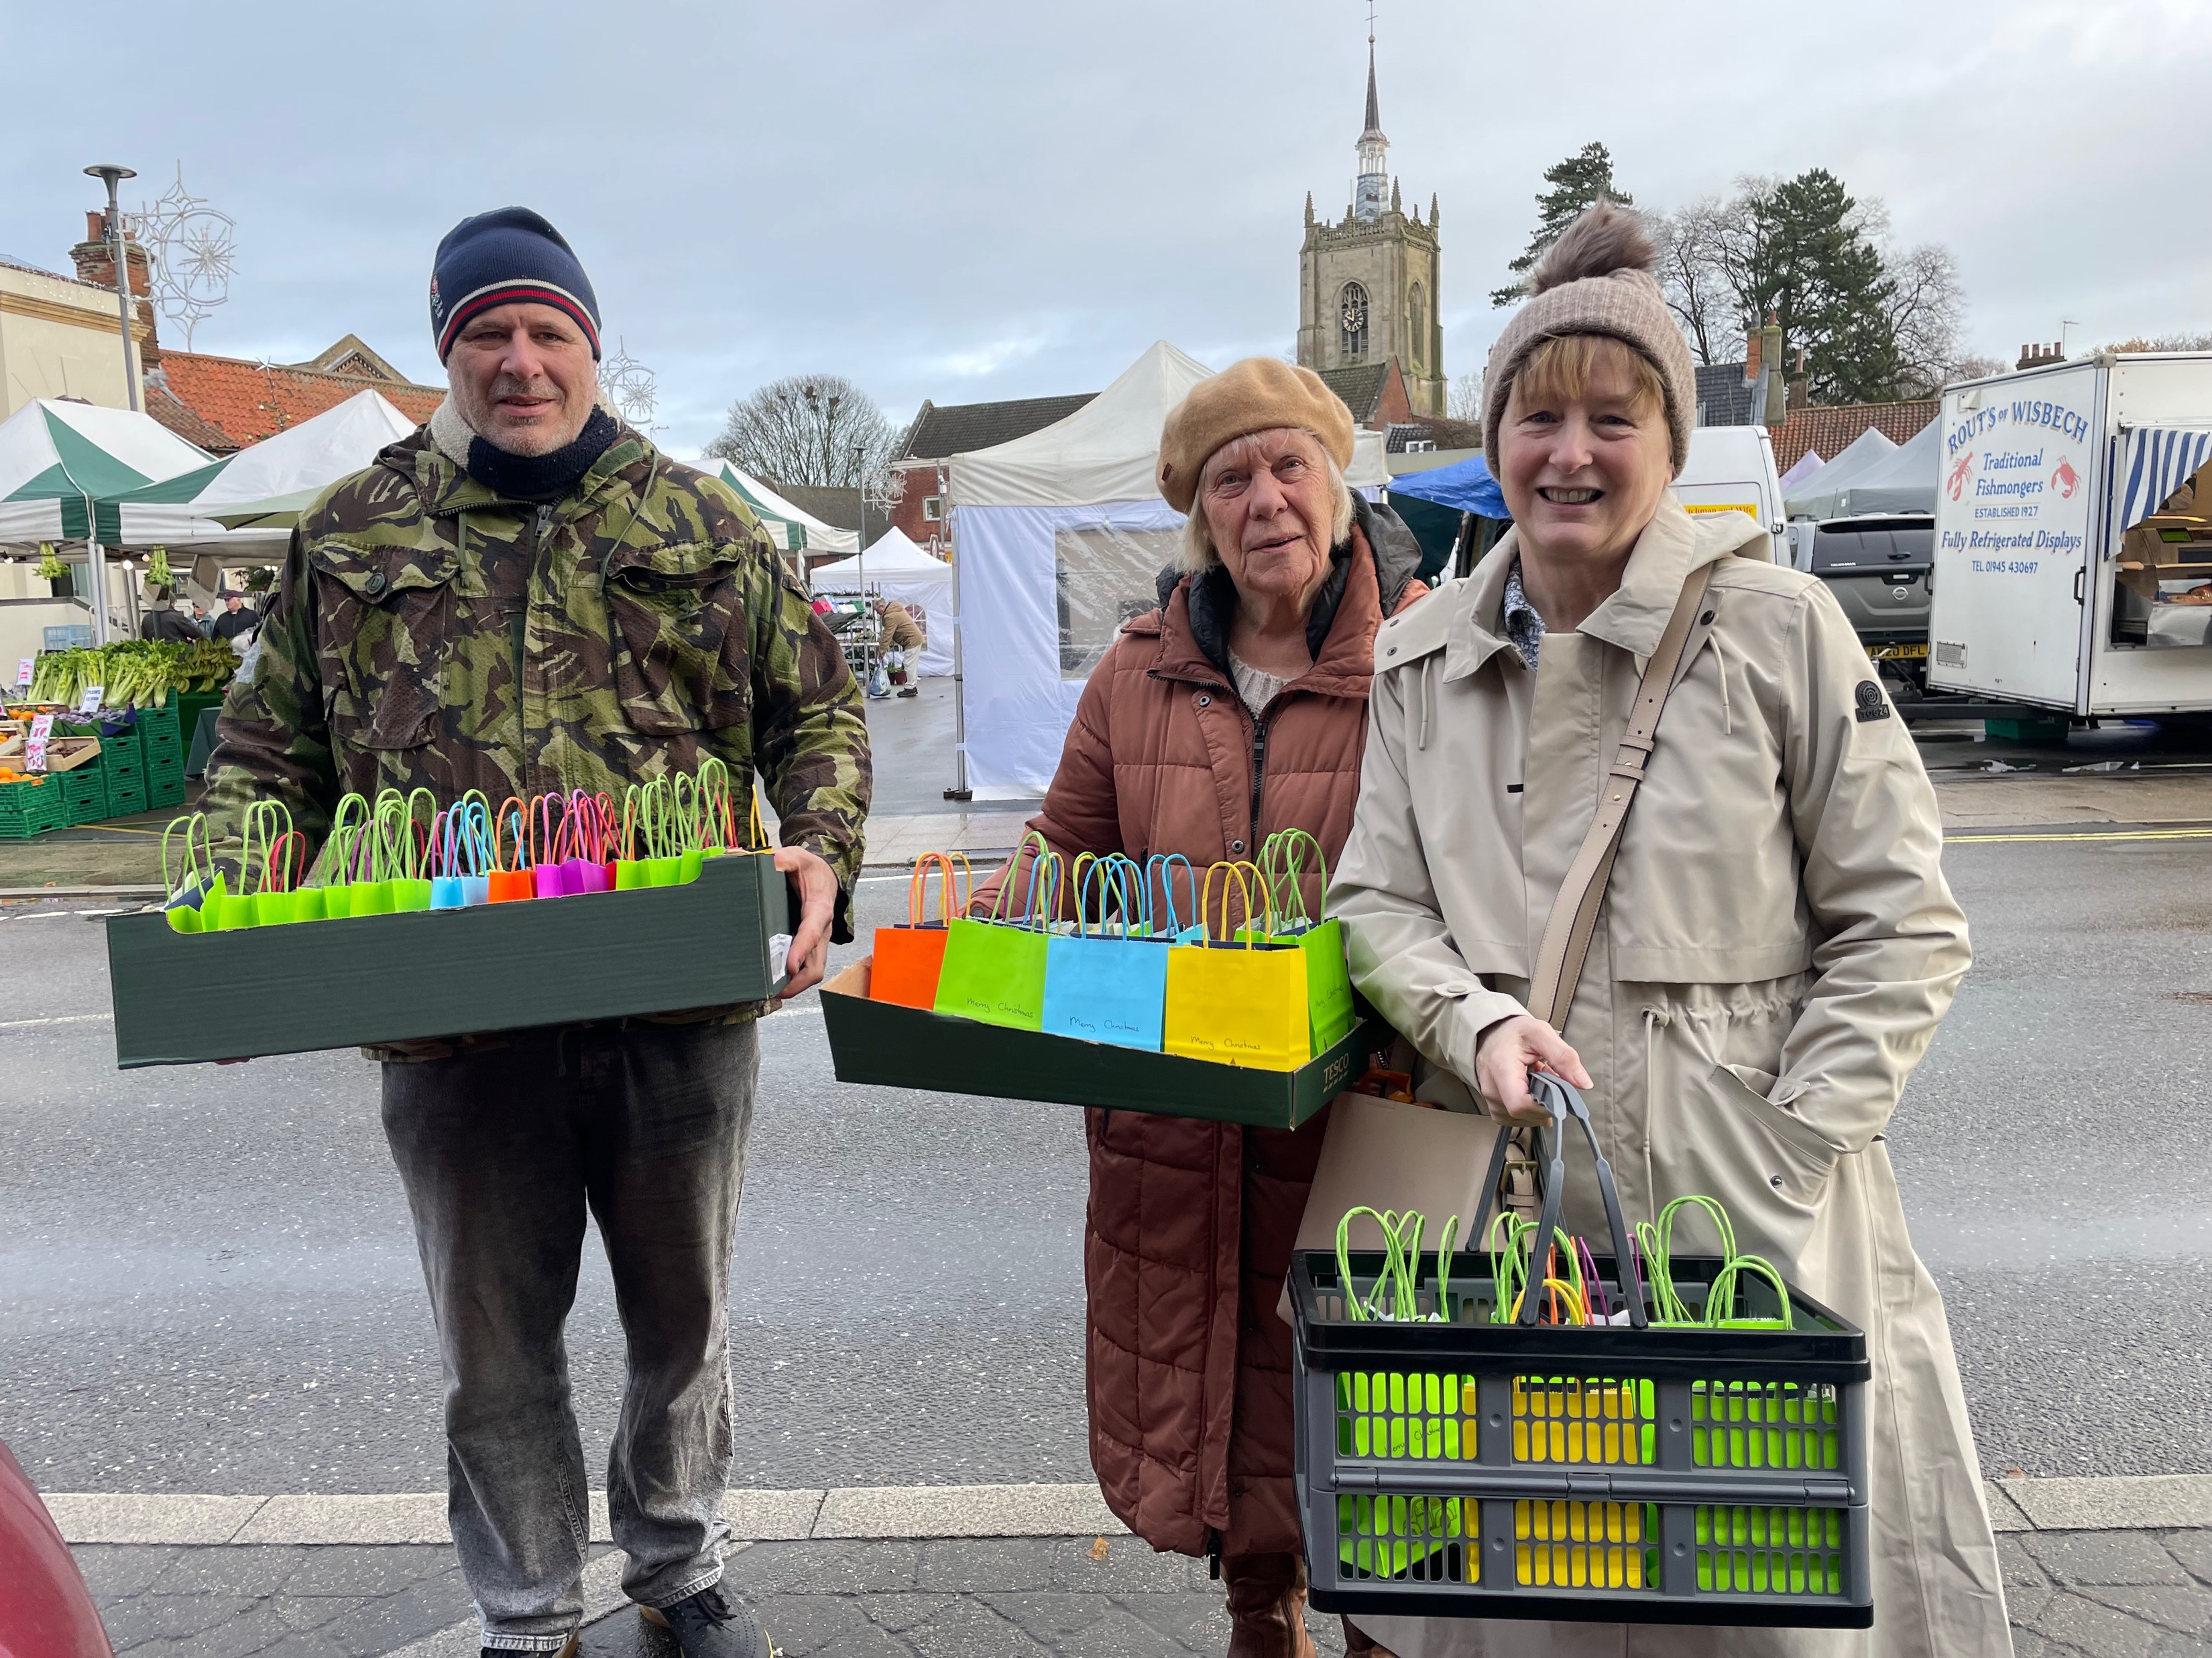
Swaffham is a growing market town in the west of Norfolk. In the heart of the town is the Baptist Church, with a fellowship of around 30. The leadership team consists of Barry, Tim, Chris and Barb (Deacons), Jo (Secretary) and Simon (Moderator). The church is currently going through a period of increasing stability, with new members of the congregation bring new skills and gifts.
The church runs a Craft Group which provides an opportunity for outreach into the community. They run a regular Prayer and Soup Meeting, and in addition to their traditional Sunday services, supported by several retired ministers and preachers, they have a monthly more informal Café style service. A Bible study group meets bi-weekly, based on the story of Joseph in Genesis.
Prayer Focus: Swaffham Baptist Church

Slide 2
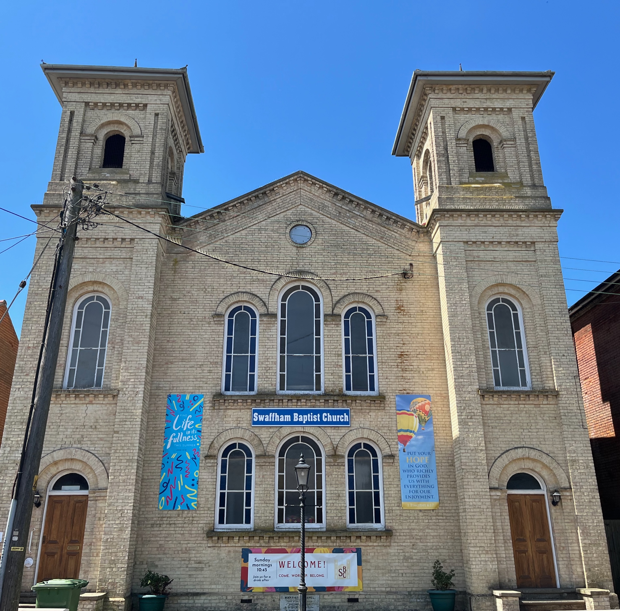
Please pray for:
• Continued stability and growth as new members of the church settle into the fellowship and share their gifts.
• A number of the church family who are currently facing challenges.
• Continued positive response to outreach events as the fellowship seek to the bless their local community, particularly the weekly market traders.
Prayer Focus: Swaffham Baptist Church

