Slide 1
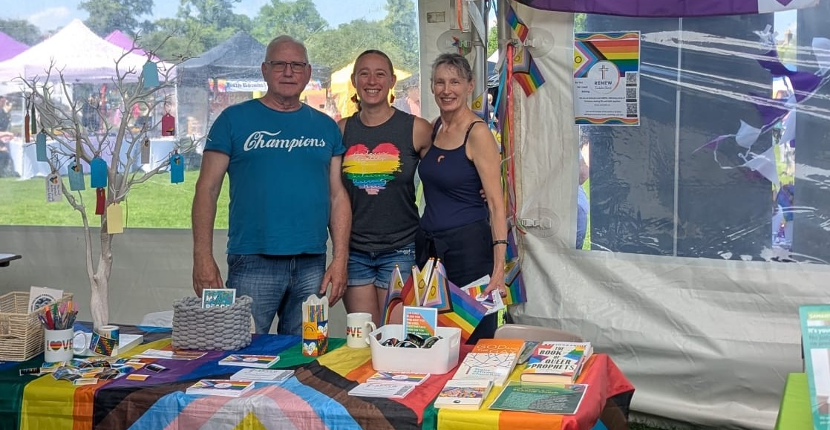
P
Prayer Focus: Renew Inclusive Church, Cambridge
Renew is a small fellowship that describes itself as a phoenix rising from a previous traditional Baptist Church. The decision to become inclusive with a positive LGBTQI stance was a painful time for all, and the church was unable to sustain funding for its minister. Since then, the church grown by 50%, has had a baptism, and covers a wide age and demographic range. It has also moved from a village to Cambridge. The church reaches out to those without any experience of, or painful experience of church, and those from the LGBTQI community who need a spiritual home.

Slide 2
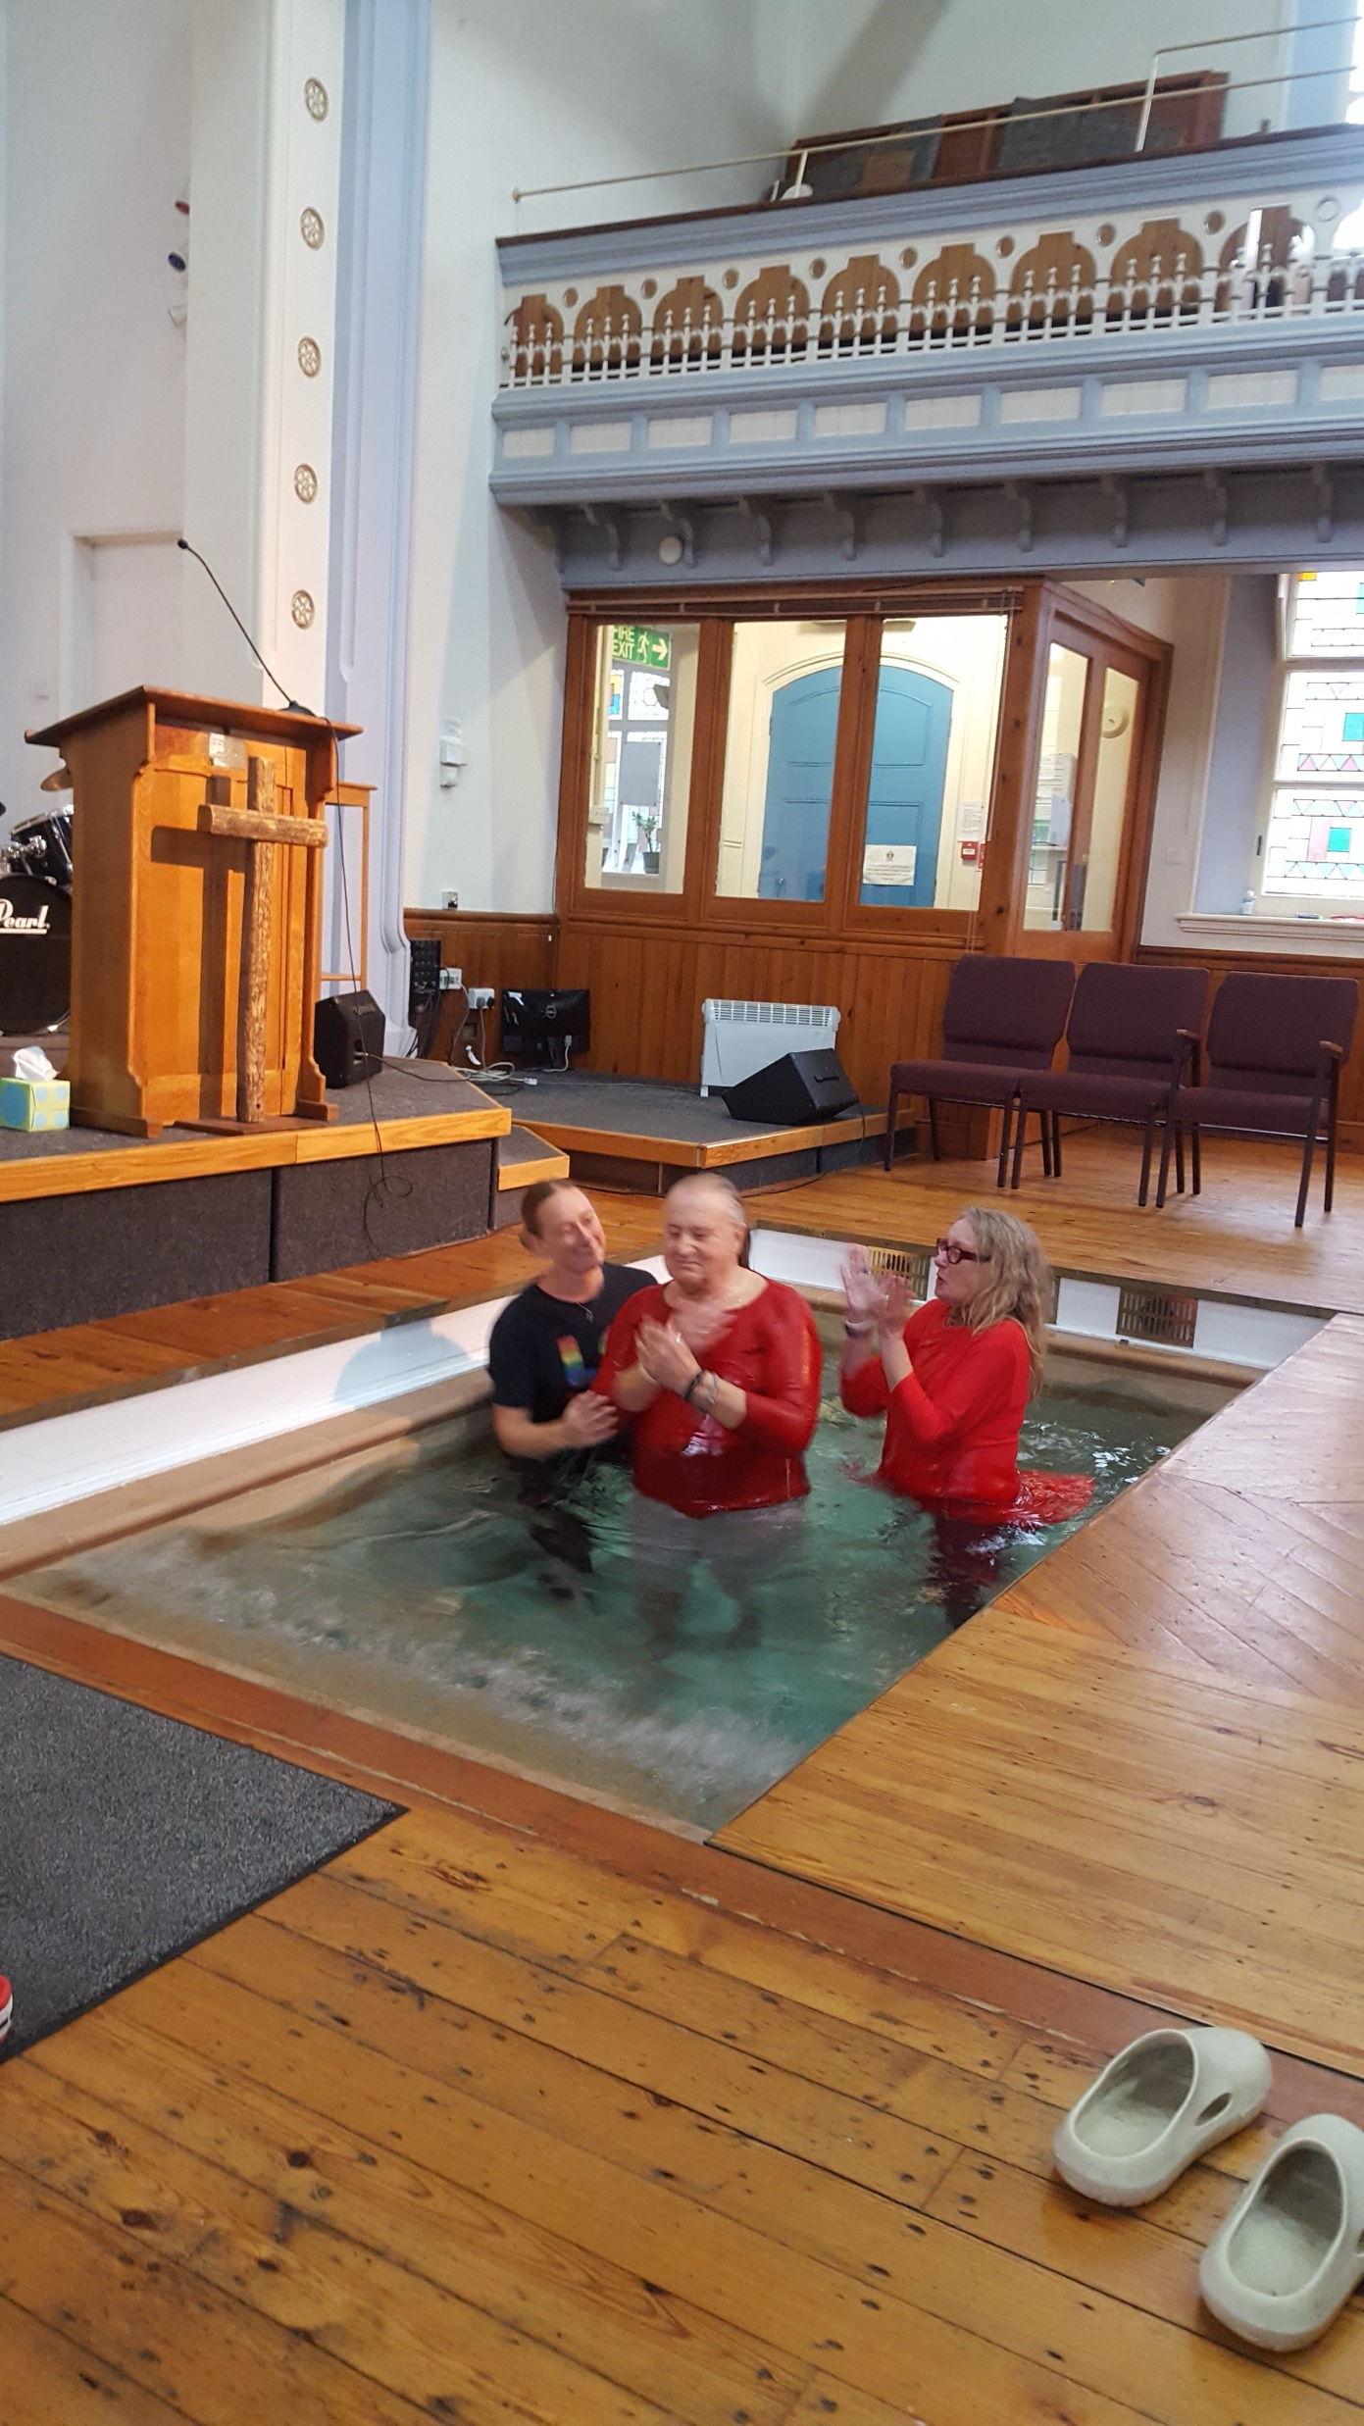
The membership practices mutual reliance and support, and the sharing of meals, forging a strong bond to one another. Worship is open and informal and includes a time of sharing and a house-group style discussion. The church has been grateful for the help and support it has received. The church feels it is on the brink of growth and longs to appoint a part-time minister to increase its presence in the local and LGBTQI communities, funded through the sale of the church manse. Please pray for: • The Leadership Team – Jess (Worship Leader), Nigel (Treasurer), Jackie (Secretary) • The sale of the manse and financial wisdom on the use of funds this would release • Continued church growth amongst the local and LGBTQI communities • A lightweight, portable keyboard.
P
Prayer Focus: Renew Inclusive Church

