Slide 1
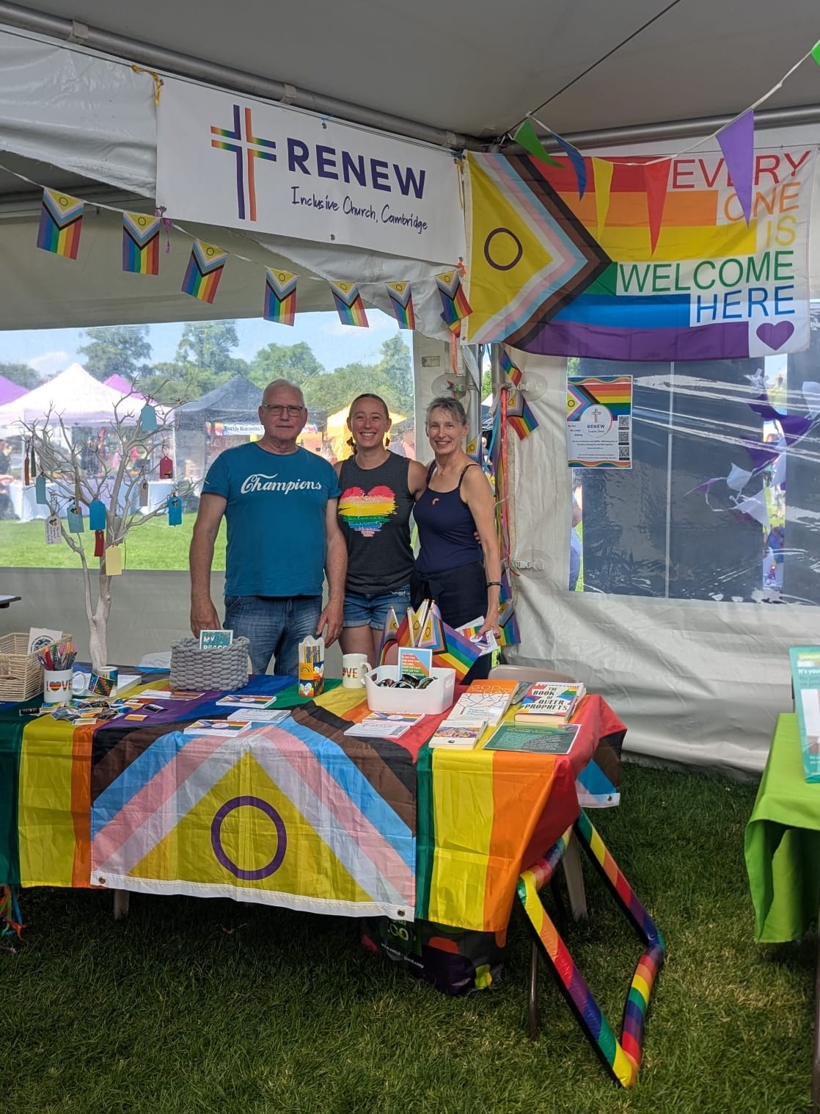
Renew Inclusive Church Cambridge is a small fellowship that meets in a community centre in Cambridge. It describes itself as a phoenix rising from a previous traditional Baptist Church. The decision to become inclusive with a positive LGBTQI stance took its members to a crossroads. It was a painful time for all involved – for those holding a more traditional viewpoint and left, and for the very small number who remained. The church was unable to sustain funding for its minister and he left. Since then, the church has undergone growth of 50% and regular worshippers cover a wide age and demographic range. It has also moved from its former crumbling premises in a village location to the community centre in the heart of Cambridge.
The church reaches out to those without any experience of church or whose experience has been painful, and those from the LGBTQI community who know Jesus and have been searching for a spiritual home. It has recently celebrated a baptism.
Prayer Focus: Renew Inclusive Church

Slide 2
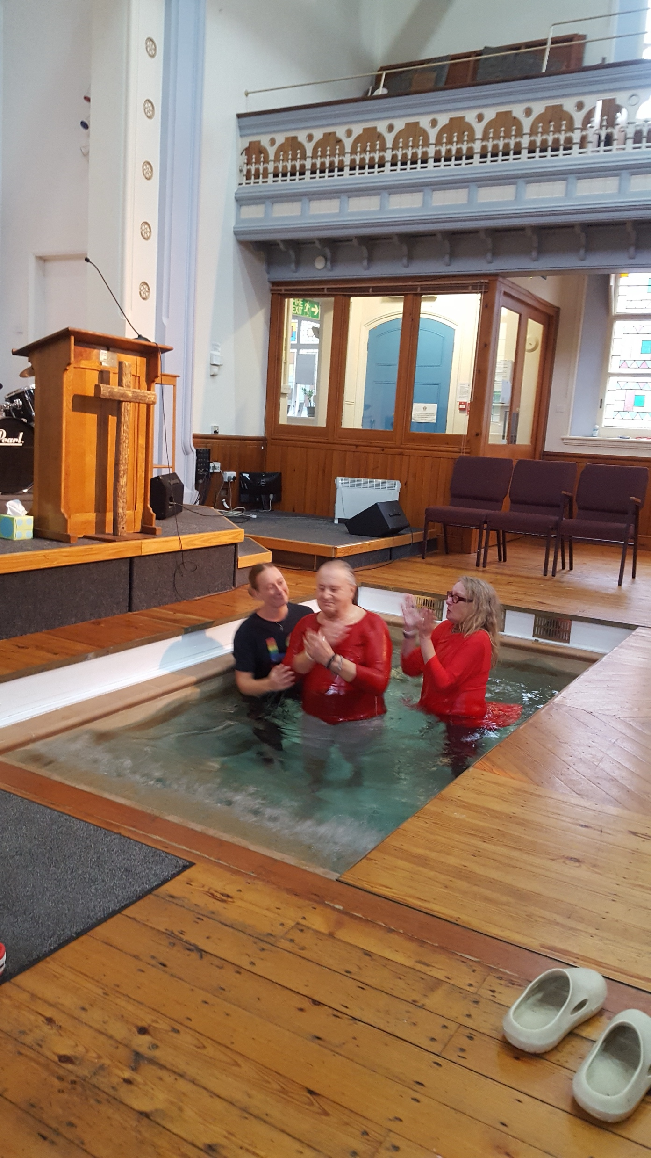
The core membership practices mutual reliance and support, and the sharing of meals. This has forged a strong bond of commitment to one another. Worship is open and informal and includes a time of sharing and a house-group style discussion instead of a sermon. The church has been grateful for the help and support it has received from other fellowships and ecumenical expressions of church in the local community. The church feels it is on the brink of growth and further change and longs to be able to appoint a part-time minister to increase its presence in the local and LGBTQI communities, funded through the sale of the church manse. Please pray for:
• The Leadership Team – Jess (Worship Leader), Nigel (Treasurer), Jackie (Secretary)
• The sale of the manse and financial wisdom on the use of funds this would release
• Continued church growth amongst the local and LGBTQI communities
• A lightweight, portable keyboard.
Prayer Focus: Renew Inclusive Church

