Slide 1
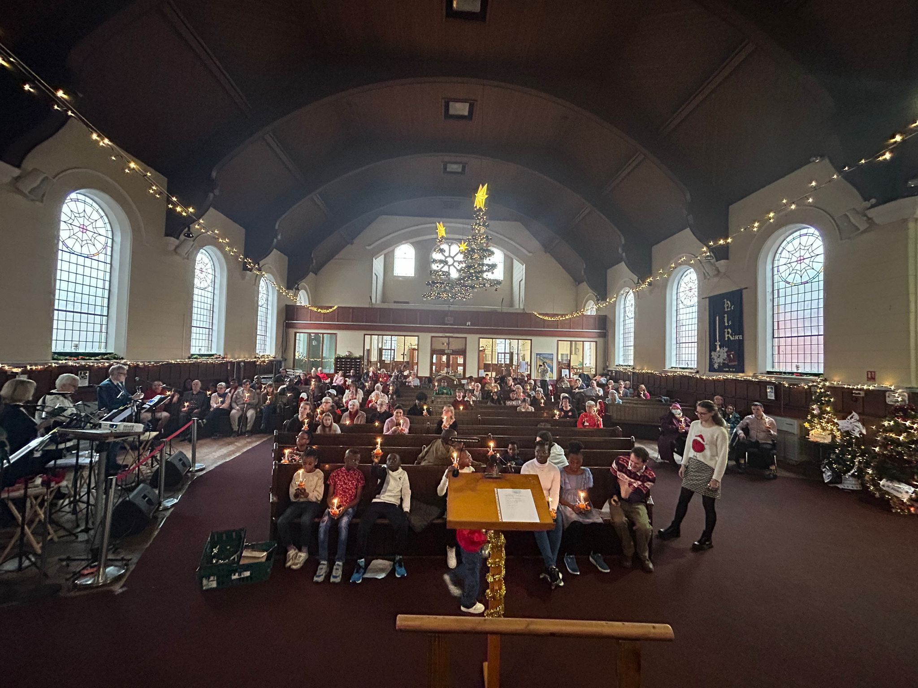
P
Prayer Focus: Pier Avenue Baptist Church, Clacton-on-Sea
Pier Avenue Baptist Church is a busy and vibrant church, just 10 minutes from the seaside and adjacent to the town centre, which has a diverse cross-section of people attending its Sunday services and many activities. These include a toddler’s group, Girls Brigade, boys club, house groups and a Saturday coffee morning. There is also a project for vulnerable people which is its own small church community. Michelle, their minister, is looking forward to the next baptism service, adding to the 5 people already baptised.

Slide 2
Joint community events include a walk of witness, carols, an alternative Halloween event - where party bags were distributed and town community days which sees the church taking a stall. Looking forward, there are plans for increasing support for the homeless. Please Pray: • For the mission group, that they may catch God’s vision and consolidate future ideas, including being out in the town and inviting people to events such as the World Cup • For equipping their Leadership team for the business and demands. • That the members may be inspired as they revisit the Church Vision • For the children’s and family’s ministry • For a vision for a new Parish Nursing service.
P
Prayer Focus: Pier Avenue Baptist Church

