Slide 1
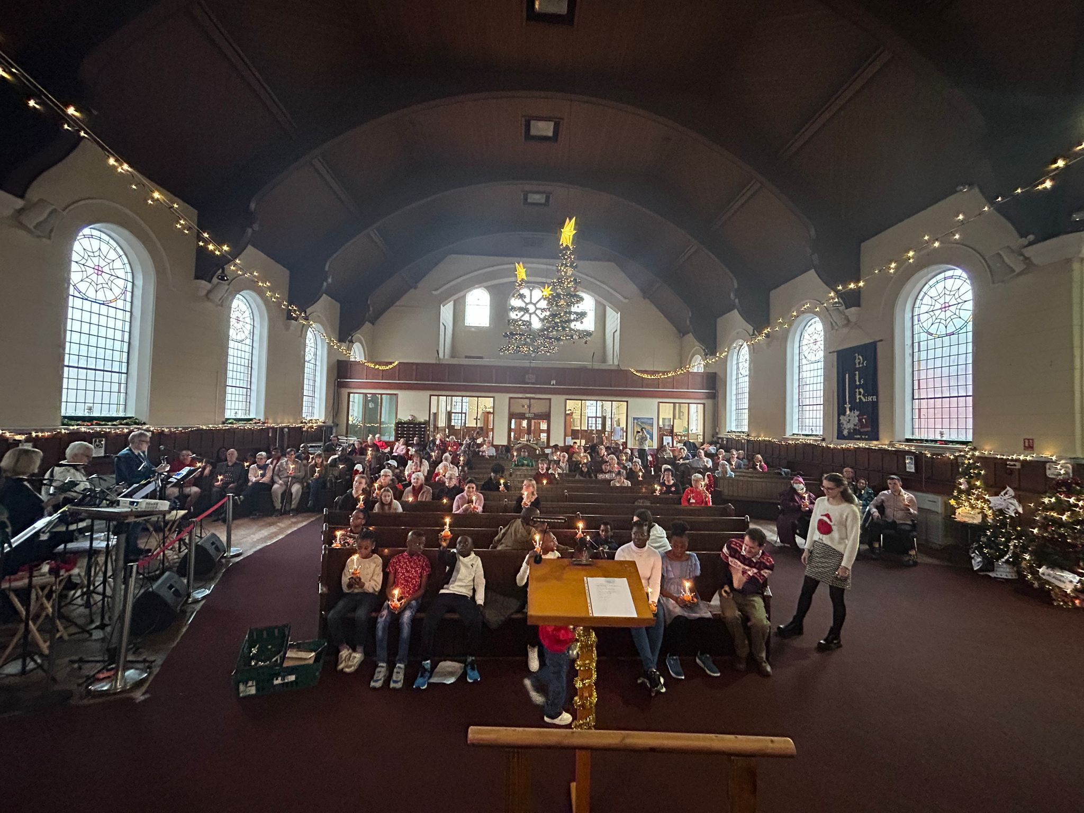
Pier Avenue Baptist Church is a busy and vibrant church in Clacton-on-Sea. The church, which is just 10 minutes from the seaside and adjacent to the town centre, has a diverse cross-section of people attending its Sunday services and many activities.
On a Sunday, the service includes participation church leaders, members and children. However, much of the business is during the week. This includes a toddler’s group, Girls Brigade, boys club for primary age, house groups and a Saturday coffee morning. There is also a project for vulnerable people which is its own small church community.
Michelle, their minister, is looking forward to the next baptism service, adding to the 5 people already baptised.
Prayer Focus: Pier Avenue Baptist Church

Slide 2
Outside the church, there community links, including partnership with Churches Together and Community Voluntary Services. Regular events include a walk of witness, carols, an alternative Halloween event - where bags of light (party bags) were distributed in the town. In the town there are community days which sees the church taking a stall. Looking forward, there are plans for increasing support for the homeless. Please Pray:
• For the mission group, that they may catch God’s vision and consolidate future ideas, including being out in the town and inviting people to events such as the World Cup
• For equipping their Leadership team for the business and demands.
• That the members may be inspired as they revisit the Church Vision
• For the children’s and family’s ministry
• For a vision for a new Parish Nursing service.
Prayer Focus: Pier Avenue Baptist Church

