Slide 1
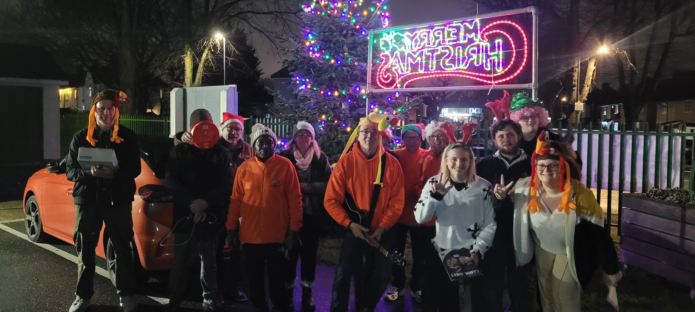
NRBC lies on a council estate, and the heart of their message can be wrapped up in ‘following, serving and sharing Christ.’ They seek to reach out to the community around and give help where needed and regularly run community events. Extra events will be held as they joyfully celebrate their centenary this year: an event at Easter with a hip hop artist; afternoon tea in May and a summer event will see a group called Tough Talk sharing their faith. The church also collaborates with other local churches. Regular activities at the church include a lunch club and prayer and bible studies. Due to only having a small number of children they run Sunday School once every three weeks. The church hall is also hired to outside groups which helps to support the work of the church.
Prayer Focus: Nansen Road Baptist Church, Nacton, Ipswich

Slide 2
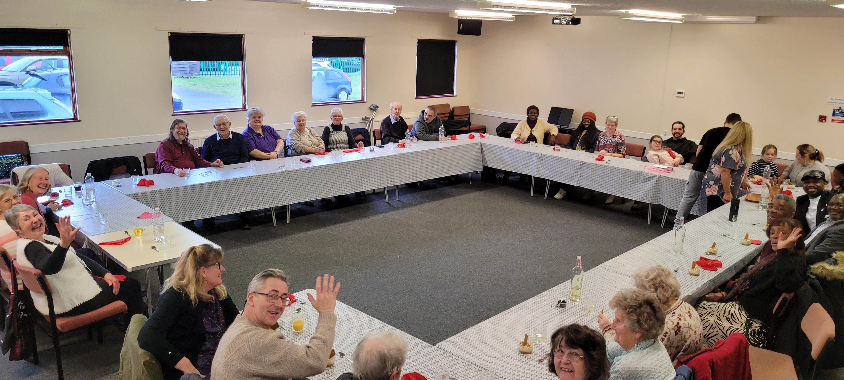
The church is currently in a pastoral vacancy and are supported by lay preachers and a Moderator. Just now they are not looking to take on a minister until God tells them to and their primary focus is on reaching out to the community and building links. They would value prayer: • For events for the year to go well and good connections to be made with the community. • For growing links between the community and the church and for more young people and families to be drawn into the fellowship. • That they would discern and seek God’s will in all that they do.
Prayer Focus: Nansen Road Baptist Church

