Slide 1
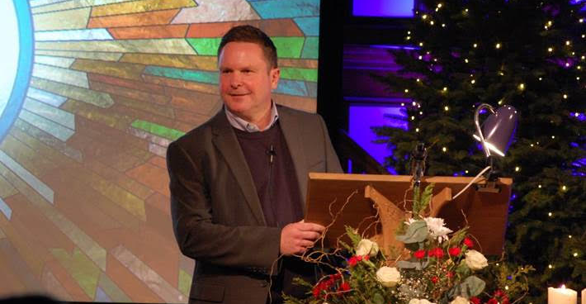
P
Prayer Focus: Leigh Road Baptist Church
LRBC is possibly the oldest Baptist Church in Leigh-on-Sea, Southend. Yet its focus is not on the past, but on serving the local community now, showing them Jesus and equipping its members to grow in discipleship. This ethos is lived through its activities engaging with over 750 people, its buildings, sporting outreach, encouragement of wellbeing groups, relationships with schools, concern for the environment, support of local businesses, etc. Through ‘doing life together’, the church actively builds relationships, promoting physical and spiritual wellbeing towards wholeness.

Slide 2
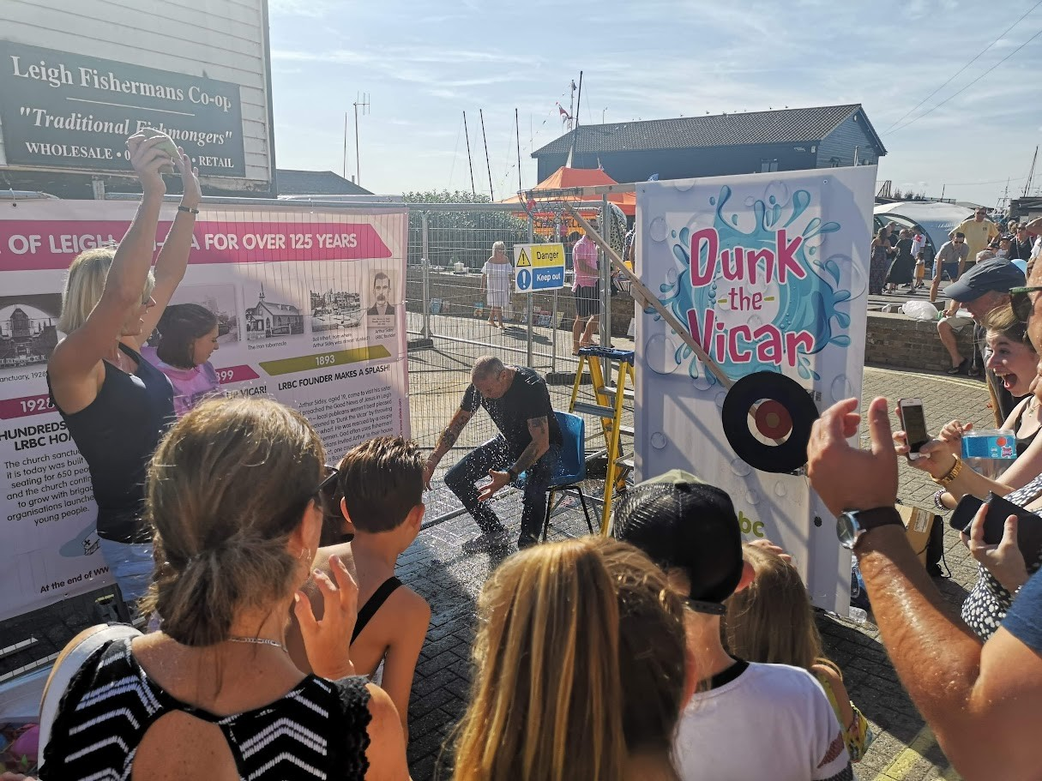
Please pray for
• The new ministry team – Ian (Senior Minister), Steve, Catriona, David and Hanli – and the wider staff and Leadership team
• The church as it seeks to reach out and extend positive invitations to the many people on its fringes who take part in its weekly activities
• Church members as they seek to deepen their discipleship and become confident in sharing Jesus on their ‘frontlines’
• The church as it finds ways of engaging with the community to show God’s love
P
Prayer Focus: Leigh Road Baptist Church

