Slide 1
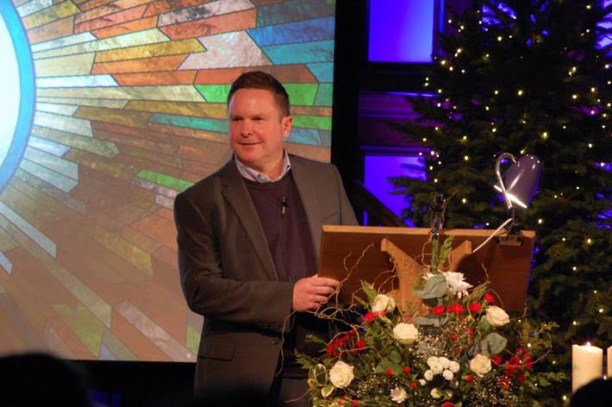
Leigh Road Baptist Church is possibly the oldest Baptist Church in Leigh-on-Sea, Southend. Yet its focus is not on the past, but on serving the local community now, showing them Jesus and equipping its members to grow in discipleship. The church welcomes over 100 people on a Sunday, with new faces each week. The church’s ethos of engaging with its local community is lived through its many activities engaging with over 750 people of all ages, the availability of its buildings, and its sporting outreach, encouragement of wellbeing groups, growing relationships with schools, concern for the environment, support of local businesses, and much more. Through its intentional approach of ‘doing life together’, the church actively seeks to build relationships, promoting their physical and spiritual wellbeing towards wholeness.
Prayer Focus: Leigh Road Baptist Church

Slide 2
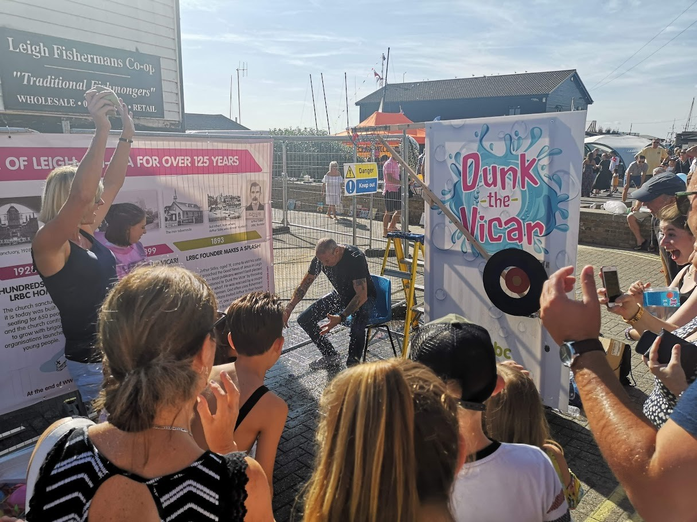
Please pray for • The new ministry team – Ian (Senior Minister), Steve (Ministry Assistant), Catriona (Youth Worker), David (Creative/Community Worker) and Hanli (Children & Families Worker) – and the wider staff and Leadership team in their desire to serve Jesus and not be distracted by the busyness of the church • The church as it seeks to reach out and extend positive invitations to the many people on its fringes who take part in its weekly activities • Church members as they seek to deepen their discipleship and become confident in sharing Jesus on their ‘frontlines’ • The church as it seeks to find new ways of visibly engaging with the community to show them God’s love
Prayer Focus: Leigh Road Baptist Church

