Slide 1
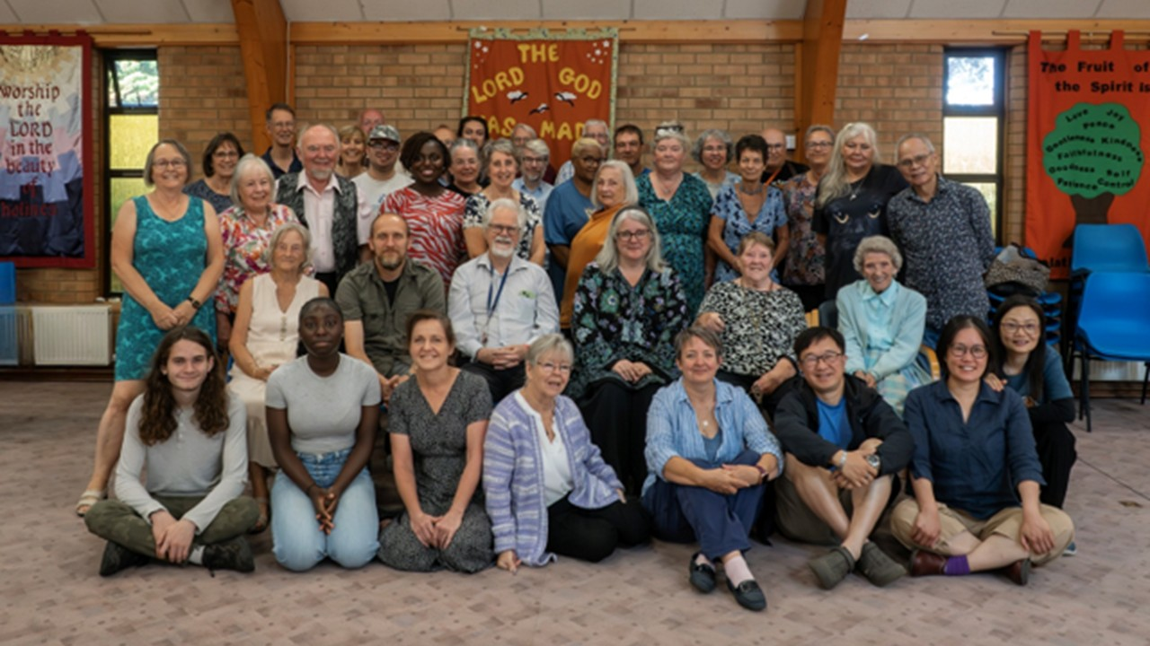
P
Prayer Focus: Orchard Baptist Church, Colchester
OBC is a community of around 40 members, who serve a community with diverse and multiple needs. Currently in pastoral vacancy the church is serving its community through a Table Tennis Group, Knitting and Craft and Coffee and Cake. The weekly toddler group is always full, with parents and carers having to book their places on Eventbrite! Under the leadership team, the church has maintained weekly worship through the support of visiting preachers and is opening a “Warm Space”. This will provide warmth, company and support to those who need it.

Slide 2
Please Pray for: • The church, as it draws up its profile and begins the search for a new minister. • As it enters the new year, a few officers are reaching the end of their term, pray for a smooth transition to new leadership and those willing to take up these roles. • That there continues to be willing preachers Sunday by Sunday, • And for the continued success of the Church’s outreach as it seeks to shine Christ’s light into its community.
P
Prayer Focus: Orchard Baptist Church

