Slide 1
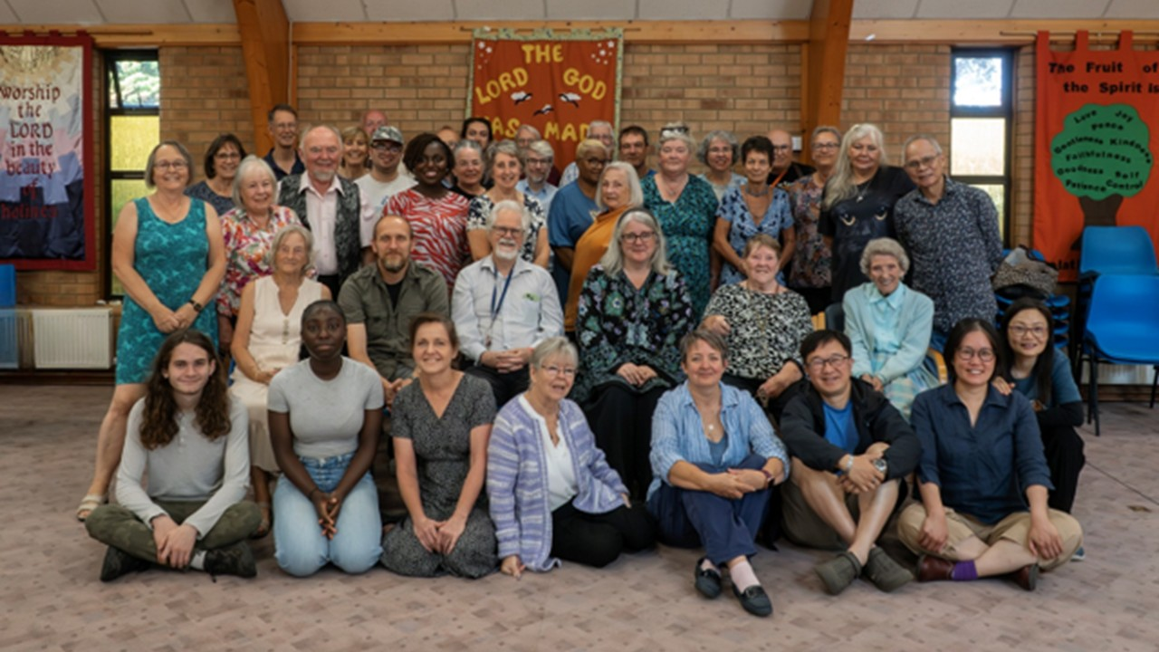
Orchard Baptist Church, Colchester is a community of around 40 members, with up to 30 worshipping regularly. Located to the south of Colchester, the church serves a diverse community with diverse and multiple needs. Currently in pastoral vacancy the church is maintaining its commitment to serving its community through a Table Tennis Group, Knitting and Craft and Coffee and Cake. The weekly toddler group is always full, with parents and carers having to book their places on Eventbrite! Under the leadership team, Church Secretary, Treasurer and a dedicated set of Deacons, the church has maintained weekly worship through the support of visiting preachers and is opening a “Warm Space” for locals on a Thursday evening. This will provide warmth, company and support to those who need it.
Prayer Focus: Orchard Baptist Church

Slide 2
Please Pray for:
• The church, as it draws up its profile and begins the search for a new minister.
• As it enters the new year, a few officers are reaching the end of their term, pray for a smooth transition to new leadership and those willing to take up these roles.
• That there continues to be willing preachers Sunday by Sunday,
• And for the continued success of the Church’s outreach as it seeks to shine Christ’s light into its community.
Prayer Focus: Orchard Baptist Church

