Slide 1
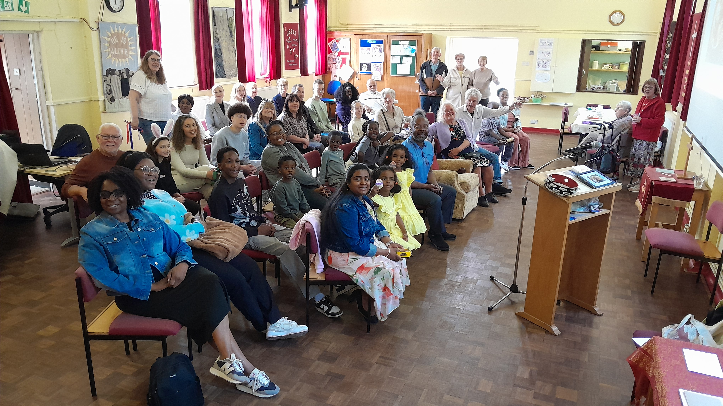
P
Prayer Focus: Harold Park Baptist Church
HPBC has existed since 1928, originally as part of the Baptist Union, and has thrived and declined, most recently since Covid. It changed to FIEC in 1959 but in 2025 decided to rejoin the Baptist Union. During this period, new folk began to attend, of all age groups. A new leadership team have explored many ideas to reunite with the local community. As a fellowship they are going from strength to strength. Christingles were provided for a community event, and an outdoor Nativity and Christmas Carol service was well supported.

Slide 2
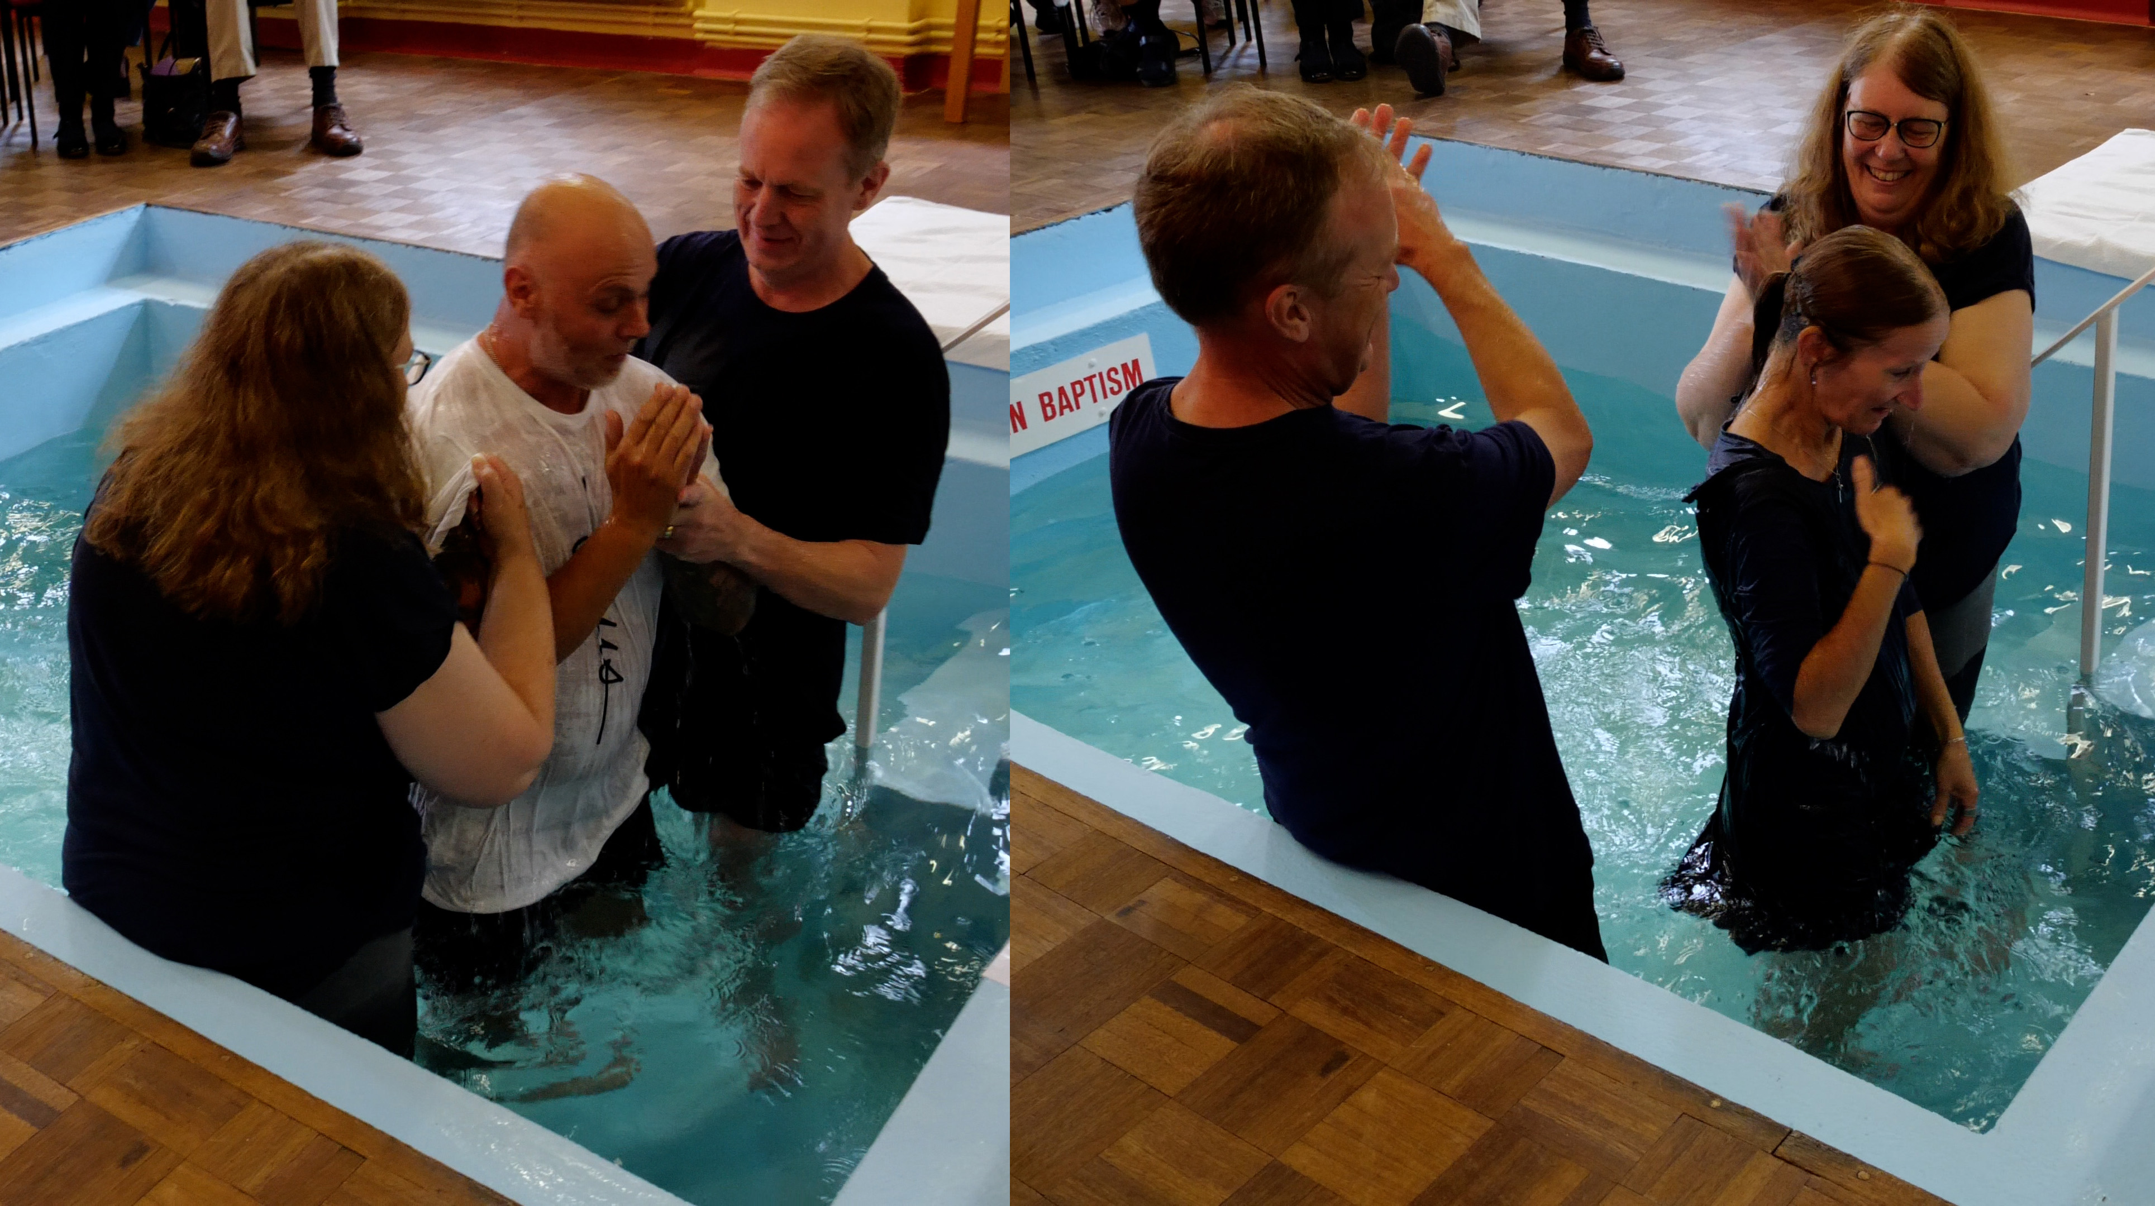
They pray weekly for local streets. In January, a Bible Study and prayer group and walk will be reinstated, coffee morning started and there are plans to ascertain whether to form a Toddlers group. In September, two baptisms took place, which were very encouraging, and people have entered into membership. Please Pray for: * God’s guidance as they move forward, particularly for the Bible study, prayer group and upcoming coffee morning. * The new leadership to have discernment from God for all that lies ahead. * Forming new ways to get back into the community
P
Prayer Focus: Harold Park Baptist Church

