Slide 1
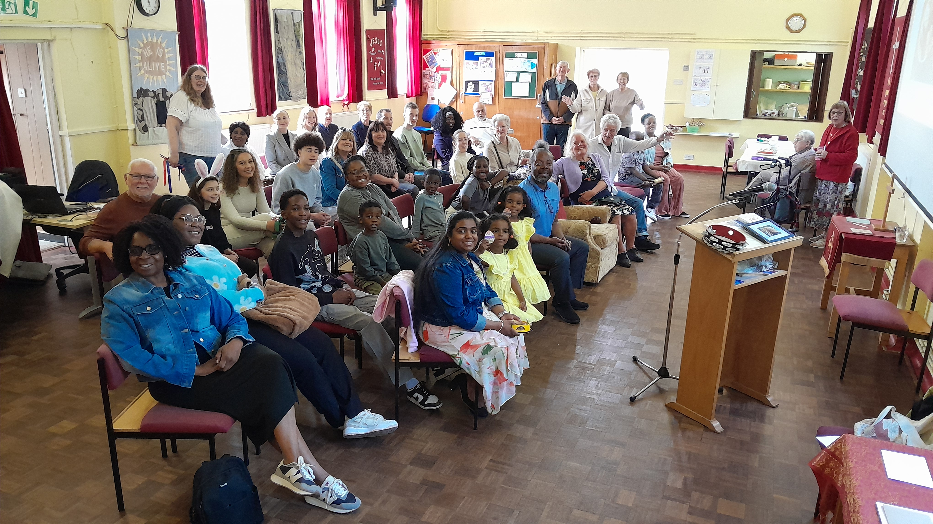
Harold Park Baptist church has existed since 1928, originally as part of the Baptist Union, and has thrived and declined, most recently since Covid. It changed to FIEC in 1959 but in 2025 it was unanimously decided to rejoin the Baptist Union. This process is now reaching completion. During this period, new folk began to attend, of all age groups. A new leadership team have explored many ideas to reunite with the local community. As a fellowship they are going from strength to strength.
Christingles were provided for a community event, and a very successful outdoor Nativity and Christmas Carol service was well supported. They pray weekly for local streets. In January, a Bible Study and prayer group and walk will be reinstated, coffee morning started and there are plans to ascertain whether to form a Toddlers group.
Prayer Focus: Harold Park Baptist Church, Essex Border

Slide 2
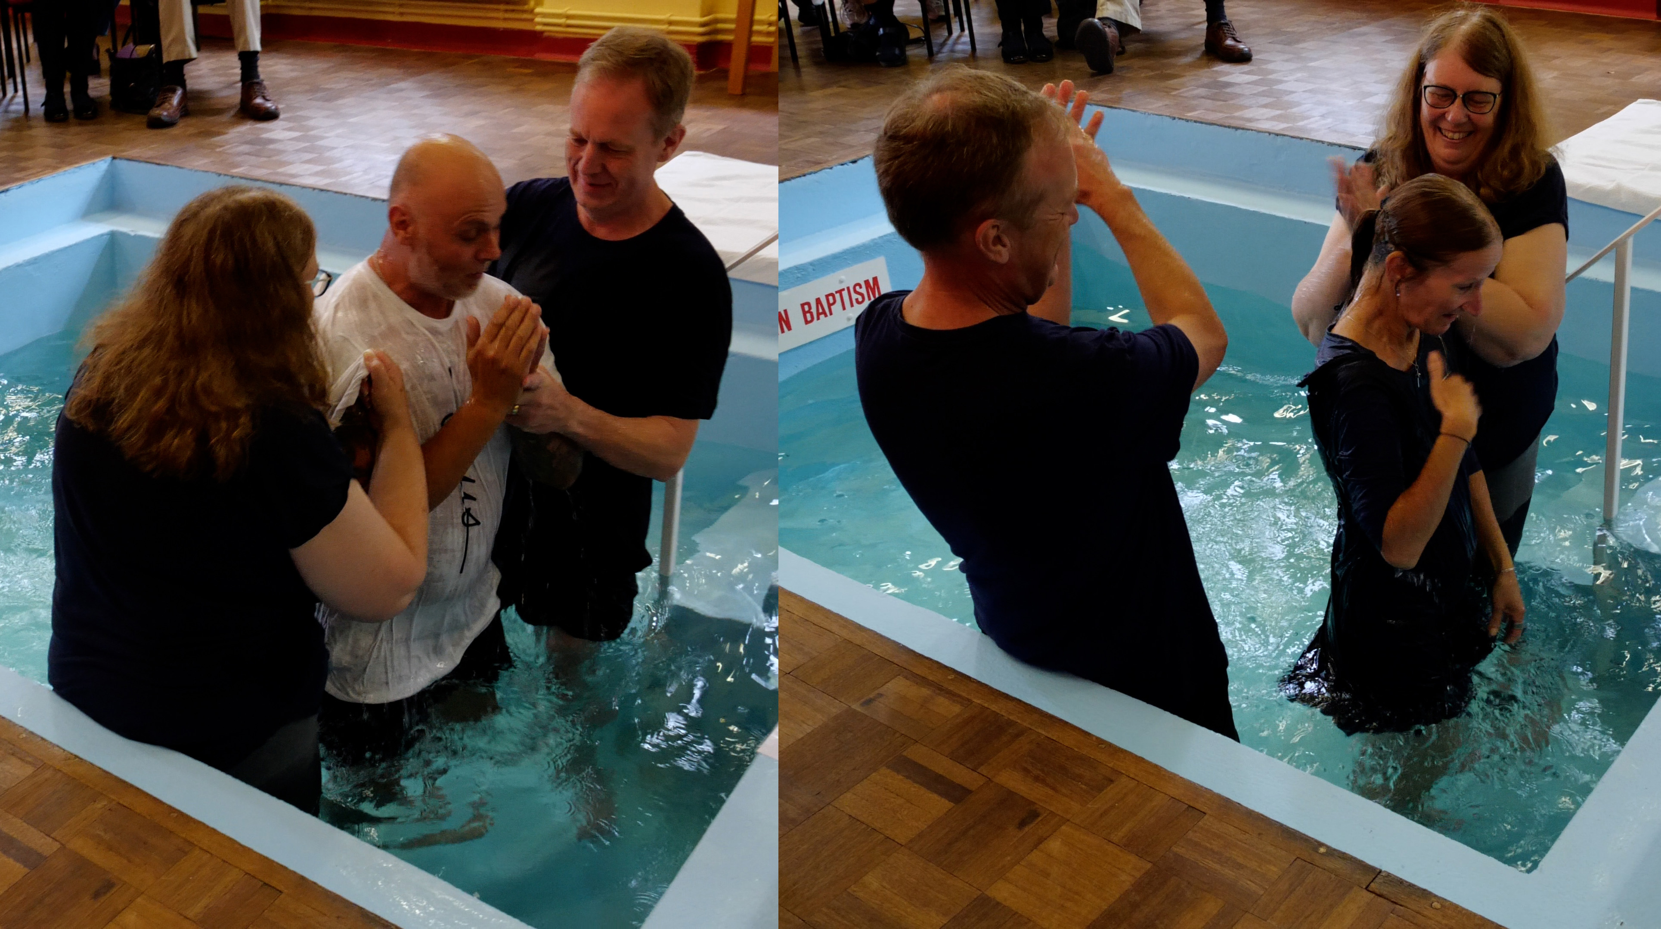
In September, two baptisms took place, which were very encouraging, and people have entered into membership. They would deeply value prayer for:
* God’s guidance as they move forward, particularly for the Bible study, prayer group and upcoming coffee morning.
* The new leadership to have discernment from God for all that lies ahead.
* Forming new ways to get back into the community, as they see reaching out as crucially important.
* They give thanks for all God has done over all the years and is doing now and for the encouragement this has given everyone in church.
Prayer Focus: Harold Park Baptist Church

