Slide 1
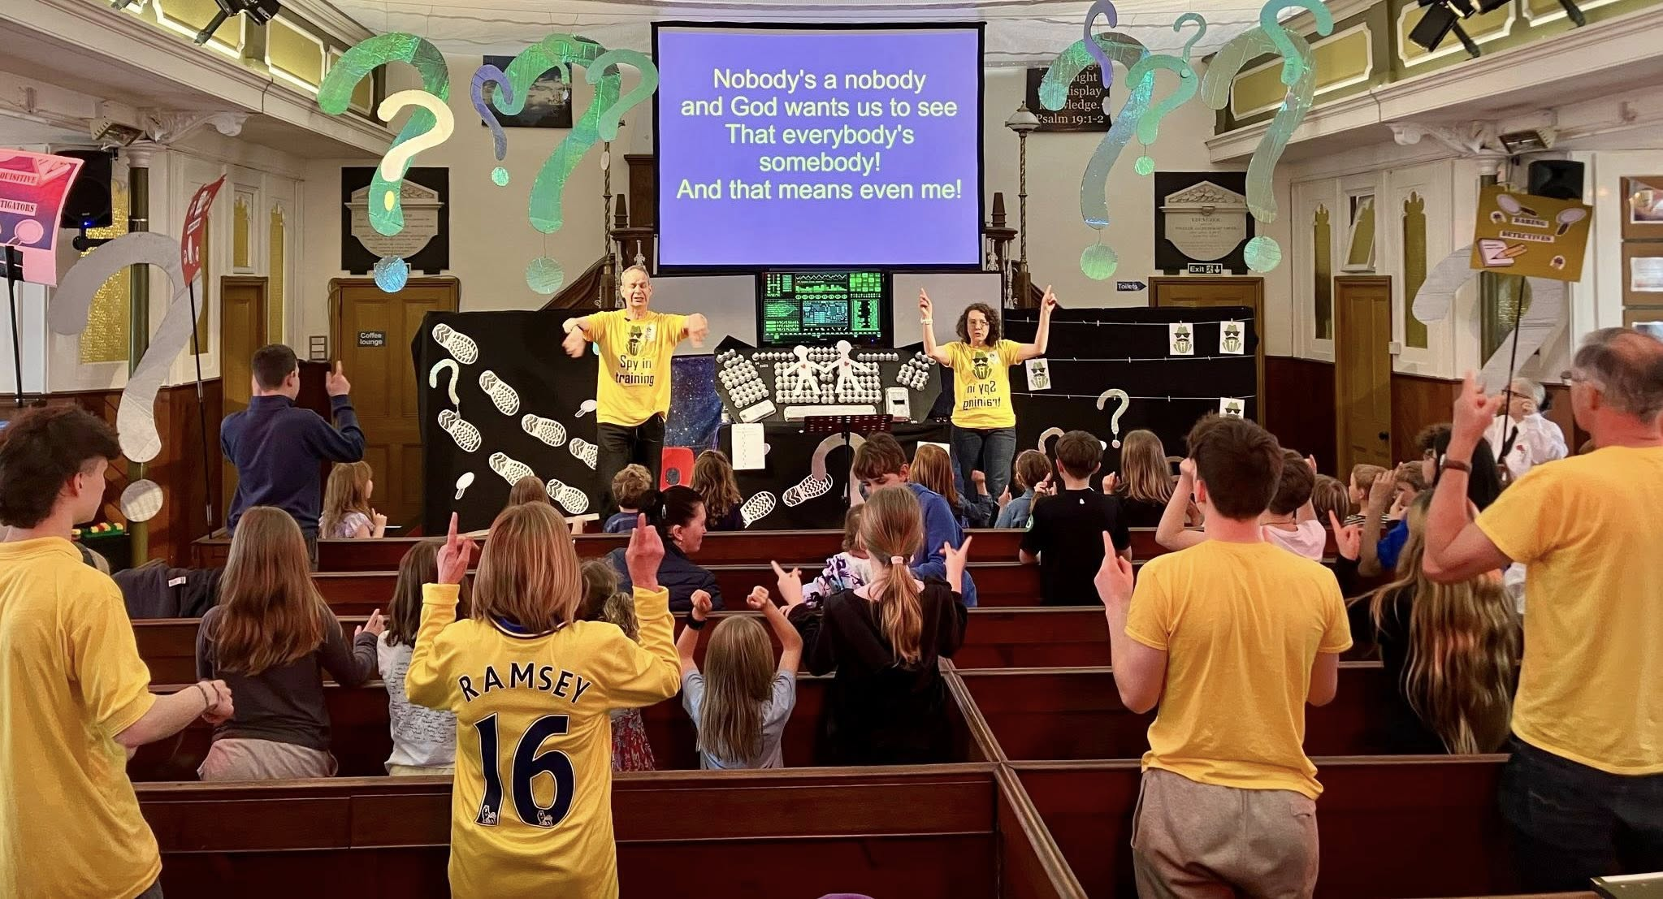
P
Prayer Focus: Cottenham Baptist Church
CBC is small family church of varied ages and diversity. They are keen to discern where God is at work in their community and where He wishes them to focus their resources and have given time for exploring His will through prayer and the Bible. In 2025 Rev Kate Lees has focused on encouraging and empowering people to live as Christians in their different everyday lives and in meeting together regularly to pray, seeking discernment and God’s guidance.

Slide 2
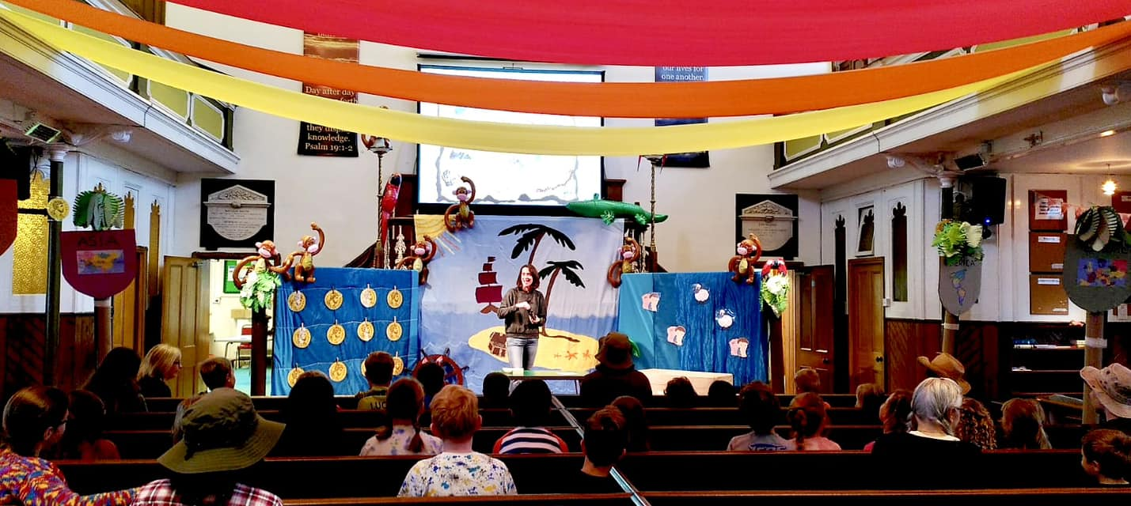
Prayer points: · Give thanks for spiritual growth within the Church and ask that people will continue to desire to draw closer to God and be expectant that they will hear God speaking. · For guidance and resources for their children and youth work. · That they will see fruitful outcomes from events such as the “Christmas Grotto” and children’s holiday club, as well as from their monthly coffee morning · That God will keep moving in their village and show where the Church should be. · For the Minister, Kate, as she has a sabbatical – for refreshment and renewal and for energy and blessing on those who will lead the Church during this period.
P
Prayer Focus: Cottenham Baptist Church

