Slide 1
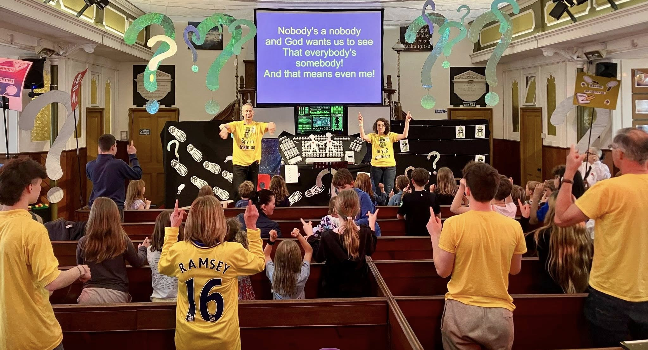
The Baptist Church has been a part of the village of Cottenham for very many years. A small family church of varied ages and diversity, they have seen a little growth in recent times with new people moving into the area. They are keen to discern where God is at work in their community and where He wishes them to focus their resources and energy and have given time for exploring His will through prayer and Biblical studies. Rev Kate Lees has been their Minister since 2008 and has encouraged the Church to grow deeper in relationship with God and to walk in faith together through the ups and downs of life. They have used the Bible course and the LICC frontline resources to facilitate this. In 2025, they have focused on encouraging and empowering people to live as Christians in their different everyday lives and in meeting together regularly to pray, seeking discernment and God’s guidance.
Prayer Focus: Cottenham Baptist Church

Slide 2
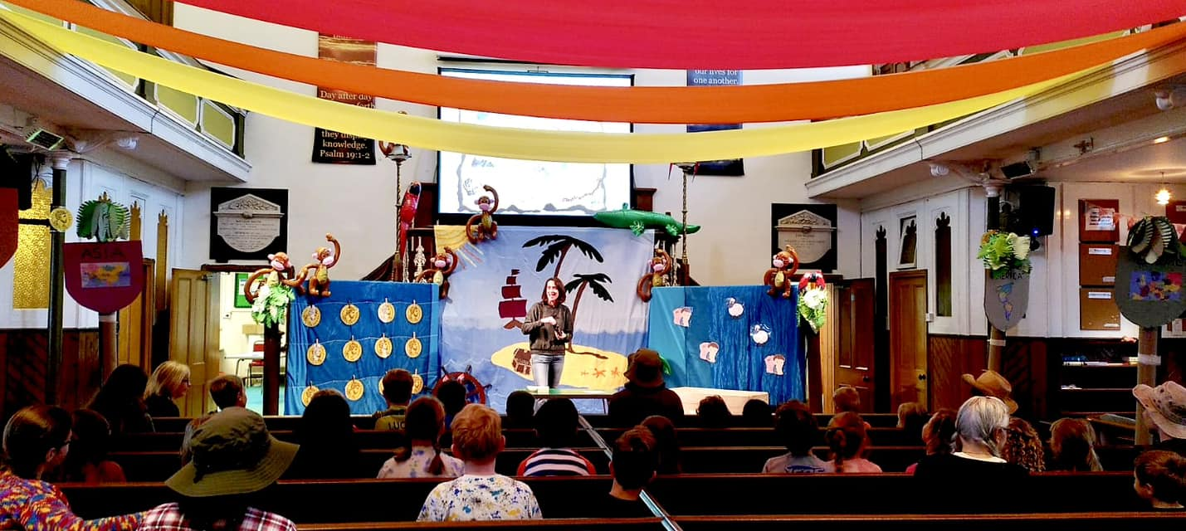
Prayer points: · Give thanks for spiritual growth within the Church and ask that people will continue to desire to draw closer to God and be expectant that they will hear God speaking. · For guidance and resources for their children and youth work – to be able to run weekly activities and other events through the year. · That they will see fruitful outcomes from events such as the “Christmas Grotto” (presentation of the Christmas story) and children’s holiday club, as well as from their monthly “Thursday hub” – a coffee morning which attracts a wide range of ages. · That God will keep moving in their village community and show clearly where the Church should be. · For the Minister, Kate, as she has a sabbatical – for refreshment and renewal and for energy and blessing on those who will lead the Church during this period.
Prayer Focus: Cottenham Baptist Church

