Slide 1
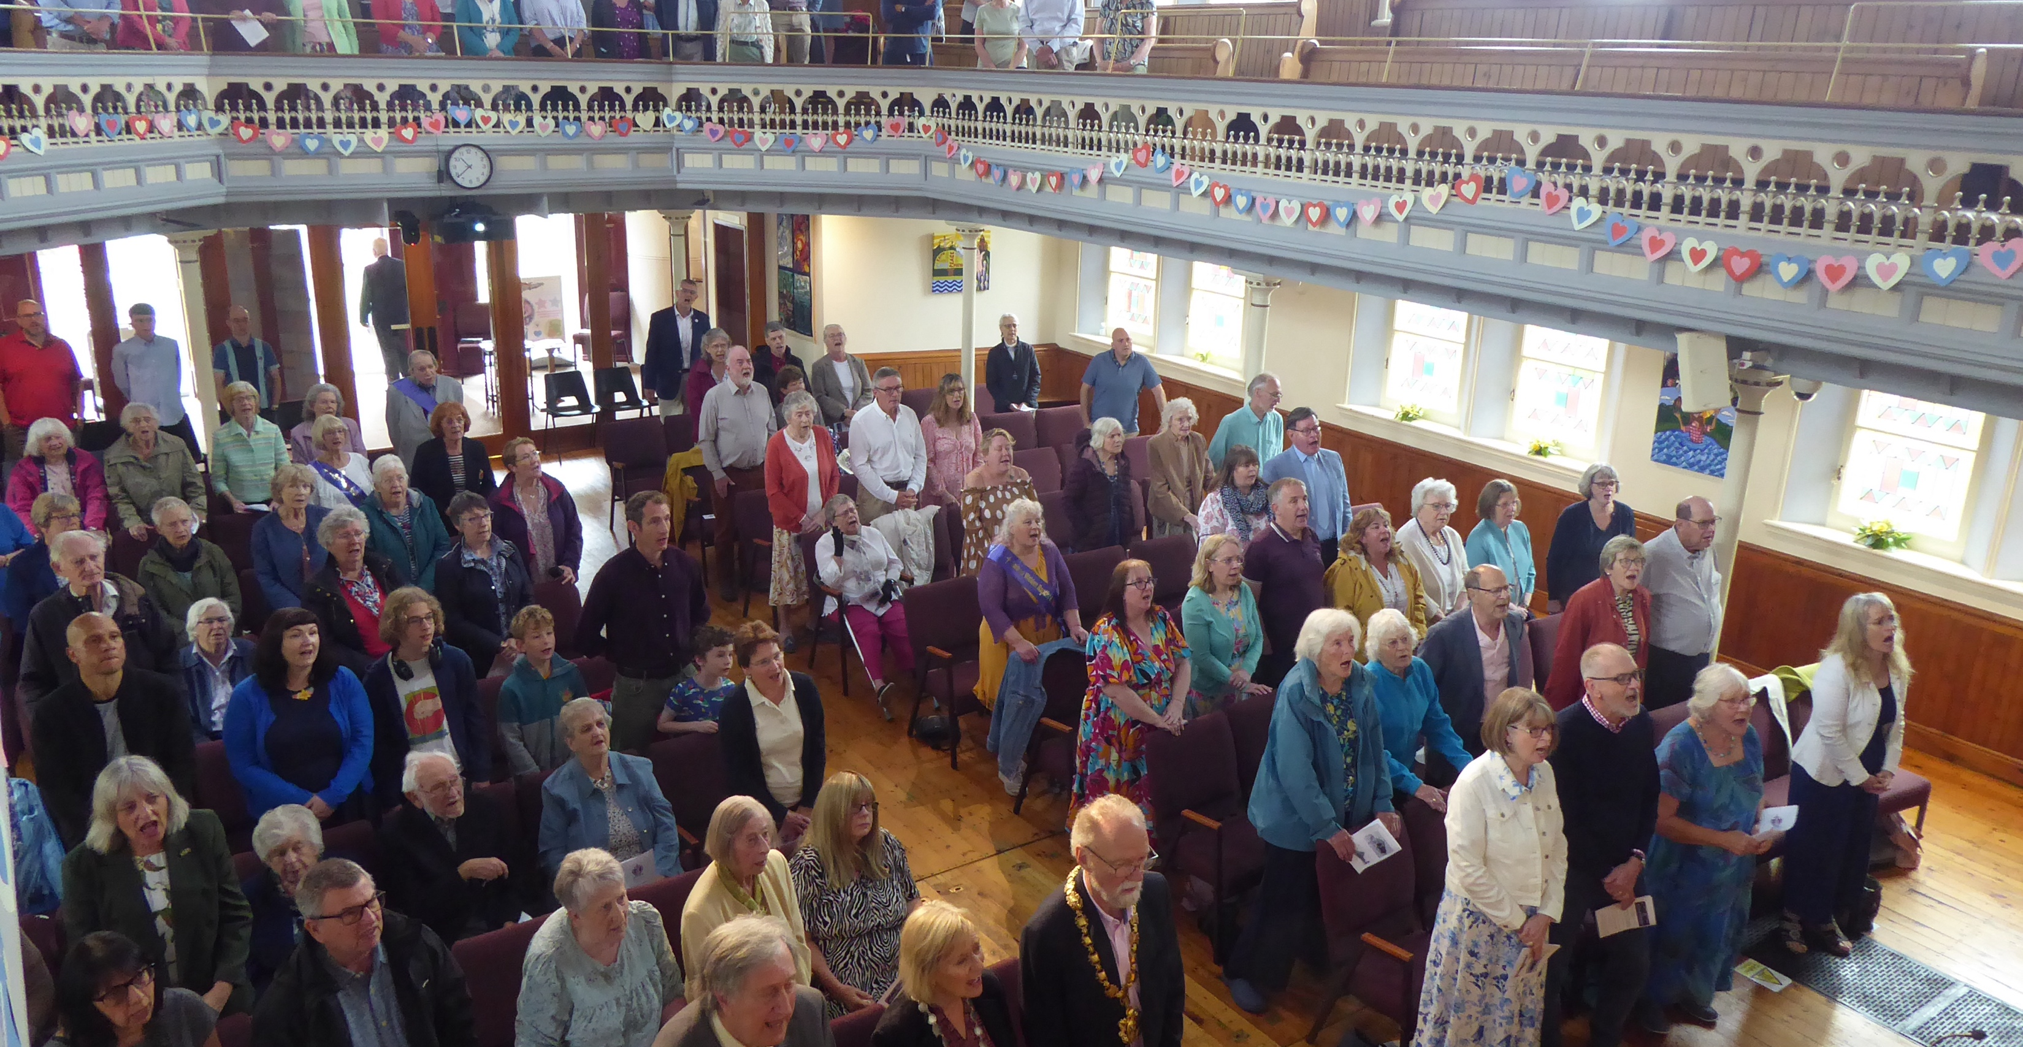
Safron Waldon Baptist Church is a friendly, welcoming and inclusive church which is part of their local community in this rural, historic market town. They are a gently growing congregation. You will find around 60 adults in their weekly services; however, regular parade services attract around 150 young people.
These uniformed organisations and Messy Church, occur alongside other social outreach activities, including Foodshare, coffee and a chat. They also have good relationships with local retirement flats, and many attend their lunch club. Their church building is in constant use by many local groups, deepening community relations.
P
Prayer Focus: Safron Waldon Baptist Church

Slide 2
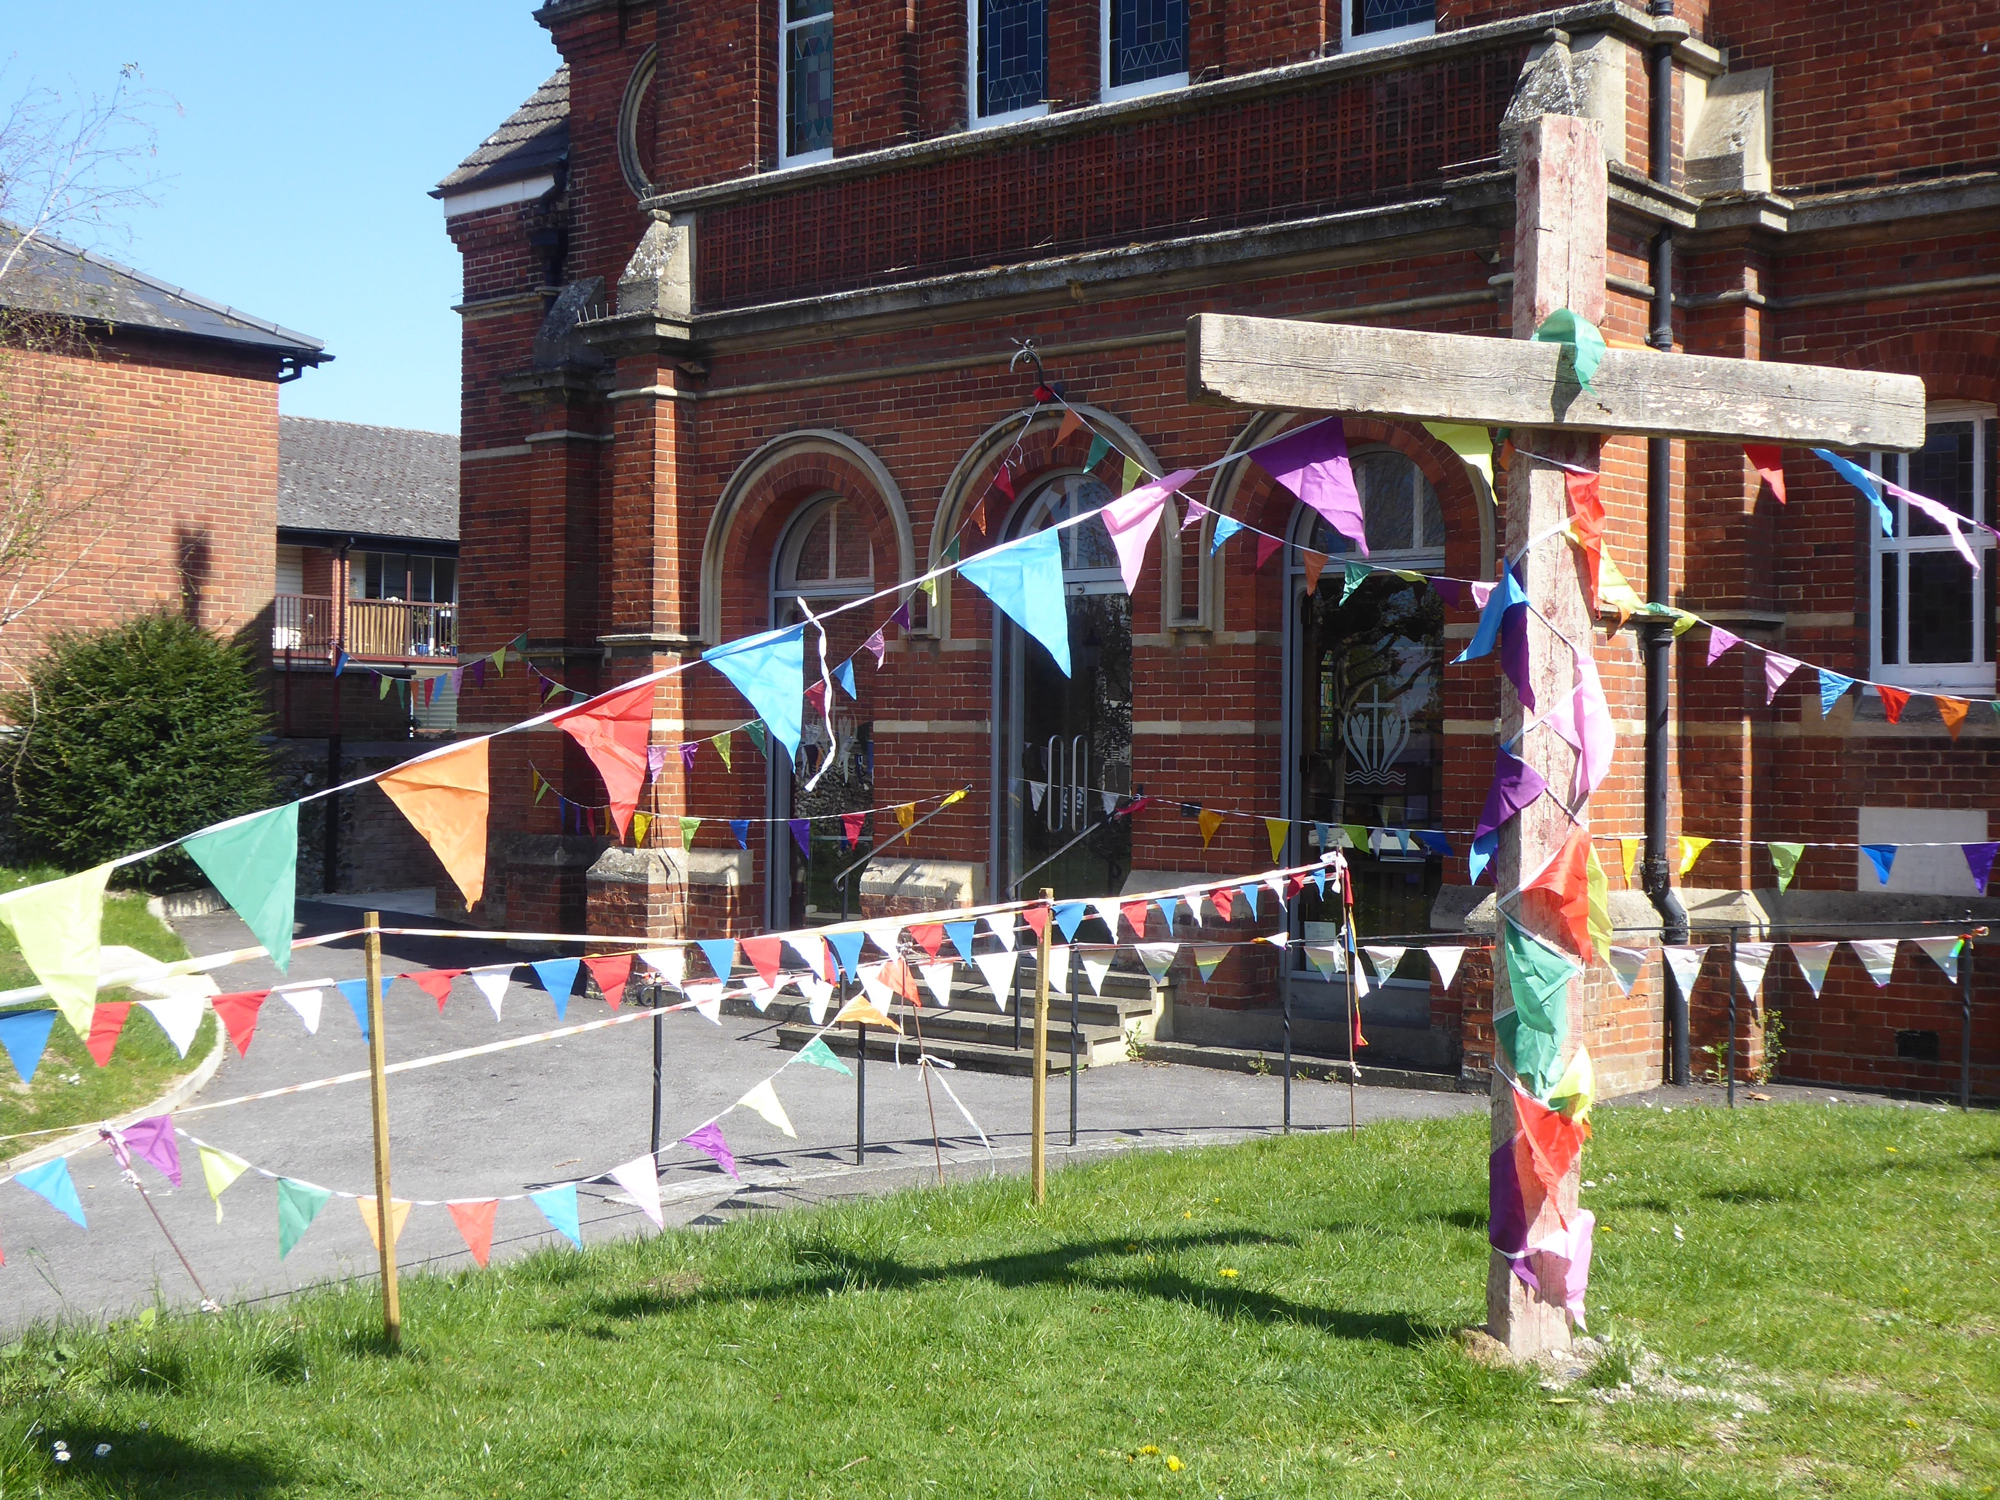
Their minister John, returns from Sabbatical, after walking for 150 miles, with a renewed passion. He is an advocate for celebrating diversity within the Baptist family. Following their 250th anniversary last year, the church looks to the future. Please pray:
• That they continue to be a faithful presence, bringing the love of Jesus.
• For deepening relationships with building users, maintaining hospitality
• For the Boys Brigade as they grow new leaders from their ranks
• For those in the congregation with health issues, their friends and family
• For the current and future deacons.
P
Prayer Focus: Safron Waldon Baptist Church

