Slide 1
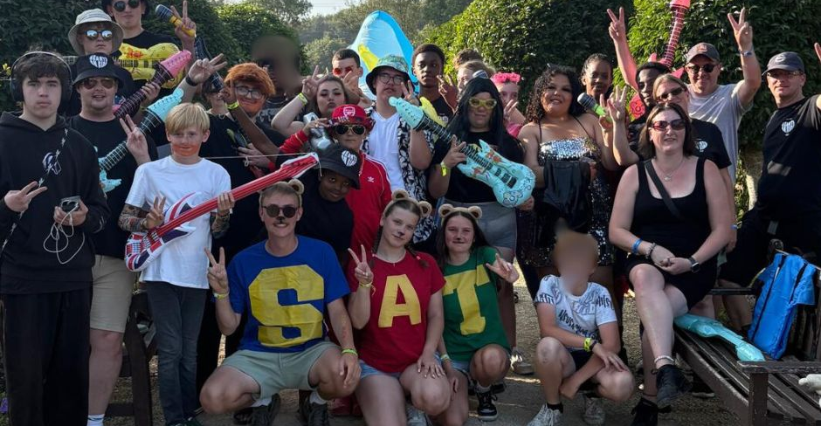
P
Prayer Focus: Shoeburyness & Thorpe Bay Baptist Church
STBBC is a lively and inclusive church. They seek to reach the community using their premises through a variety of activities. Stay & Play is for pre-school and Collective for primary school children; youth events include sleepovers and Satellites camp; senior groups include Saturday Club, Holiday at Home, and a service plus lunch. The church is a distribution centre for Southend Foodbank and operates Parish Nursing: providing whole person health care and support. This includes Singing for the Brain and Carers Wellbeing. Renew Café is a quiet space where it’s OK not to be OK and in October they ran a course for those living with depression.

Slide 2
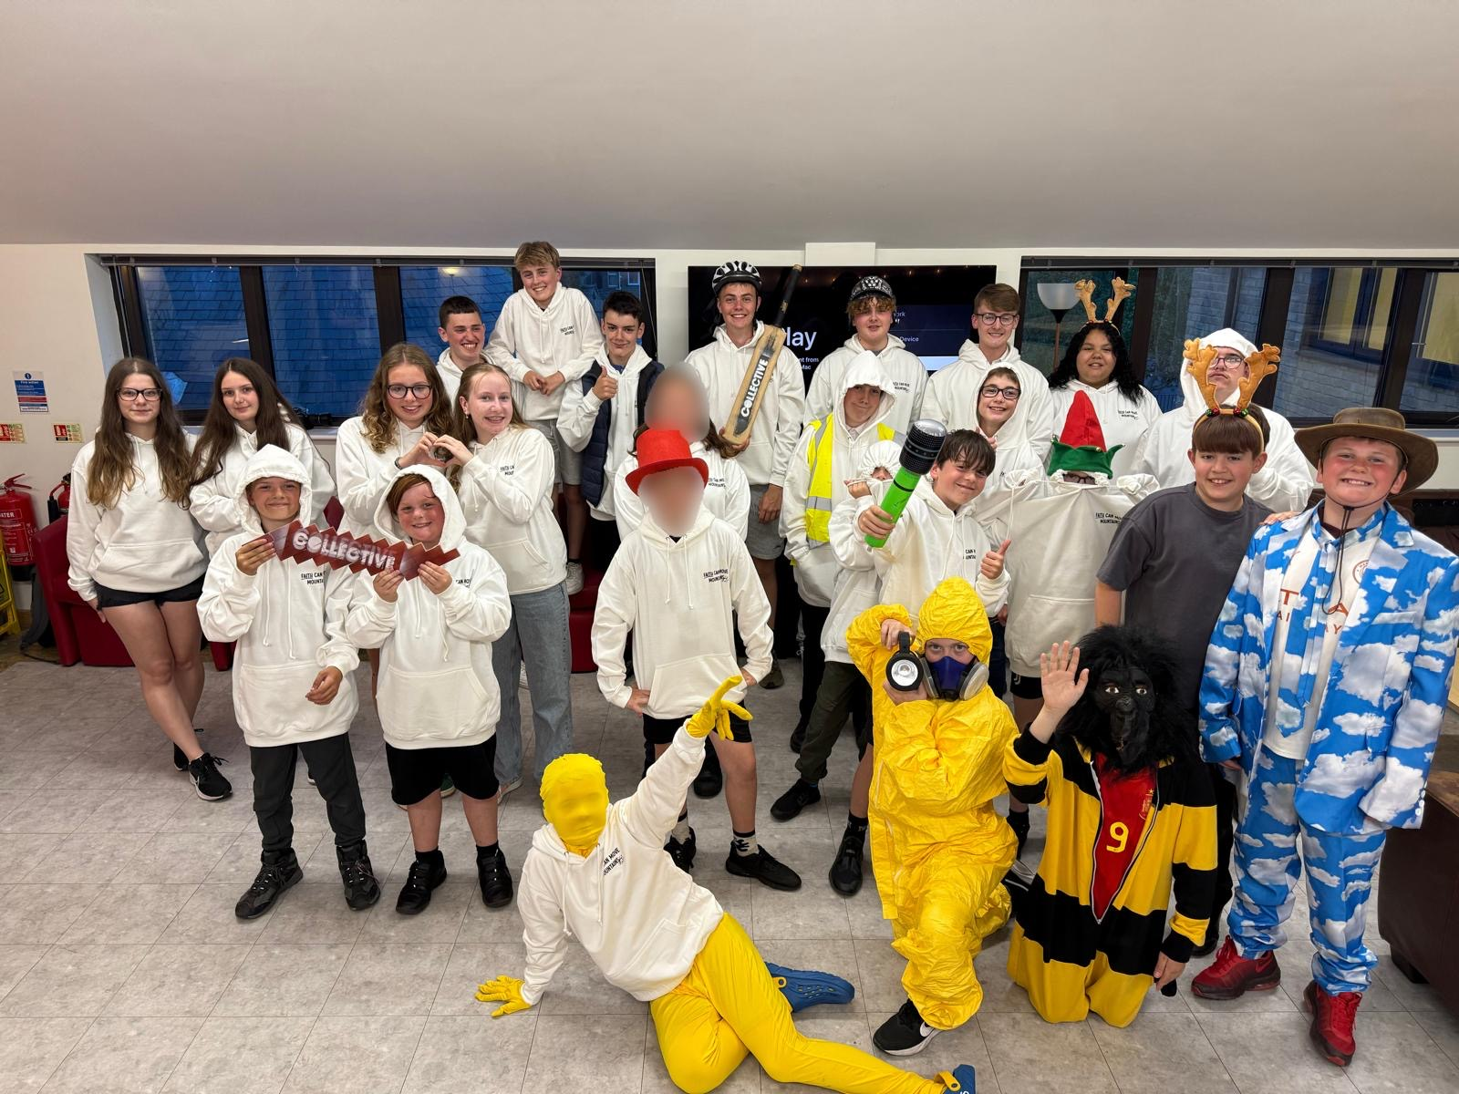
Launching soon will be a fundraising scheme, Friends of STBBC, looking to give extra support for any local community and Parish Nursing work done at the church. Could you please pray: For their minister Jo Hellenbrand and the church leadership as they take time to pause and reflect on what may happen next after the departure of their lead pastor. And that the church continues to be encouraged and thrive as they celebrate new people entering the life of the church and give thanks for the eight baptisms they have had so far this year.
P
Prayer Focus: Shoeburyness & Thorpe Bay Baptist Church

