Slide 1
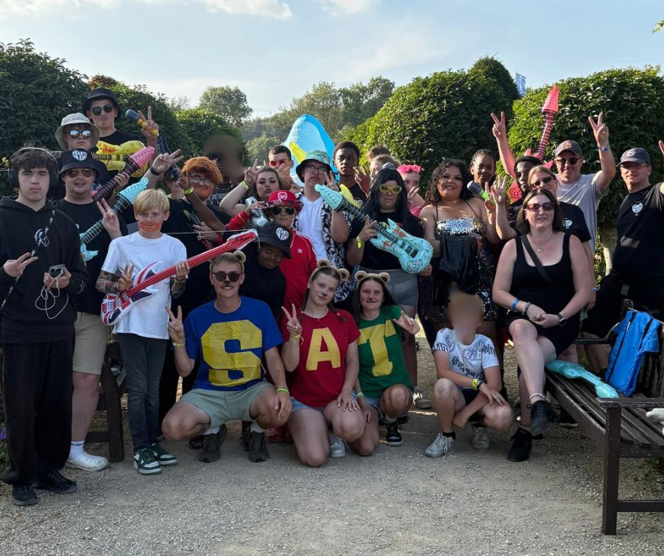
STBBC is a lively and inclusive church. They seek to reach out to the community using their premises through a variety of activities, with independent and church run groups. Stay & Play is for pre-school children and Collective for children focusing on learning new skills and faith. In addition, ad hoc events for youth include sleepovers and attending Satellites camp. Groups for Seniors include Saturday Club, Holiday at Home, and a monthly service followed by a light lunch. The church is a distribution centre for Southend Foodbank and operates Parish Nursing which seeks to provide whole person health care and support. This includes Singing for the Brain and Carers Wellbeing sessions. Renew Café which is a quiet space where it’s OK not to be OK and in October they ran a course for those living with depression.
Prayer Focus: Shoeburyness & Thorpe Bay Baptist Church

Slide 2
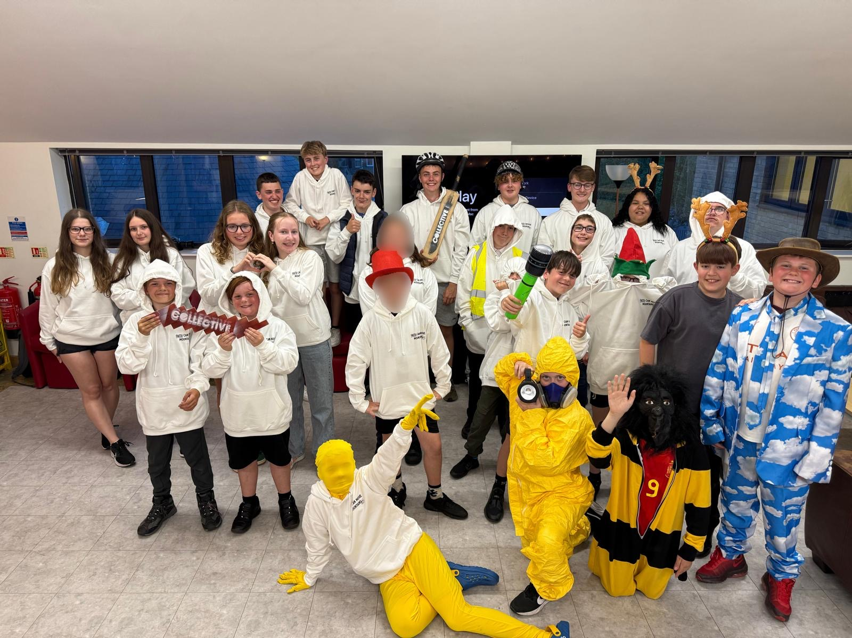
Launching soon will be a fundraising scheme, Friends of STBBC, looking to give extra support for any local community and Parish Nursing work done at the church. Could you please pray: For their minister Jo Hellenbrand and the church leadership as they currently take time to pause and reflect on what may happen next after the recent departure of their lead pastor. And that the church continues to be encouraged and thrive as they celebrate new people entering the life of the church and give thanks for the eight baptisms they have had so far this year.
Prayer Focus: Shoeburyness & Thorpe Bay Baptist Church

