Slide 1
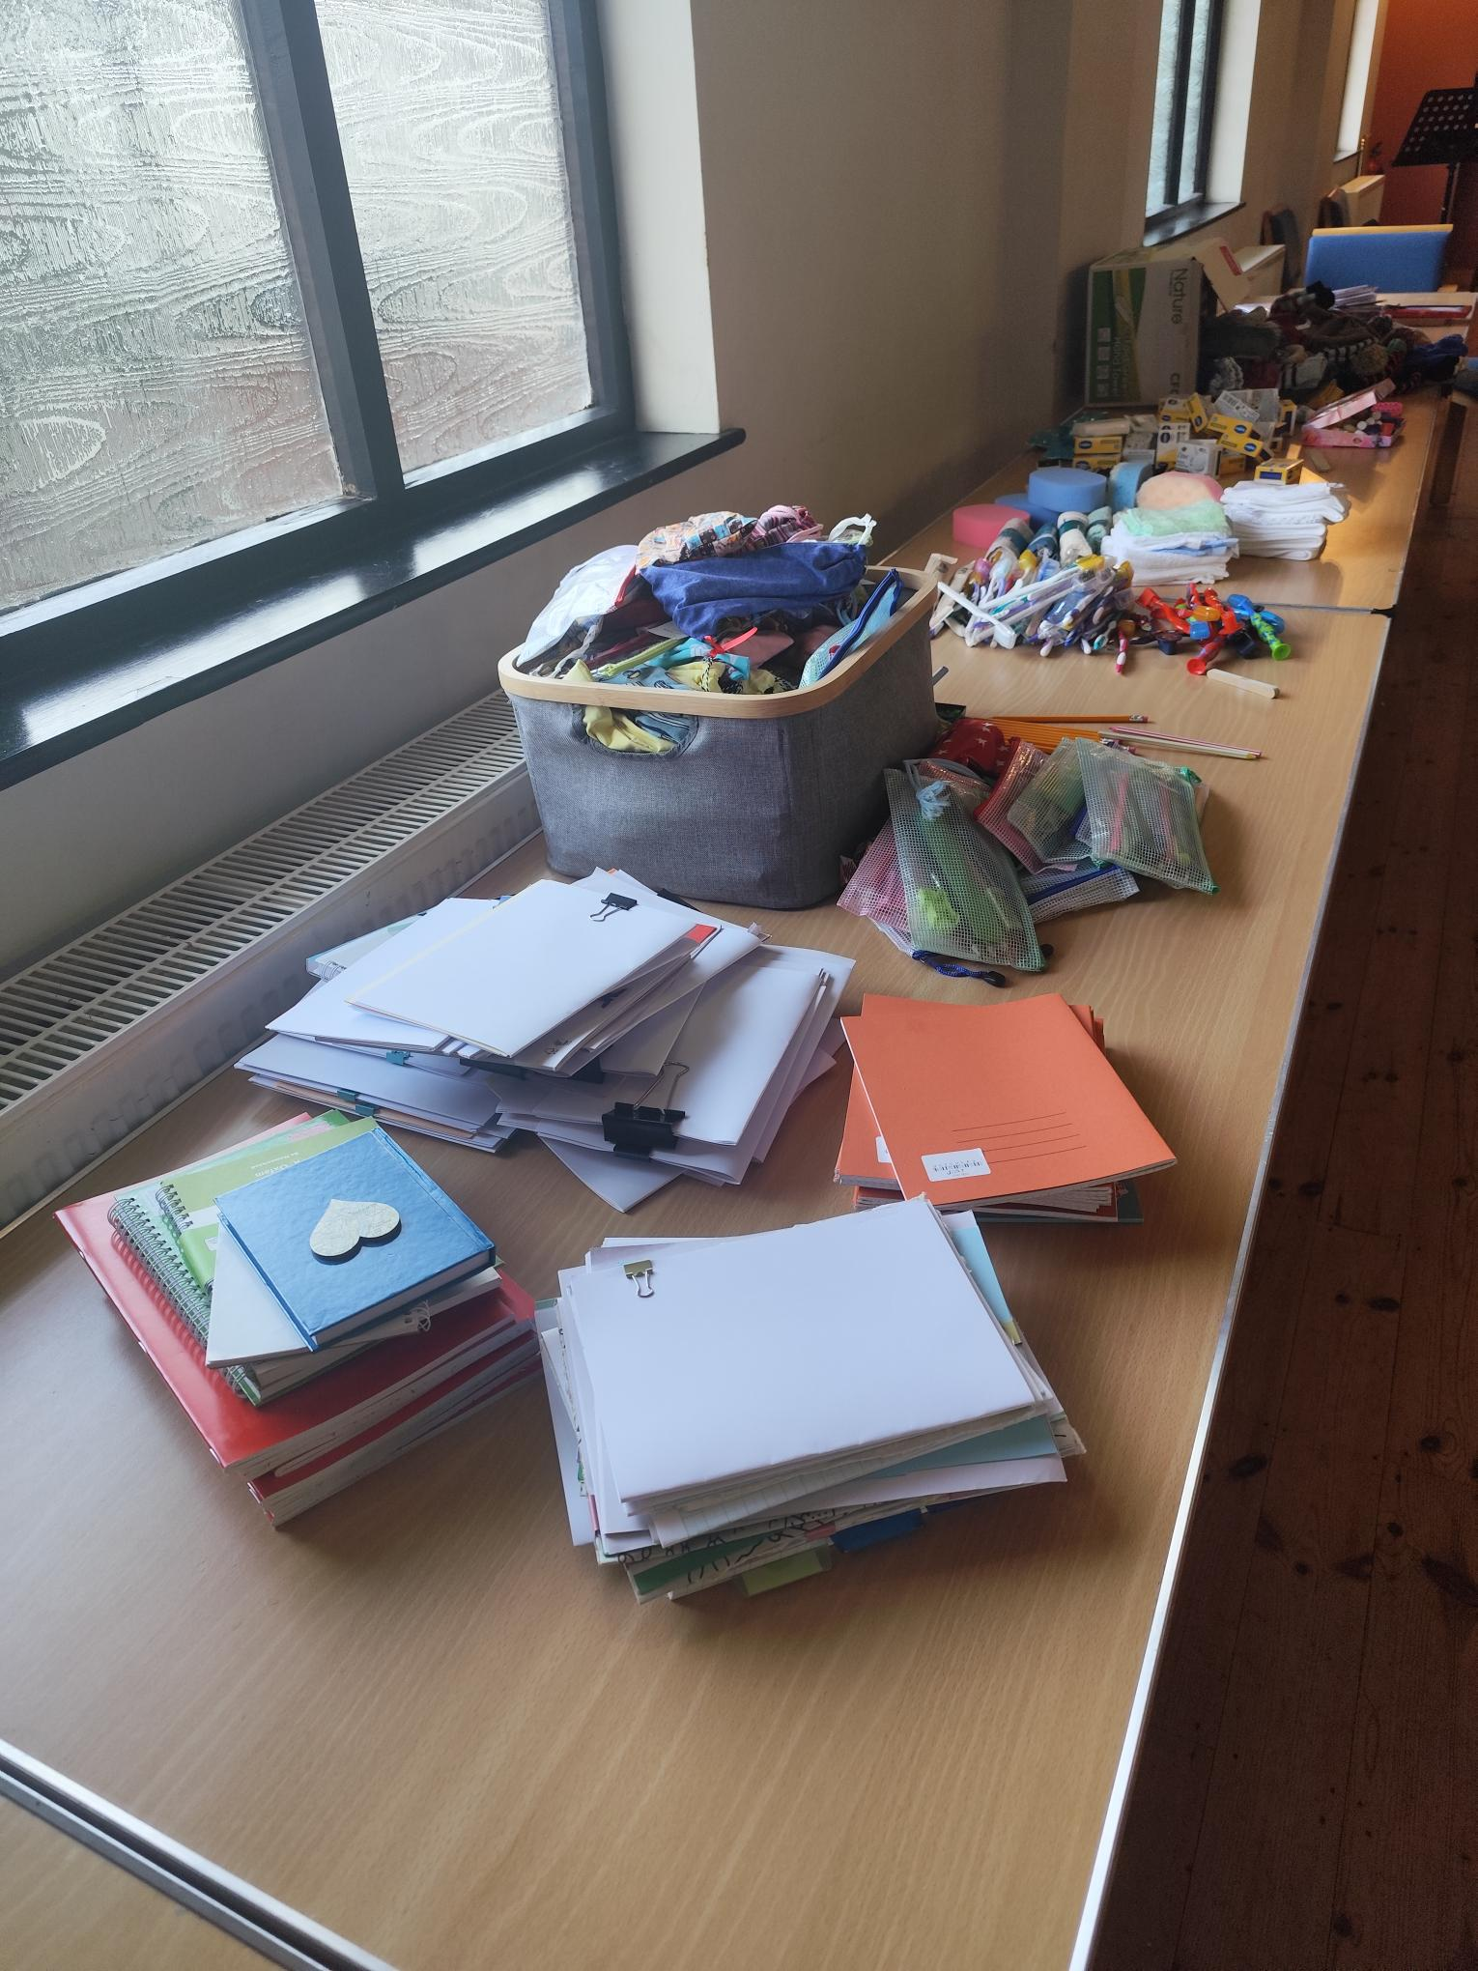
Prayer Focus: Melbourn Baptist Church, Nr Cambridge
MBC has a diverse community drawn from people in the village and the wider area. They have seen growth with new people moving into the area, and are keen to develop connections through the variety of activities they run. Their joint Ministers, Jenny and Rob Hughes, moved there about 18 months ago and continue to learn and develop ideas about how to evangelise in a mixed community setting.
Sunday morning services vary in style –informal café; all age; and task focused, for example, at the beginning of November, they filled shoeboxes.

Slide 2
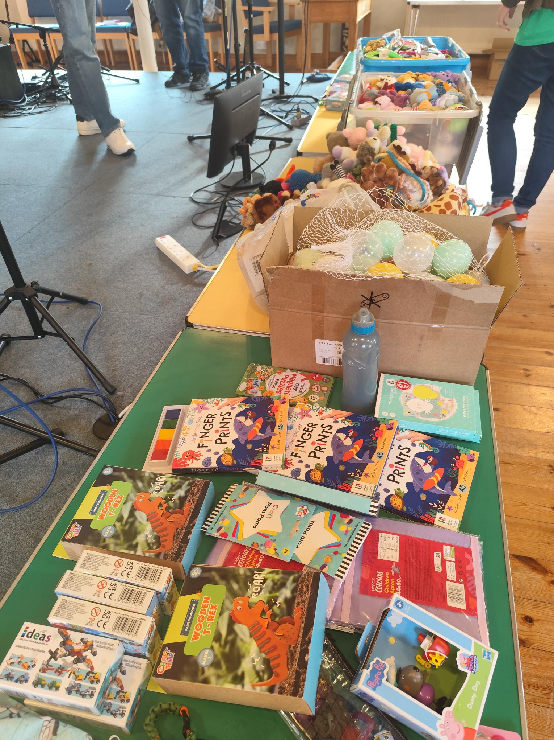
The Church has teenage, house, prayer, outreach Toddler and craft groups plus coffee morning. They hold family events and, earlier this year, they ran a CAP money coaching course and plan to do that again in 2026. Please join them in praying:
• For wisdom and discernment in finding ways to connect with a mixed community – may the Lord show the ways that He wants the Church to go.
• For a deepening of connections and relationships with people attending current activities, to enable people to encounter and build a relationship with the Lord.
• For God to bless the work with teenagers and for an increase in families outreach.
P
Prayer Focus: Melbourn Baptist Church

