Slide 1
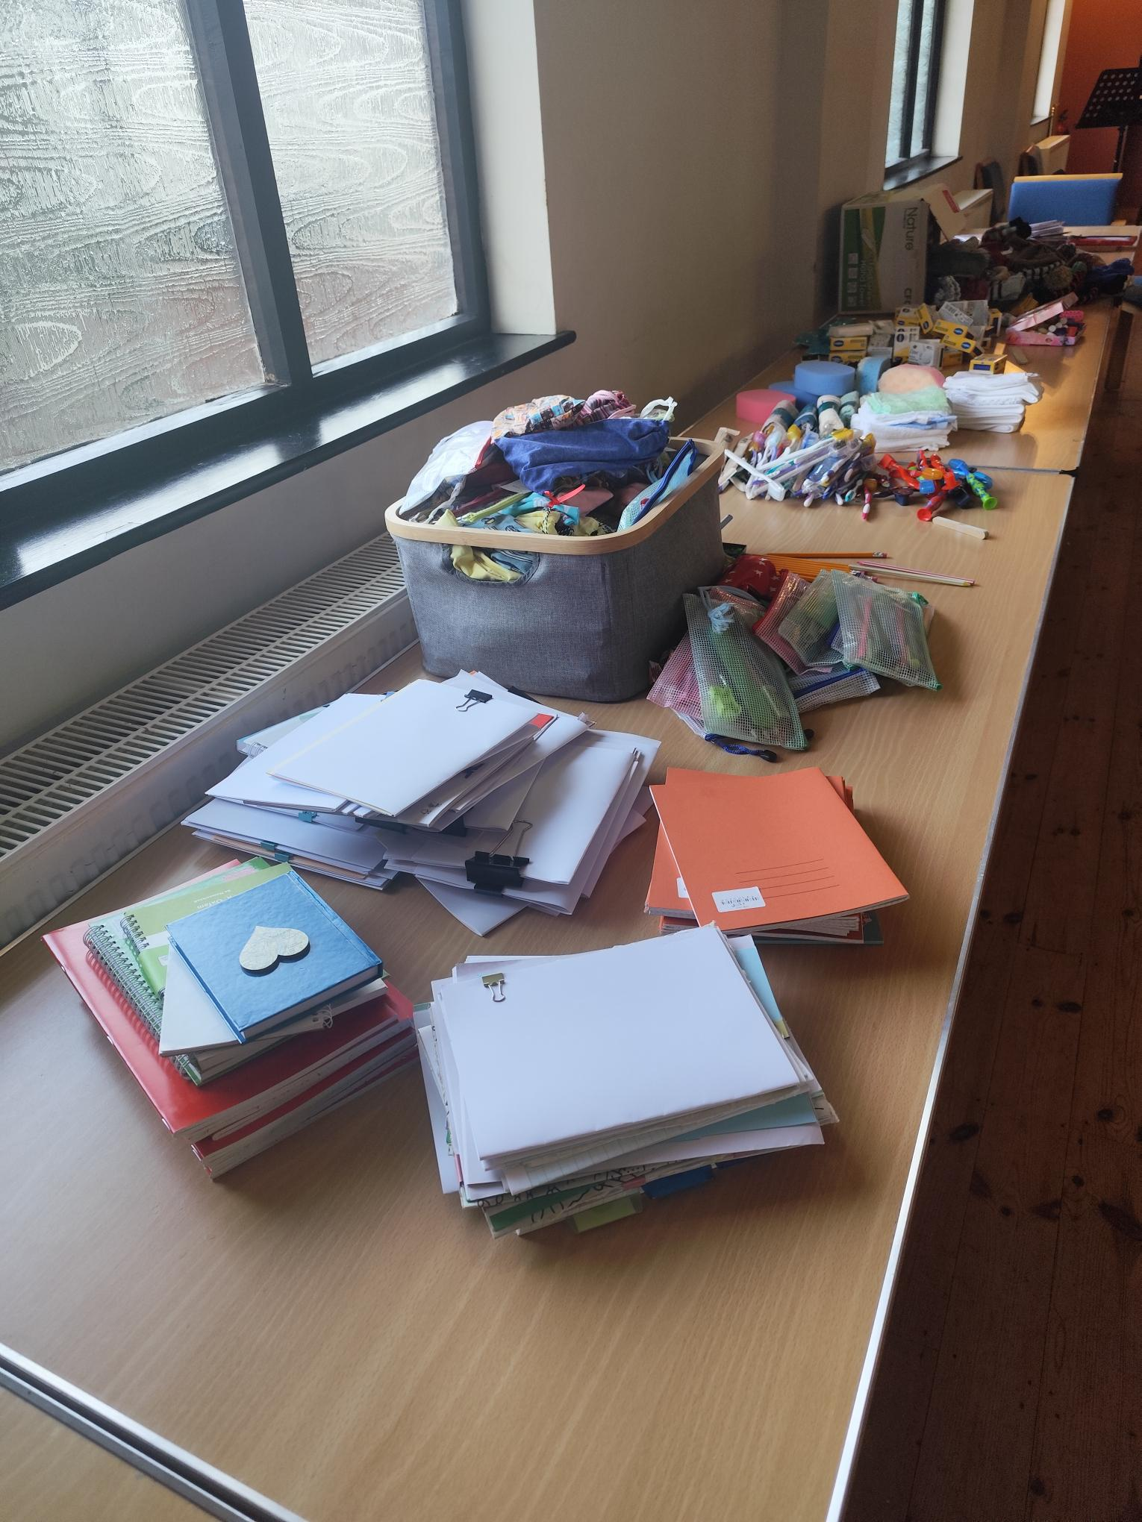
Located in the village of Melbourn, southwest of Cambridge, the Church has a diverse community drawn from people in the village and the wider area. They have seen growth in recent times with new people moving into the area, and are keen to develop connections through the variety of activities they run. Their joint Ministers, Jenny and Rob Hughes, moved there about 18 months ago and continue to learn and develop ideas about how to evangelise in a mixed community setting.
Sunday morning services vary in style – sometimes informal café style, all age once a month, and sometimes task focused to draw the Church family together, for example, at the beginning of November, they filled shoeboxes for Operation Christmas Child using items that the Church has made and collected together over the year.
Prayer Focus: Melbourn Baptist Church

Slide 2
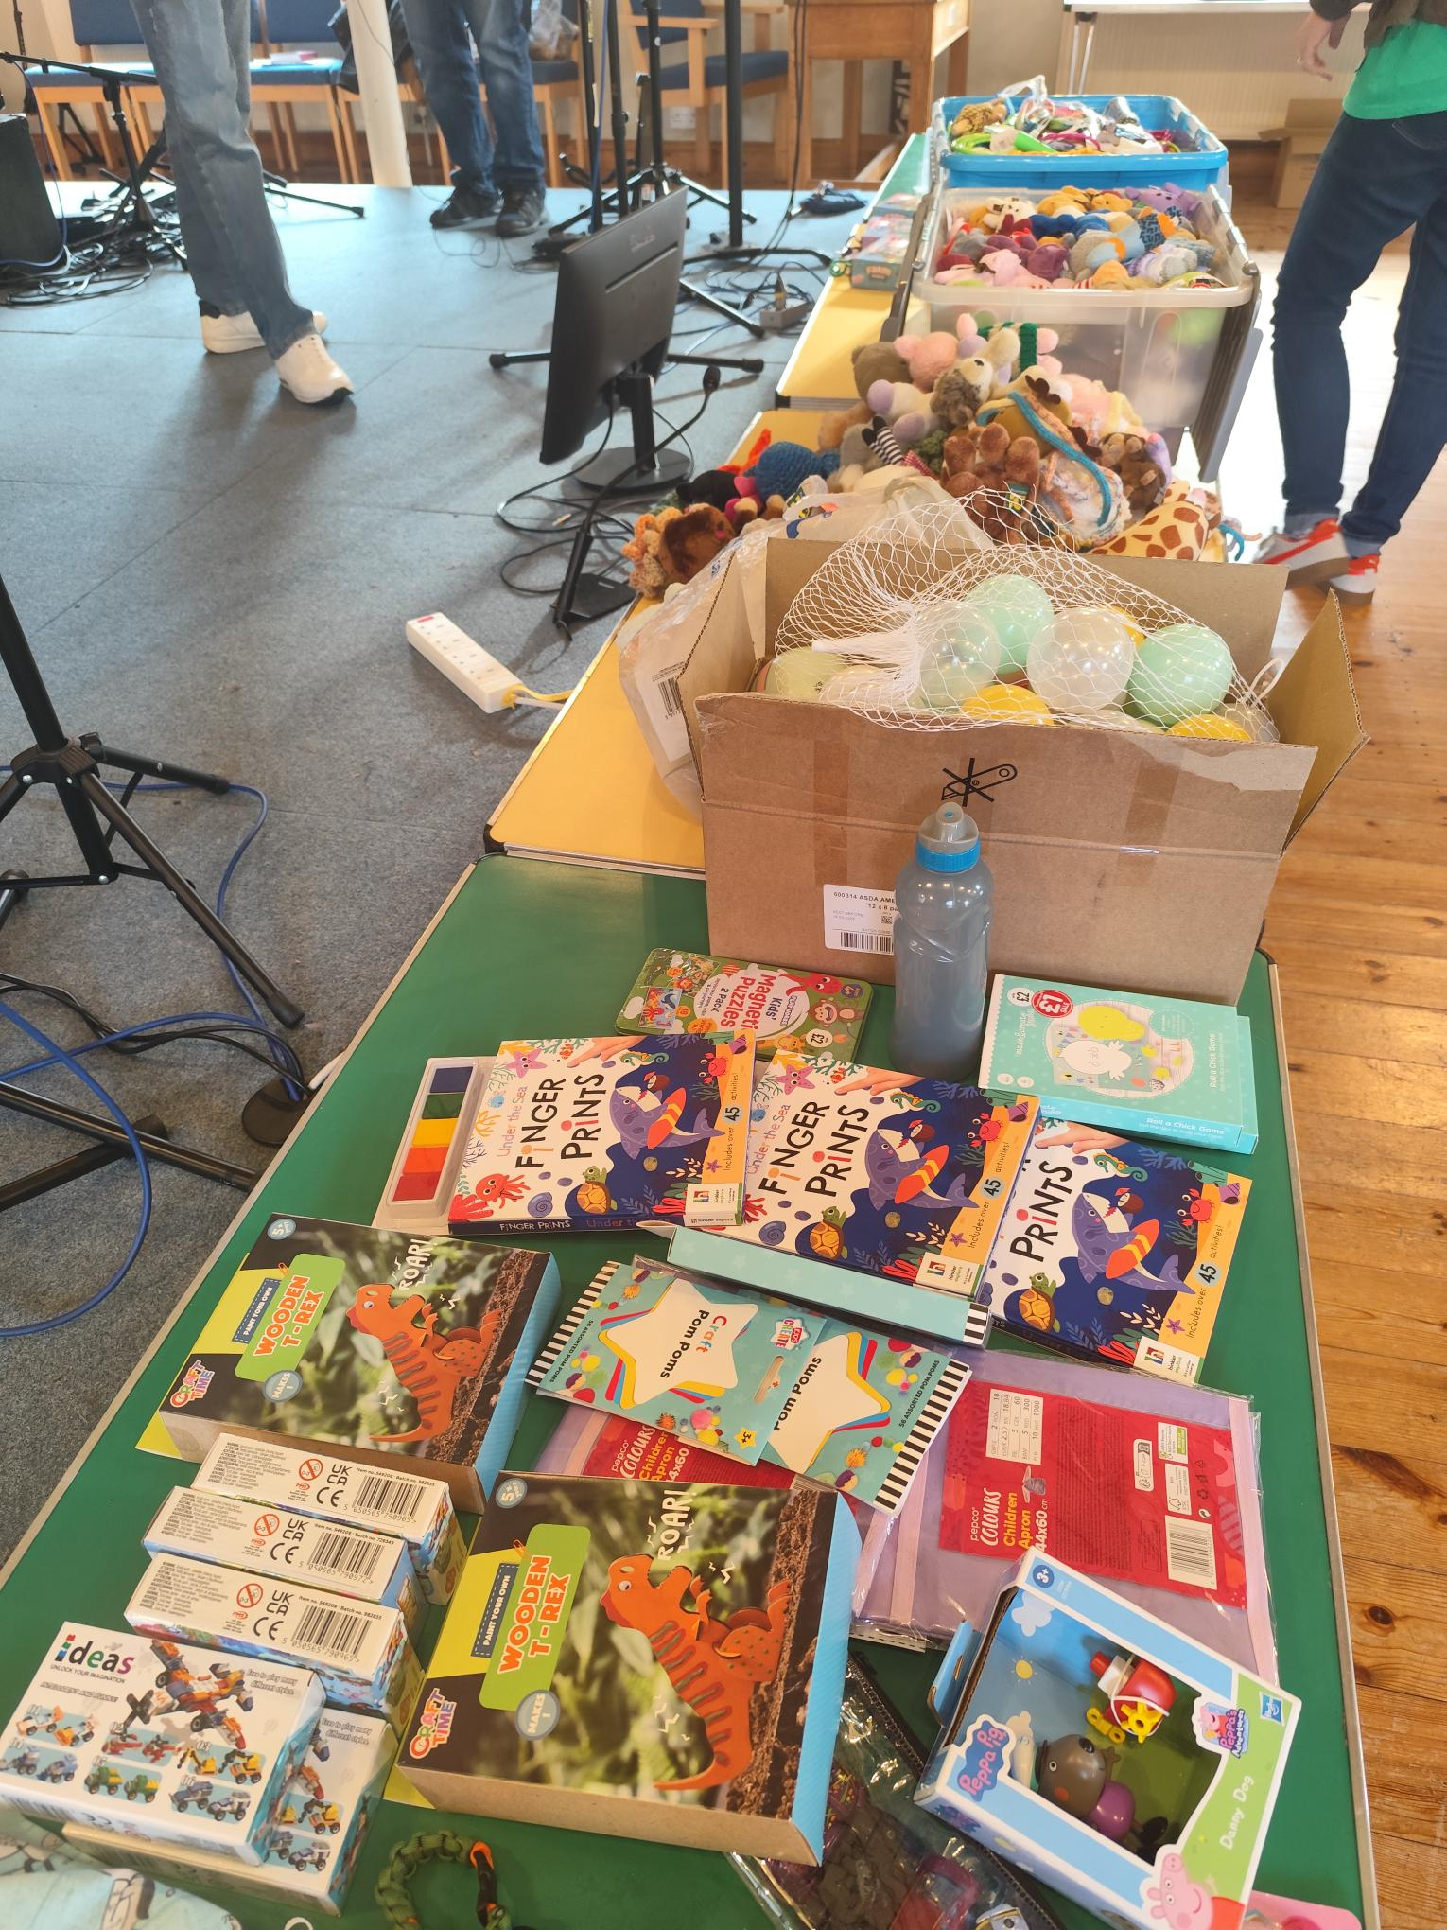
The Church has a teenage group, house groups, prayer meetings and outreach Toddler group, craft group and coffee morning. They hold events for families, such as a Children’s Cinema, and on 31st Oct held a Light Party. Earlier this year, they ran a CAP money coaching course and plan to do that again in 2026. Please join them in praying
• For wisdom and discernment in finding ways to connect with a mixed community – may the Lord show the ways that He wants the Church to go.
• For a deepening of connections and relationships with families and adults attending current activities, to enable people to encounter and build a relationship with the Lord.
• For God to bless the work with teenagers at The Grid and for the Church to be able to increase its families outreach work.
Prayer Focus: Melbourn Baptist Church

