Slide 1
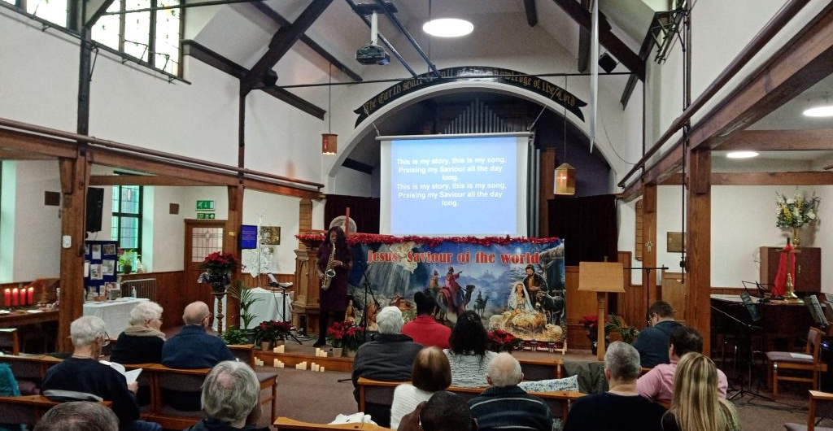
P
Prayer Focus: Attleborough Baptist Church, Norfolk
This year, Attleborough Baptist Church is celebrating 200 years of serving its local community. The Reverend Rob Gee joined the church as its pastor two and a half years ago after a long interregnum and is seeking to rebuild the fellowship. The fellowship firmly believes that church is a great place to make friends and experience God together. As well as Sunday services, the fellowship run “Warm Welcome”; and ABC Men’s Supper;Creative Club; weekly Bible study and is starting “Bible School” on Sunday evenings, following an Alpha-like approach.

Slide 2
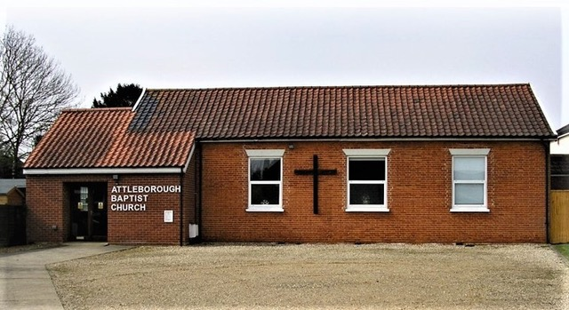
Please pray for: • The church as it seeks to develop its online presence, using its website and social media to reach its local community. • Rob and his team as they think of the future, reaching a younger age group that could lead to children and youth work becoming part of the church’s life. • Bible School on Sunday evenings as the team seek ways of reaching their local population who have little or no experience of church.
P
Prayer Focus: Attleborough Baptist Church

