Slide 1
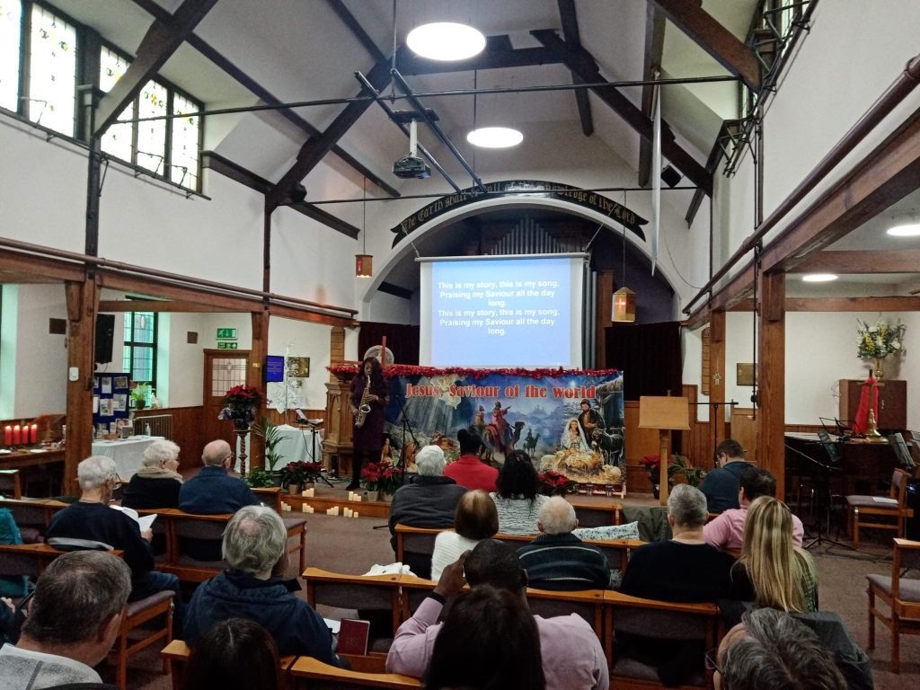
Attleborough is situated in the heart of Norfolk, about twelve miles south-west of Norwich, on the A11. This year, Attleborough Baptist Church is celebrating 200 years of serving its local community. The Reverend Rob Gee joined the church as its pastor two and a half years ago after a long interregnum and is seeking to build the fellowship up to its pre-pandemic numbers. The fellowship firmly believes that church is a great place to make friends and experience God together. As well as Sunday services, the fellowship run “Warm Welcome”, a drop-in where older members of the community receive fellowship, refreshment and the chance to play board games and socialise; ABC Men’s Supper Club is an outreach for men in the community, meeting on the third Monday of the month.
Prayer Focus: Attleborough Baptist Church

Slide 2
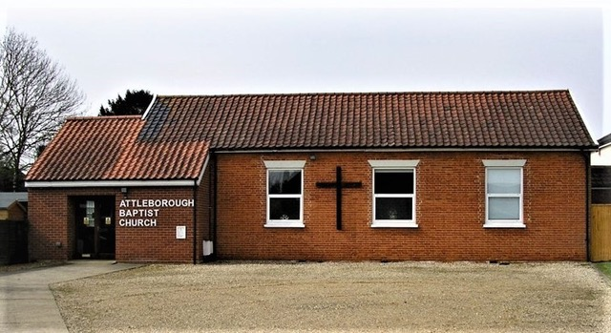
Another outreach for women of all ages is the Creative Club, which meets on the fourth Saturday of the month. The church also runs a weekly Bible study on Thursday afternoons, and is starting “Bible School” on Sunday evenings, following an Alpha-like approach. Please pray for: • The church as it seeks to develop its online presence, using its website and social media to reach its local community. • Rob and his team as they think of the future, reaching a younger age group that could lead to children and youth work becoming part of the church’s life. • Bible School on Sunday evenings as the team seek ways of reaching their local population who have little or no experience of church.
Prayer Focus: Attleborough Baptist Church

