Slide 1
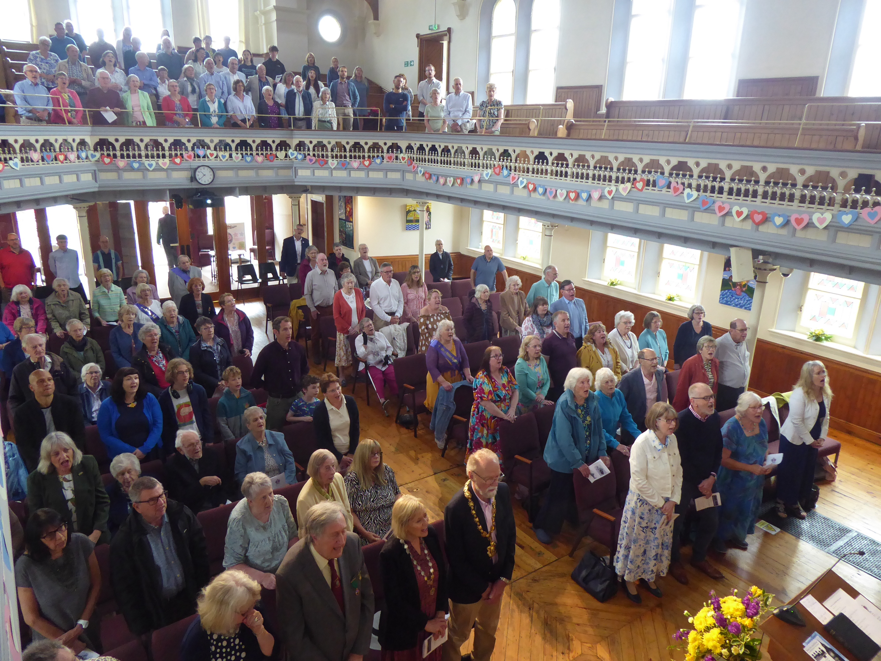
Safron Waldon Baptist Church is a friendly, welcoming and inclusive church which is part of their local community in this rural, historic market town. They are a gently growing congregation. You will find around 60 adults in their weekly services; however, regular parade services attract around 150 young people associated with the Brownies, Boys’ Brigade, and Scouts. These uniformed organisations and Messy Church, occur alongside other social outreach activities, including Foodshare, which sees around 50 people come for groceries, coffee and a chat. They also have deepening relationships with the local retirement flats, and many attend their lunch club. Their church building is in constant use by many local groups, deepening community relations.
Prayer Focus: Safron Waldon Baptist Church

Slide 2
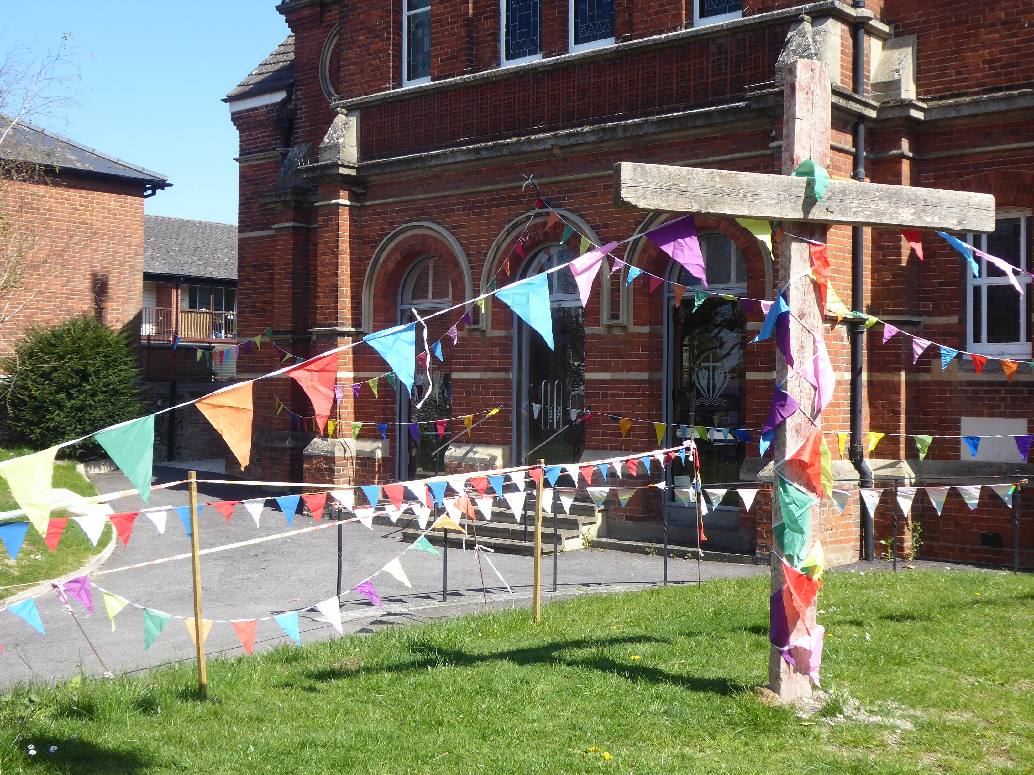
Their minister John, returns from Sabbatical, after walking 150 miles of rivers and coasts in the EBA, with a renewed passion. He is an advocate for celebrating diversity within the Baptist family and in his local community. Following their 250th anniversary last year, the church continues to look to the future. They remain focused on sharing the love of Jesus and being the church the community needs. Please pray: • That they continue to be a faithful presence, bringing the love of Jesus. • For deepening relationships with building users, maintaining hospitality • For the Boys Brigade as they grow new leaders from their ranks • For those in the congregation with health issues, their friends and family • For the current and future deacons.
Prayer Focus: Safron Waldon Baptist Church

