Slide 1
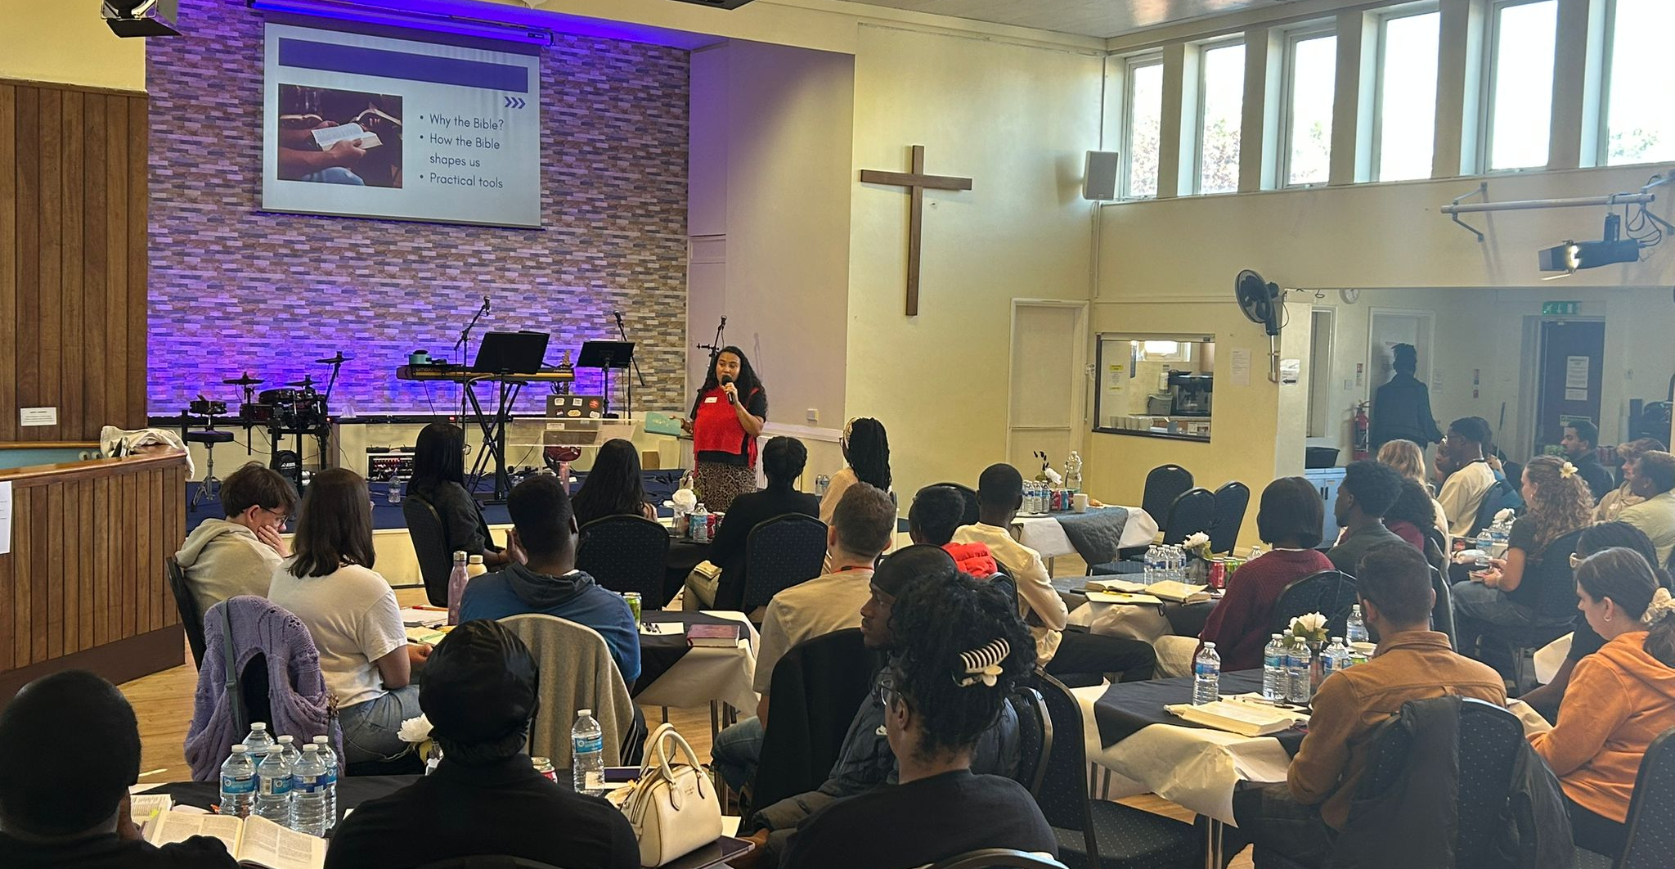
We are a growing, multi-ethnic and inter-generational fellowship: committed to being and making disciples of Jesus. We are extremely grateful to those churches who have supported us in the 2 years since our Minister left.
We continue to see 160 people attending our two services on a Sunday and most months we see new faces. Our desire is to be a place to grow, so we are trusting that a new minister will provide continuity to allow the new faces to settle with us.
We have continued to be forward-looking, launching new growth groups, investing in our online ministry and our recent Young Adults weekend.
P
Prayer Focus: Kingswood Baptist Church, Basildon

Slide 2
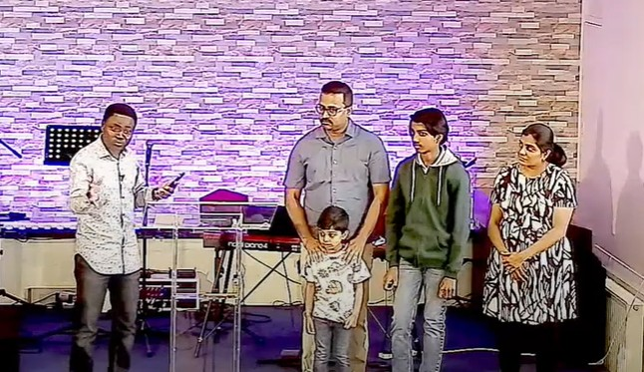
The recent appointment of our Youth and Outreach Worker has enabled a focus on our teenagers, including running Youth Alpha. We are due to apply for pre-planning permission to expand our premises, providing opportunities for mission. Please pray:
• For the Young adults who attended our weekend
• For the Youth Alpha programme
• For the Youth and Outreach Worker, as he engages with the young people
• For the search for a new senior minister.
• For the building plans, that it may receive favourable feedback from the local council.
P
Prayer Focus: Kingswood Baptist Church

