Slide 1
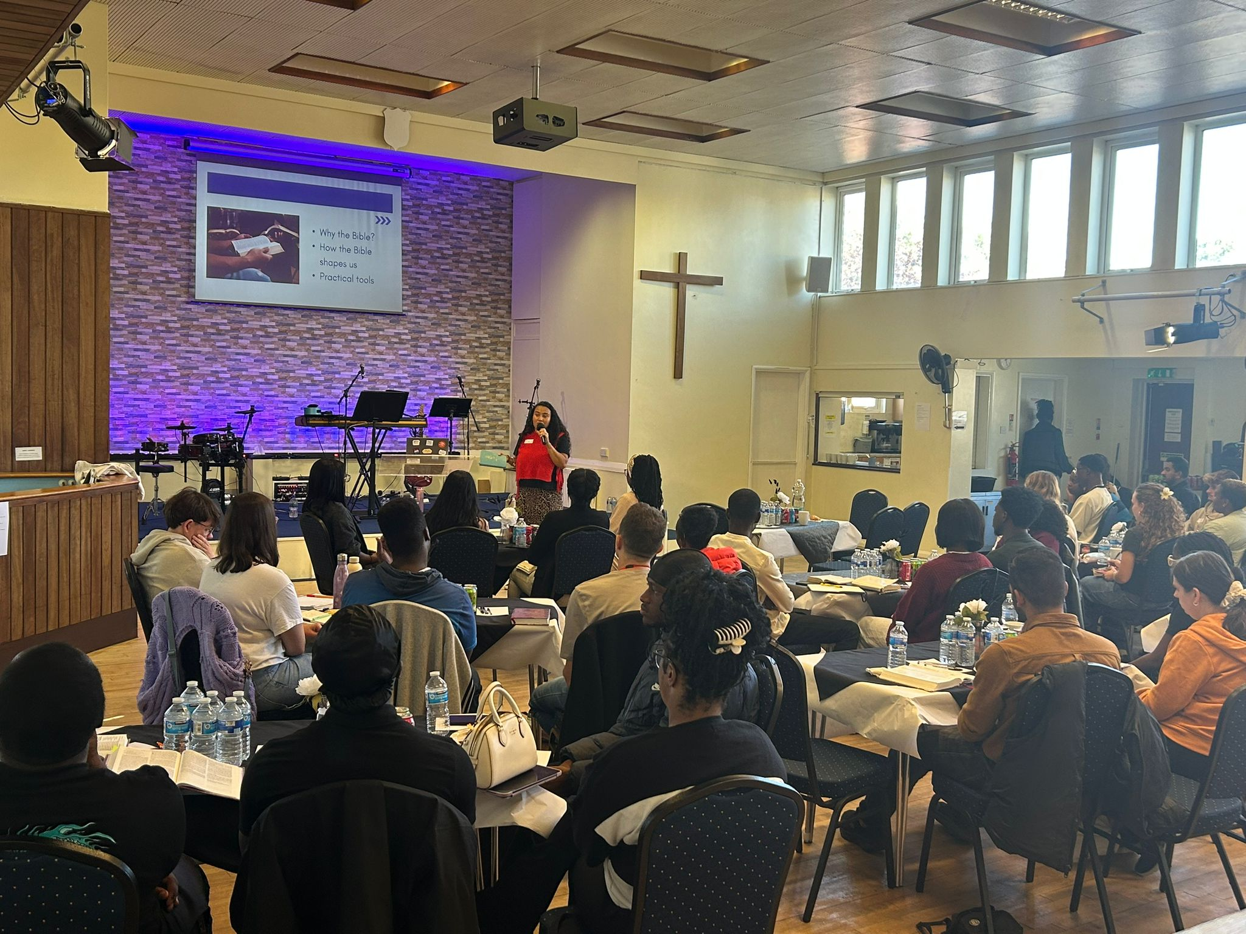
We are a growing, multi-ethnic and inter-generational fellowship located in Basildon: committed to being and making disciples of Jesus. We are extremely grateful to those churches who have been supporting us in the 2 years since our Minister left.
We continue to see 160 people attending our two services on a Sunday and most months we see new faces. Our desire is to be a place to grow, so we are trusting that a new minister will provide some continuity to allow the new faces to settle with us.
We have continued to be forward-looking, launching new growth groups, we continue to develop and invest in our online ministry, reaching people beyond our building.
We give thanks for the number of people who engaged in our recent Young Adults weekend. Our teaching theme was ‘going deeper with God’.
Prayer Focus: Kingswood Baptist Church

Slide 2
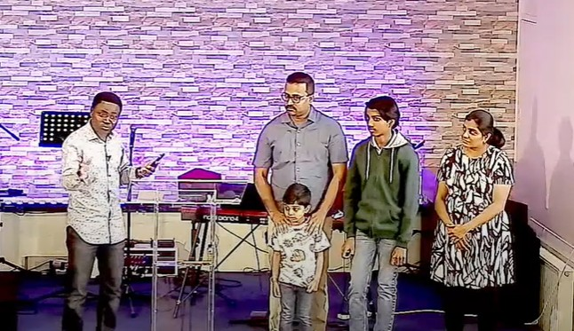
The recent appointment of our Youth and Outreach Worker has enabled a focus on our teenagers, including running Youth Alpha. We are shortly due to apply for pre-planning permission to expand our premises, providing opportunities for missional activities.
Please pray for our:
• Young adults who attended our weekend that they may grow and step into what God’s has planned for them.
• Youth Alpha programme, as the teenagers explore questions about life, and grow in their faith and experience of God.
• Youth and Outreach Worker, as he engages with the young people around our church.
• Search for a new senior minister.
• Building plans, that it may receive favourable feedback from the local council.
Prayer Focus: Kingswood Baptist Church

