Slide 1
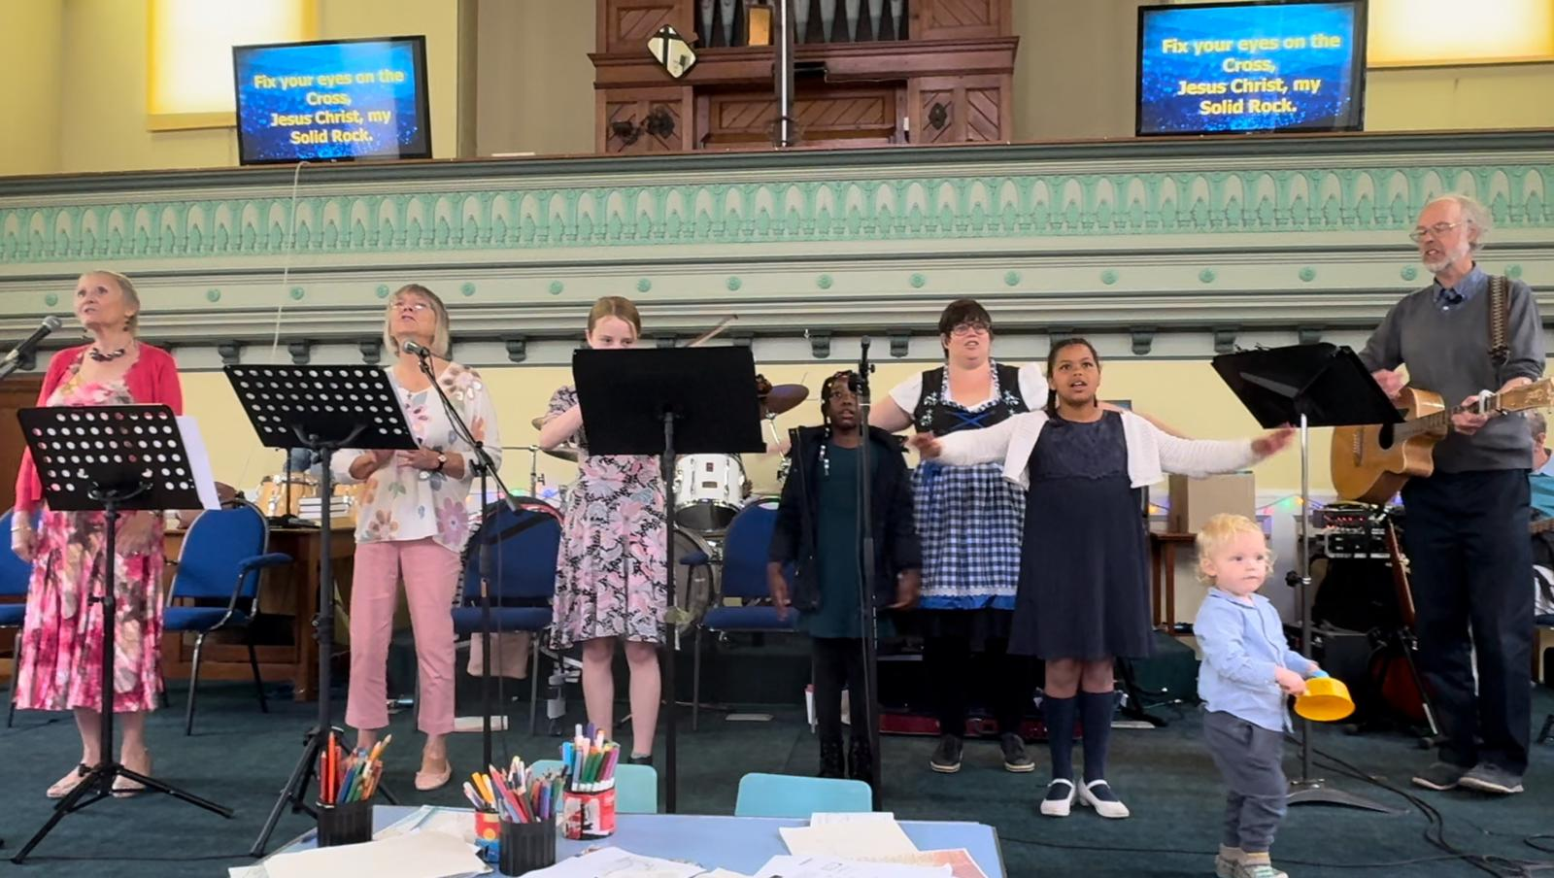
Since 1653, this thriving church remains dedicated to its core mission: placing Jesus at the centre of everything and sharing His love with the community. The church premises are a community hub, hosting a weekly Food Bank, Community Fridge, and Warm Space alongside creative and social groups like Messy Church, Bible art, and table tennis. Their "Community Scene" magazine, delivered to every door in Stalham three times a year, opens a window into church life and provides vital local information, sparking conversations across the town. Further strengthening this connection, the church is open every weekday morning for drop-in conversations
P
Prayer Focus: Stalham Baptist Church, Norfolk Broads

Slide 2
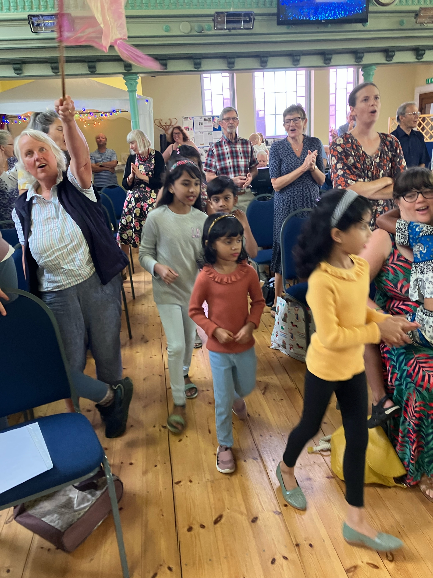
Under the steady leadership of Minister Ron and his wife, who have the congregation are bearing fruit as young people get involved, a new Alpha course runs, and over 60 Bibles have been distributed to eager readers of all ages through a local charity shop. Please pray: • For unity and an outward focus in the church • For the current Alpha group • For the annual standing-room-only Christmas Carols at the local pub
P
Prayer Focus: Stalham Baptist Church

