Slide 1
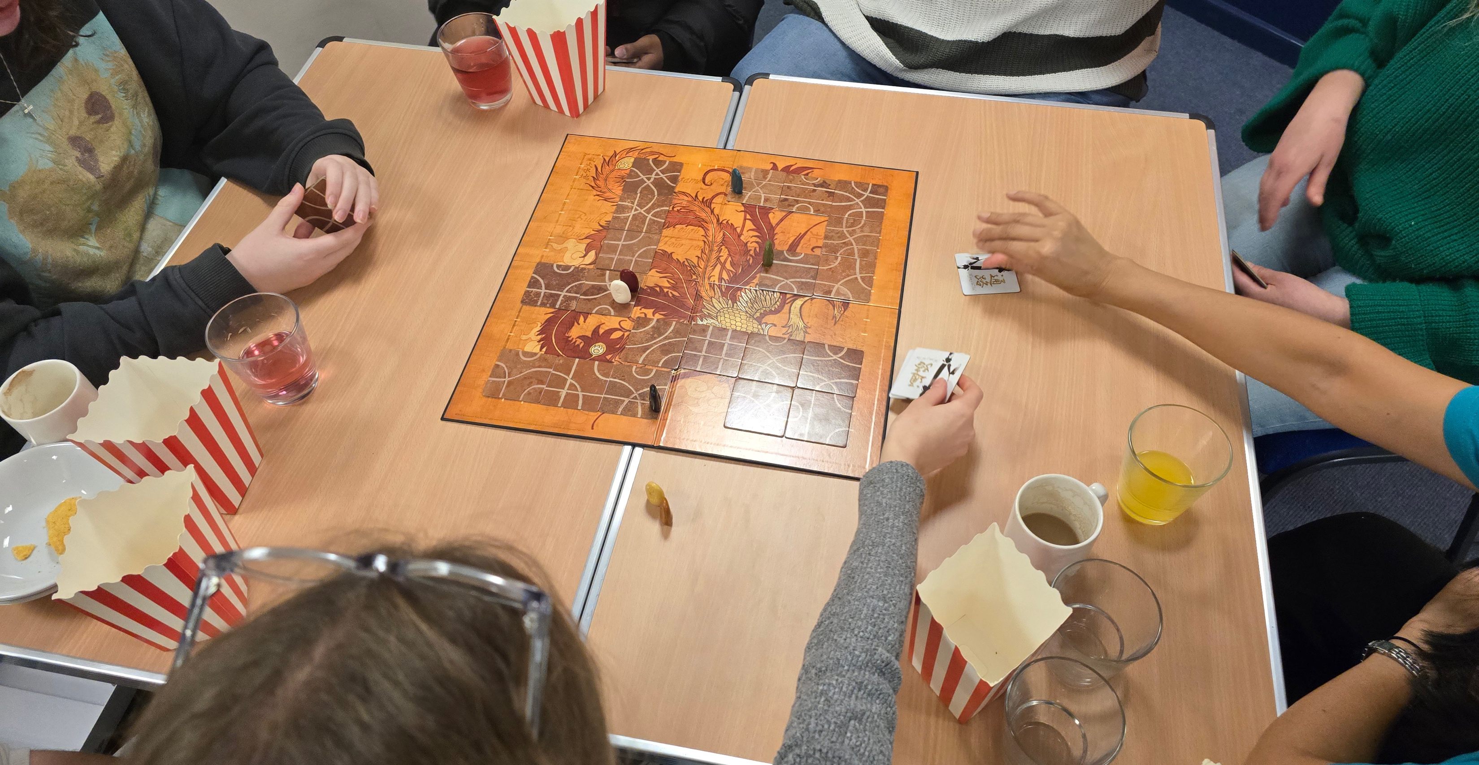
Holly Lodge Baptist Church is a small, but growing church amid large churches. Their building assists the church in being a community-based, family-friendly, and theology-based church. Their aim is to be the church that the community want to attend. They have many outreach activities, including film and games nights with a cinema-style popcorn machine, house group, youth-led activities, and a free cafe Shane has been their minister for 5 years. He is ex-military and ex police, and his practical side can be seen in his preaching..
P
Prayer Focus: Holly Lodge Baptist Church

Slide 2
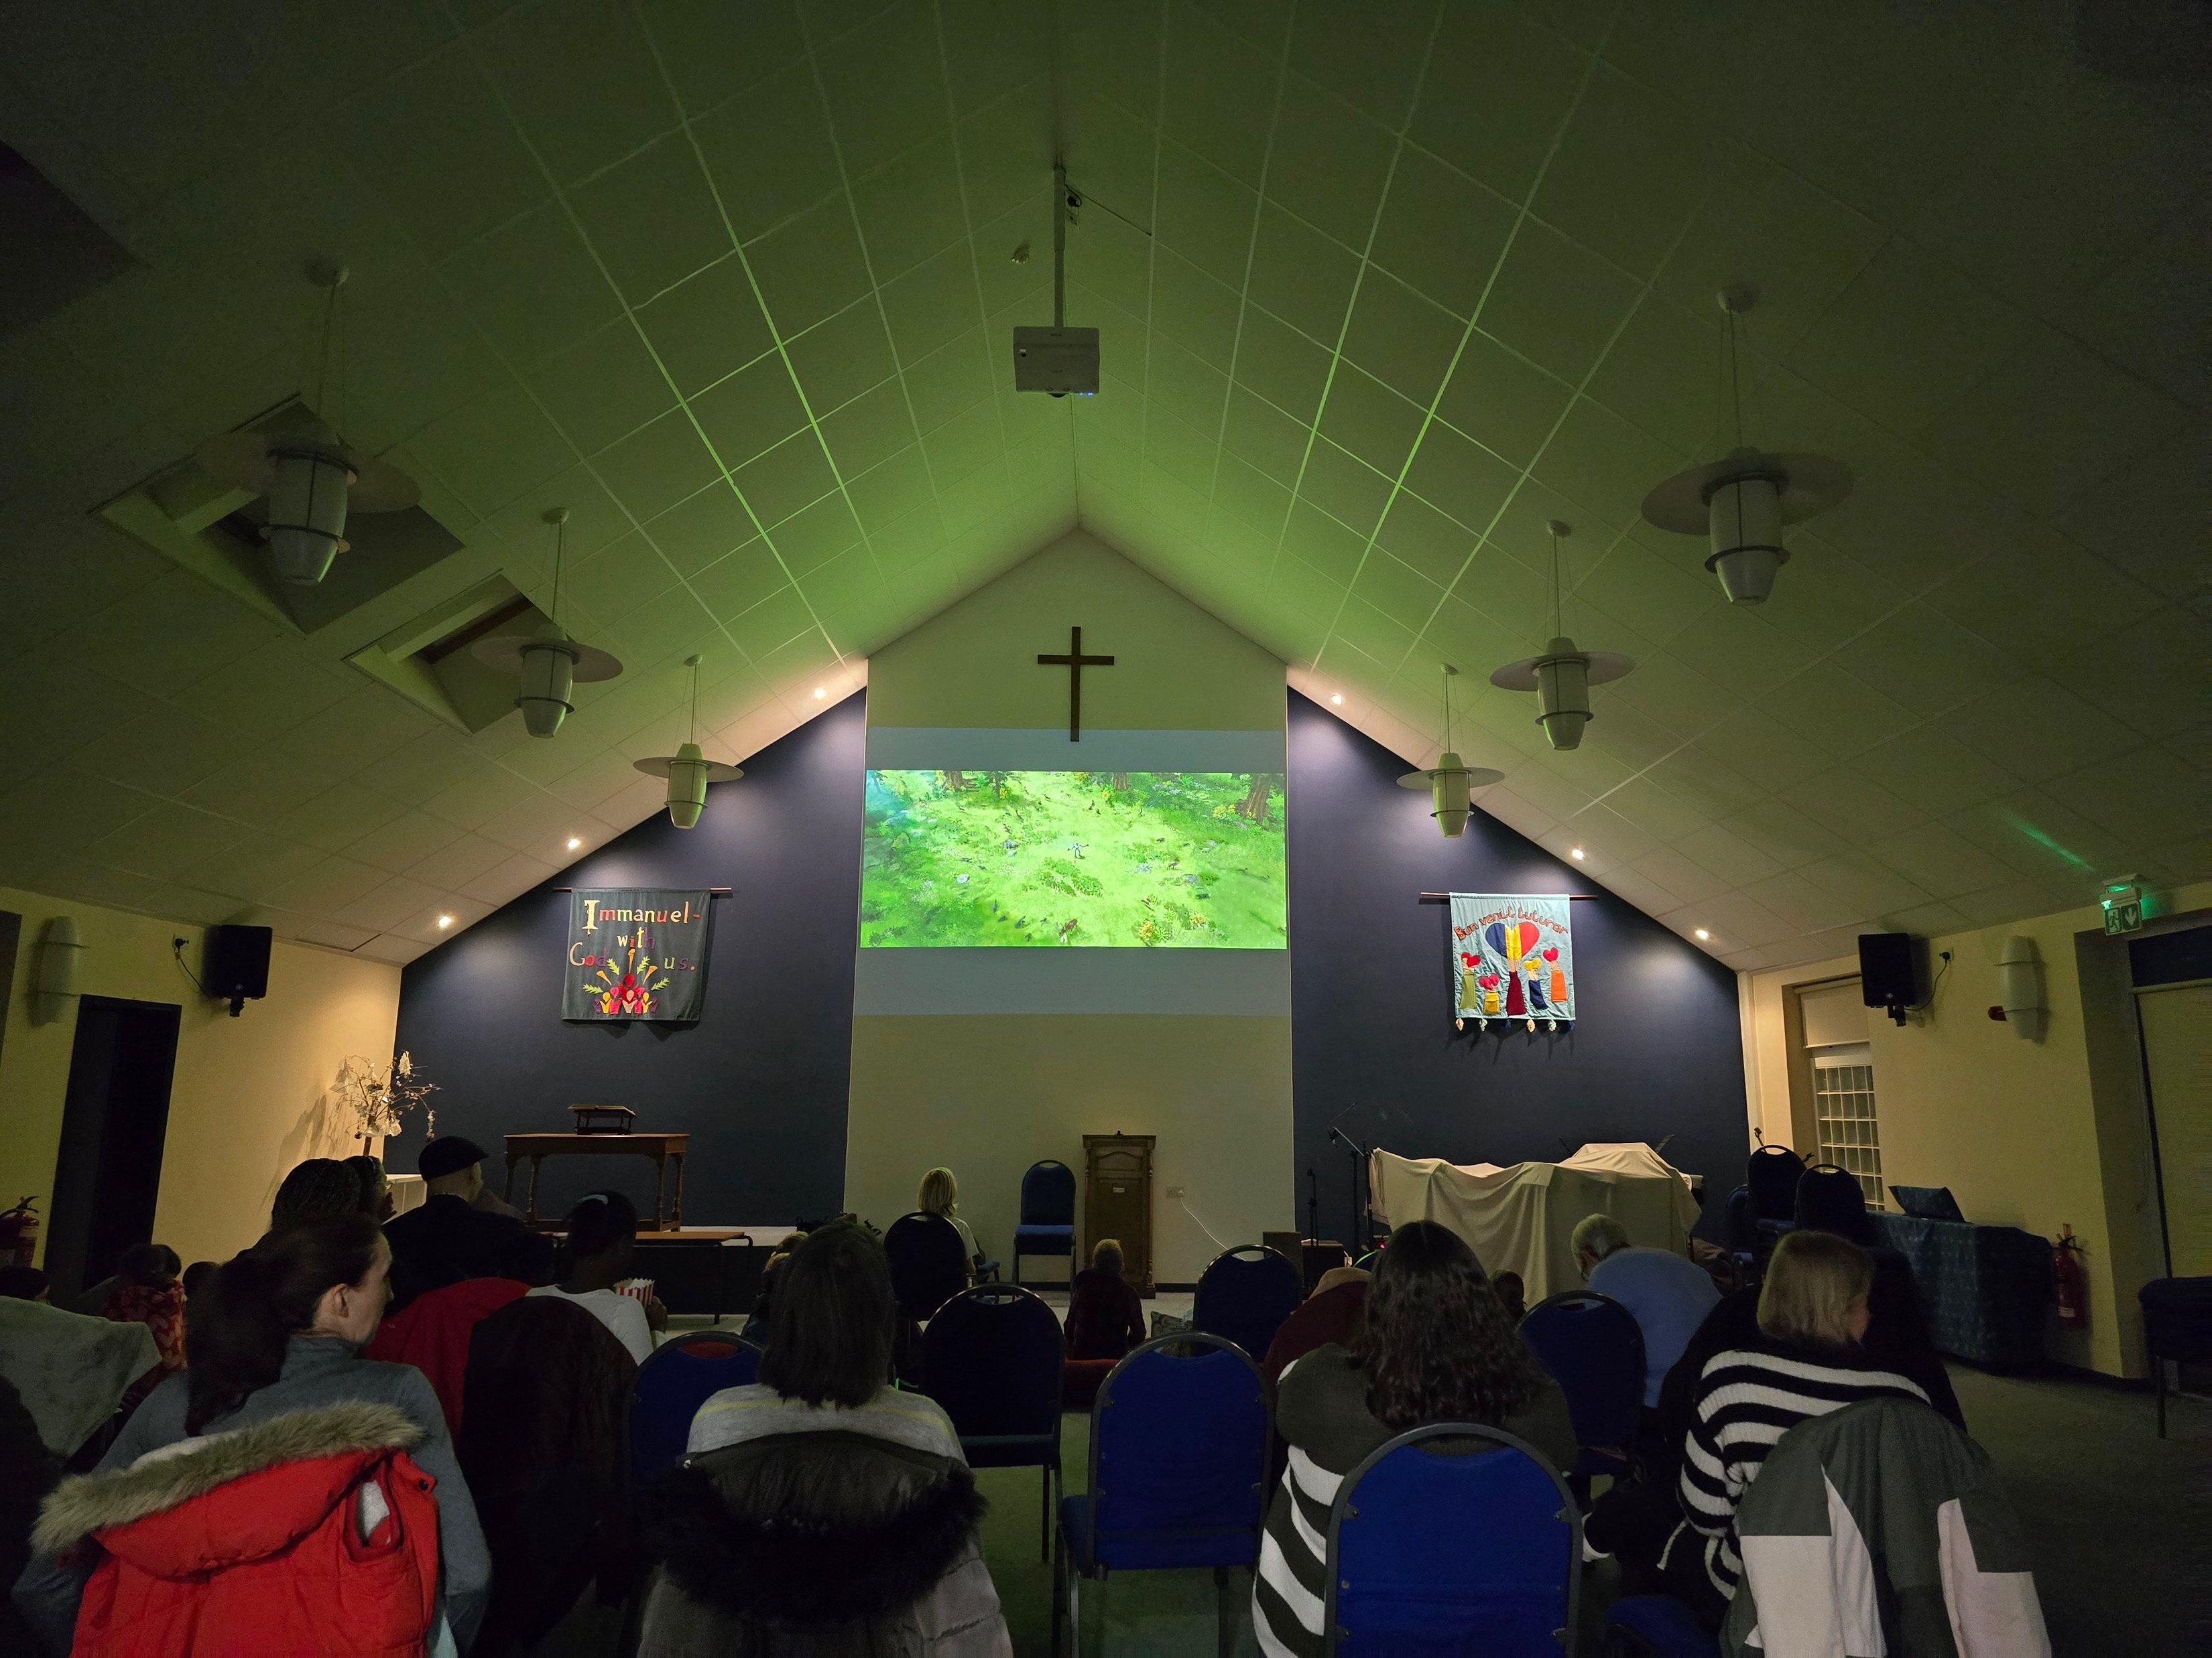
They are looking forward to 5 baptisms and the church weekend away. Looking forward, the church is restructuring leadership, as the number of people able to be trustees is low. Therefore, they are creating teams to cover roles, allowing the whole church to be involved, even if it is very occasionally. Please Pray: • That the restructuring may be fruitful • That they may know the community needs and how to fulfil this in a Biblical way • For the young people going to university, for places to support & maintain their faith • For some youth going on a 3 month mission trip, for support and arrangements
P
Prayer Focus: Holly Lodge Baptist Church

