Slide 1
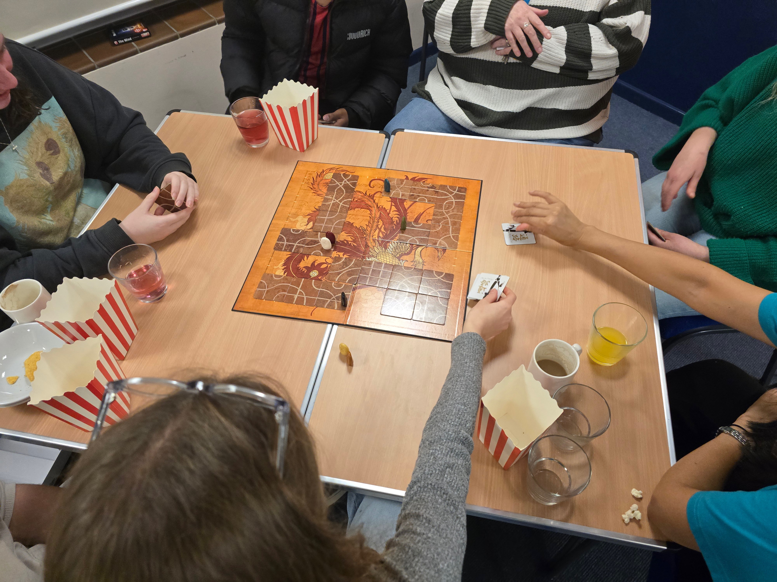
Holly Lodge Baptist Church is a small church amid large churches. It is a growing church in all aspects: in number and its focus on where God is calling them. Their building assists the church in being a community-based, family-friendly, and theology-based church. Their aim is to be the church that the community, especially non-churchgoers, want to attend. They have many outreach activities, including film and games nights where the cinema-style popcorn machine is used, house group, youth-led activities, and a cafe with free coffee and cake to relax in. Shane has been their minister for 5 years. He is ex-military and ex police, and his practical side can be seen in his preaching. He focuses on how we can apply the teaching to our everyday lives to make things better.
Prayer Focus: Holly Lodge Baptist Church

Slide 2
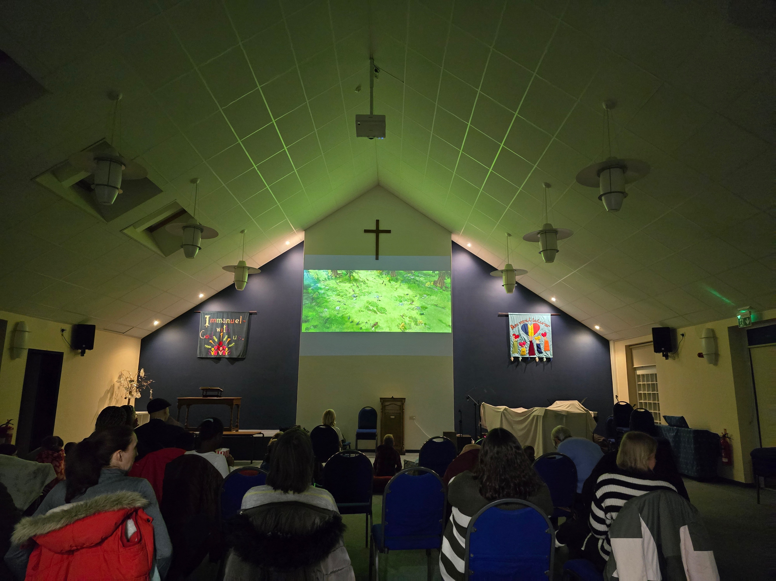
They are looking forward to 5 baptisms in the next few weeks and the church weekend away, which will celebrate those going to university. Looking forward, the church is restructuring how they lead, as the number of people able to be trustees is low. Therefore, they are creating teams to cover roles, allowing the whole church to be involved, even if it is very occasionally. Please Pray: • That the restructuring may be fruitful • That they may know the community needs and how to fulfil this in a Biblical way • For the young people going to university, for places to support & maintain their faith • For some youth going on a 3 month mission trip, that the church may appropriately support them and for arrangements
Prayer Focus: Holly Lodge Baptist Church

