Slide 1
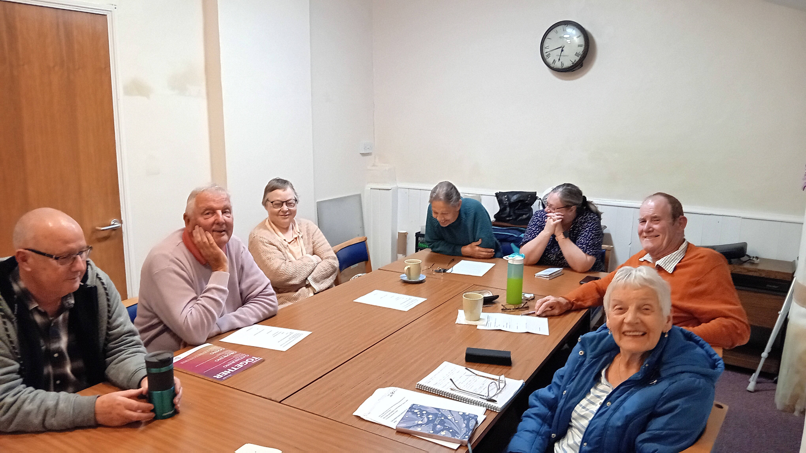
Landbeach and Milton Baptist Church is a long-established church which has a small and ageing congregation and has been in decline for some time, but now green shoots are beginning to appear, with attendance increasing. There is a deep thankfulness for the commitment and sacrifice of the long-standing church membership in time, energy and money, alongside support received from other churches, which includes preachers and financially aiding in calling Chris to become Pastor. Another example is their Treasurer, who is from another church.
P
Landbeach & Milton Baptist Church, Nr Cambridge

Slide 2
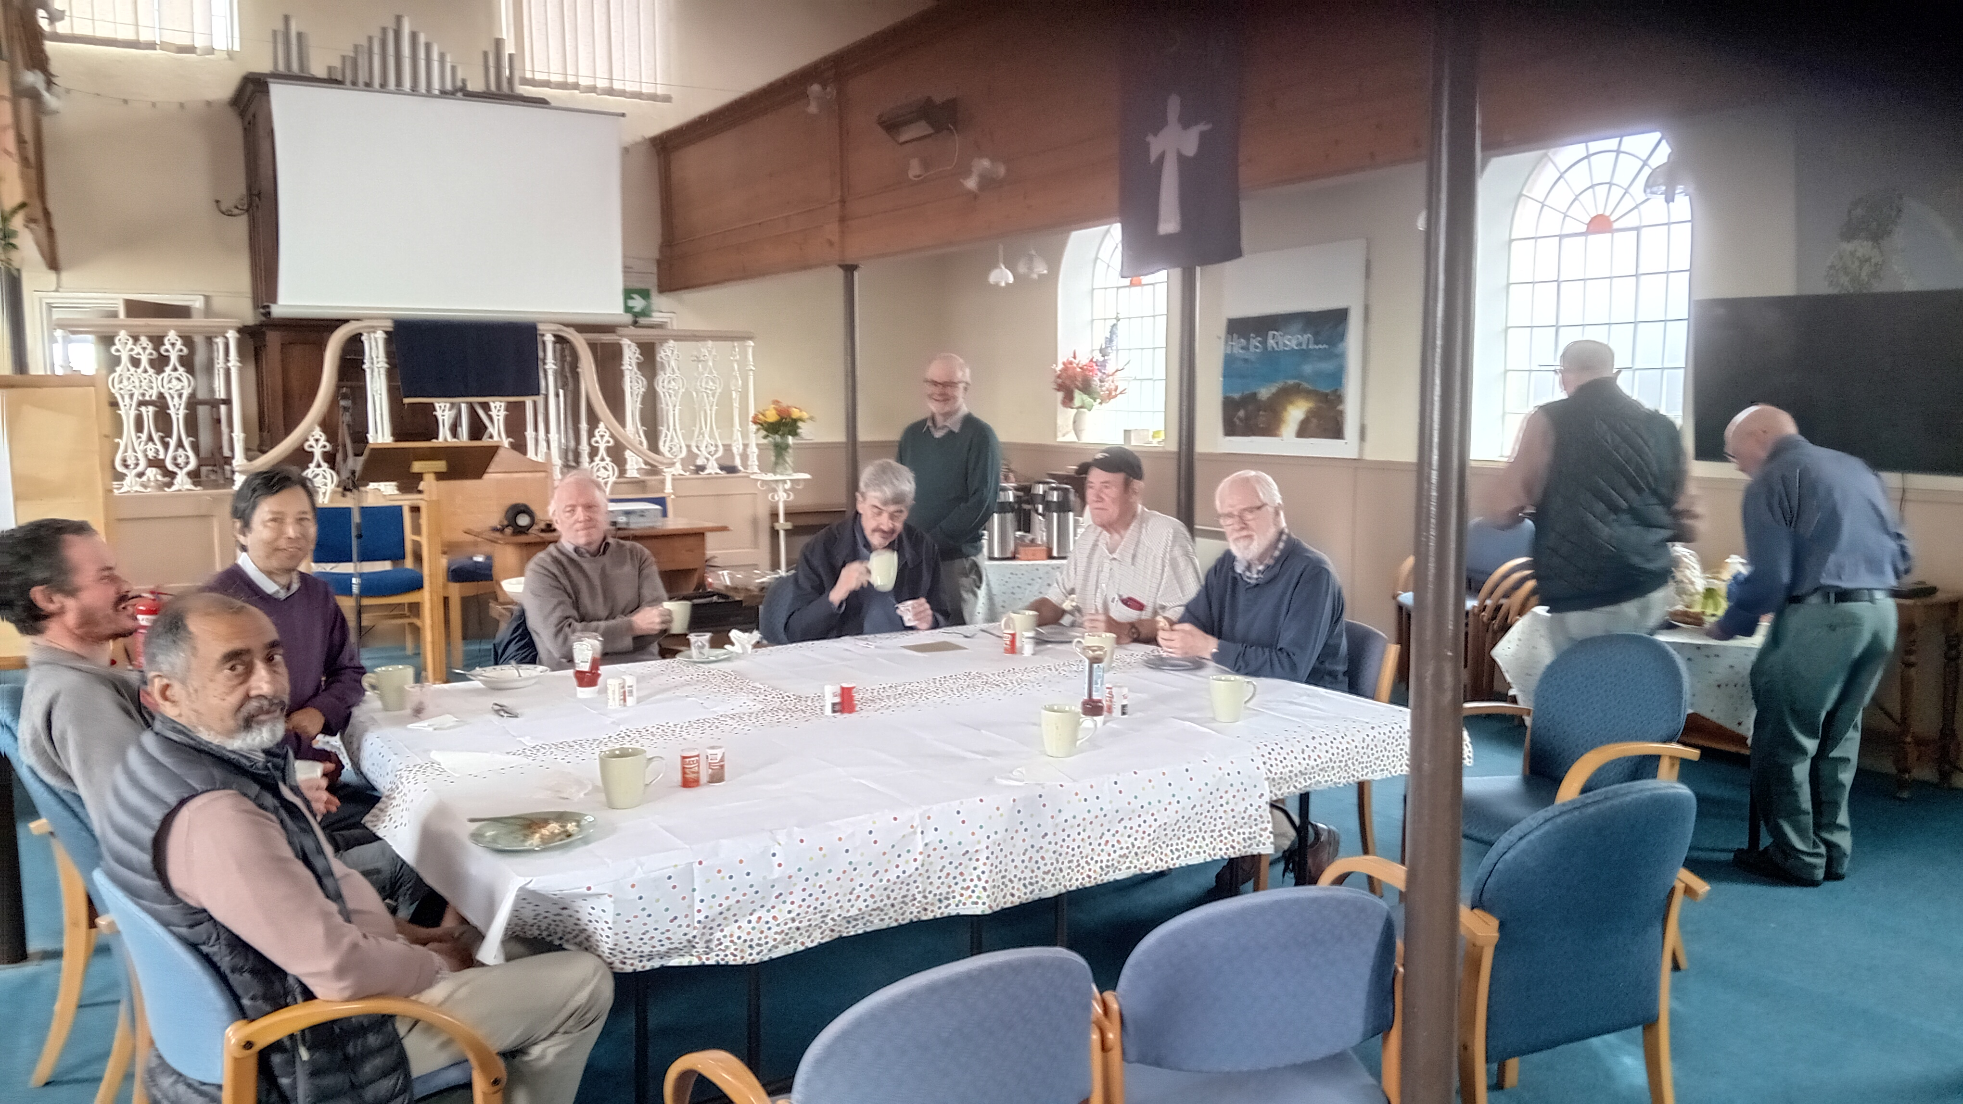
A new coffee morning started in September, alongside their men’s breakfast, craft club, exercise club and Bible study. Through these activities, the church seeks to reach their community, to see a regeneration of faith. The church would value prayer: * That the groups help to reach more people and grow connections to church. * For fruit and encouragement, seeing people come to faith and be baptised. * That connections will grow in church and community through service to the village. * And that events bring people into worshipping together and that a regeneration of faith may occur in the church and local area.
P
Prayer Focus: Landbeach and Milton Baptist Church

