Slide 1
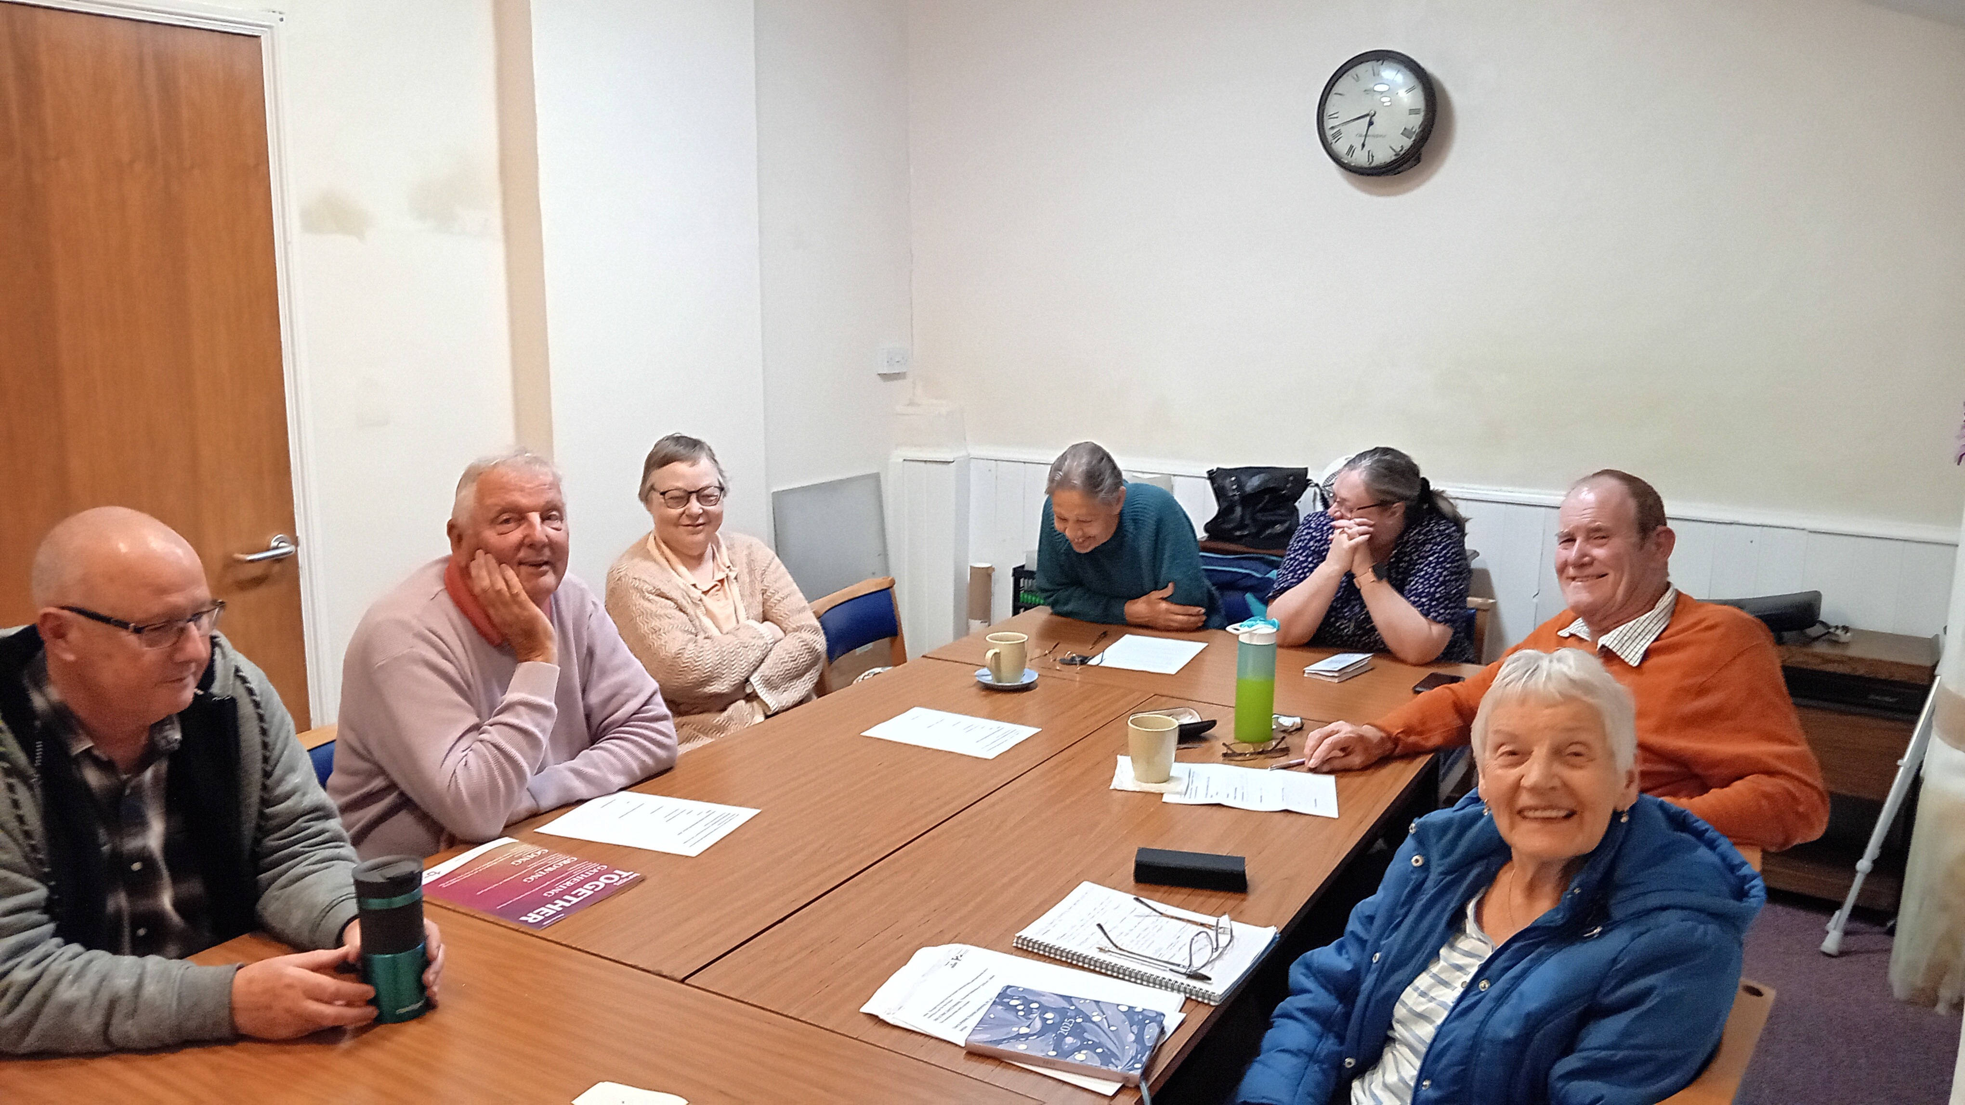
Landbeach and Milton Baptist Church lies to the north of Cambridge and is a long-established church dating back to 1798. The church currently has a small and ageing congregation and has been in decline for some time, but now green shoots are beginning to appear, and a recent Sunday service saw the best attendance yet. There is a deep thankfulness for the commitment and sacrifice of the long-standing church membership in time, energy and money given in supporting their church, with a deep appreciation of support received from other churches. This includes preachers and local Baptists who have assisted the church financially in calling Chris’ to become Pastor. Another example of wider support is from their Treasurer, who is from another local church.
Prayer Focus: Landbeach and Milton Baptist Church

Slide 2
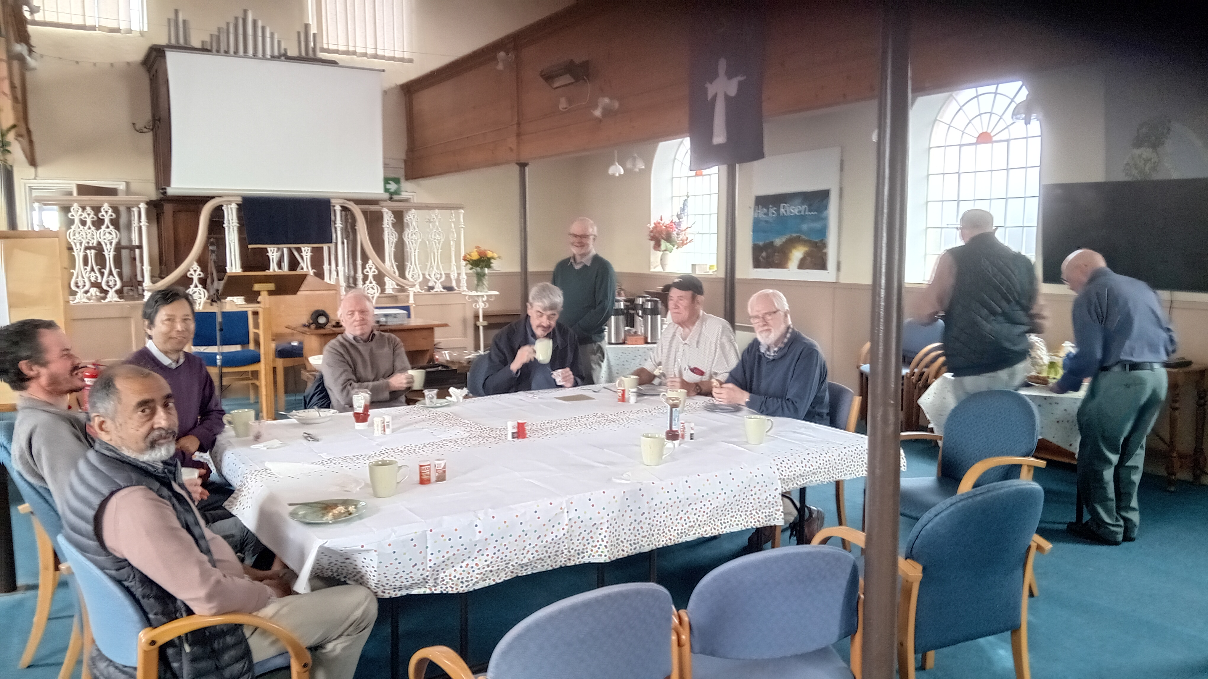
A new coffee morning started in September, alongside their men’s breakfast, long-standing craft club, exercise club and Bible study. Through these activities, both new and old, the church seeks to reach their community and bring people into worship and so hope to see a regeneration of faith. The church would value prayer: * That the groups help to reach more people and grow connections to church. * For fruit and encouragement, seeing people come to faith and be baptised. * That connections will grow in church and community through service to the village. * And that events bring people into worshipping together and that a regeneration of faith may occur in the church and local area.
Prayer Focus: Landbeach and Milton Baptist Church

