Slide 1
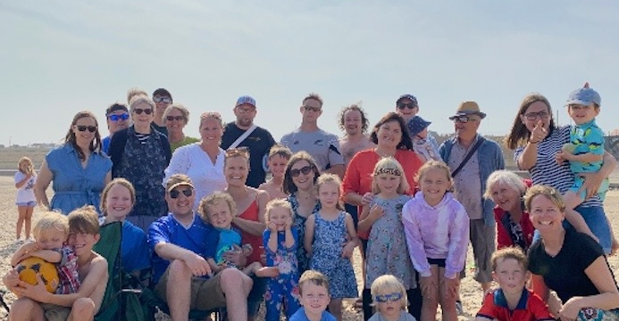
Dove River Church is a community of around 40 believers, based in Eye, Suffolk. Under the leadership of Jemma and Joe Aiken, Mike McManus and Jenny Chartier, the church has celebrated several baptisms over the past two years. Being community-focused, the church runs a Parent and Toddler Group as well as a social club on Tuesdays, and the building is open on Fridays as a “drop-in” for the people of Eye, praying that God will use these opportunities to reach those in need and shine His light into their lives.
P
Prayer Focus: Dove River Church

Slide 2
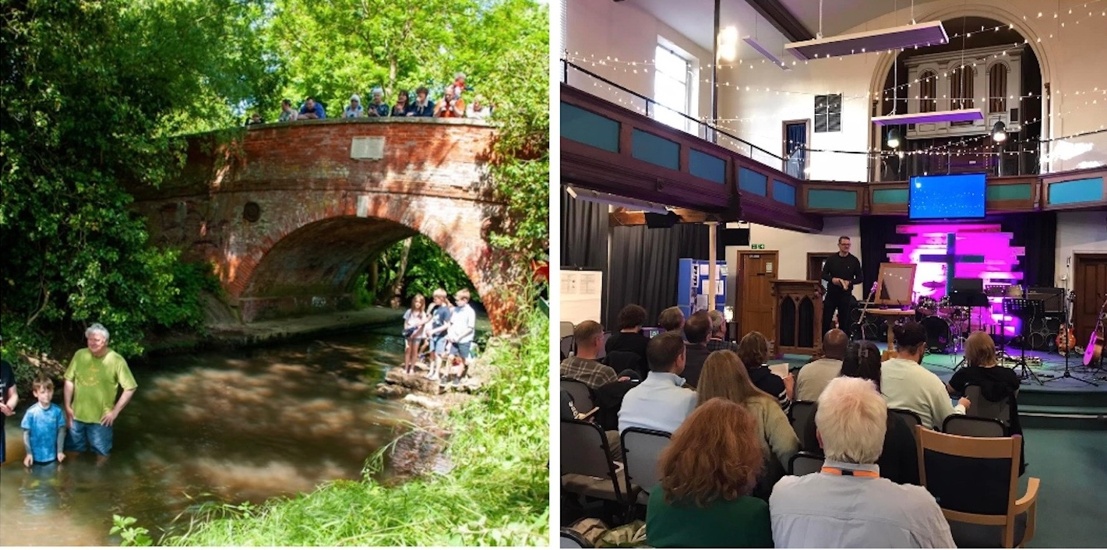
In September, the church held a week of Prayer and Fasting and they ask us for prayers for guidance about the words and pictures they had during the week. They would also ask for prayer for their three new Home Groups, starting in October, which will be adding to a regular Friday Night Art Group, and Wednesday’s Prayer meeting that meets online.
P
Prayer Focus: Dove River Church

