Slide 1
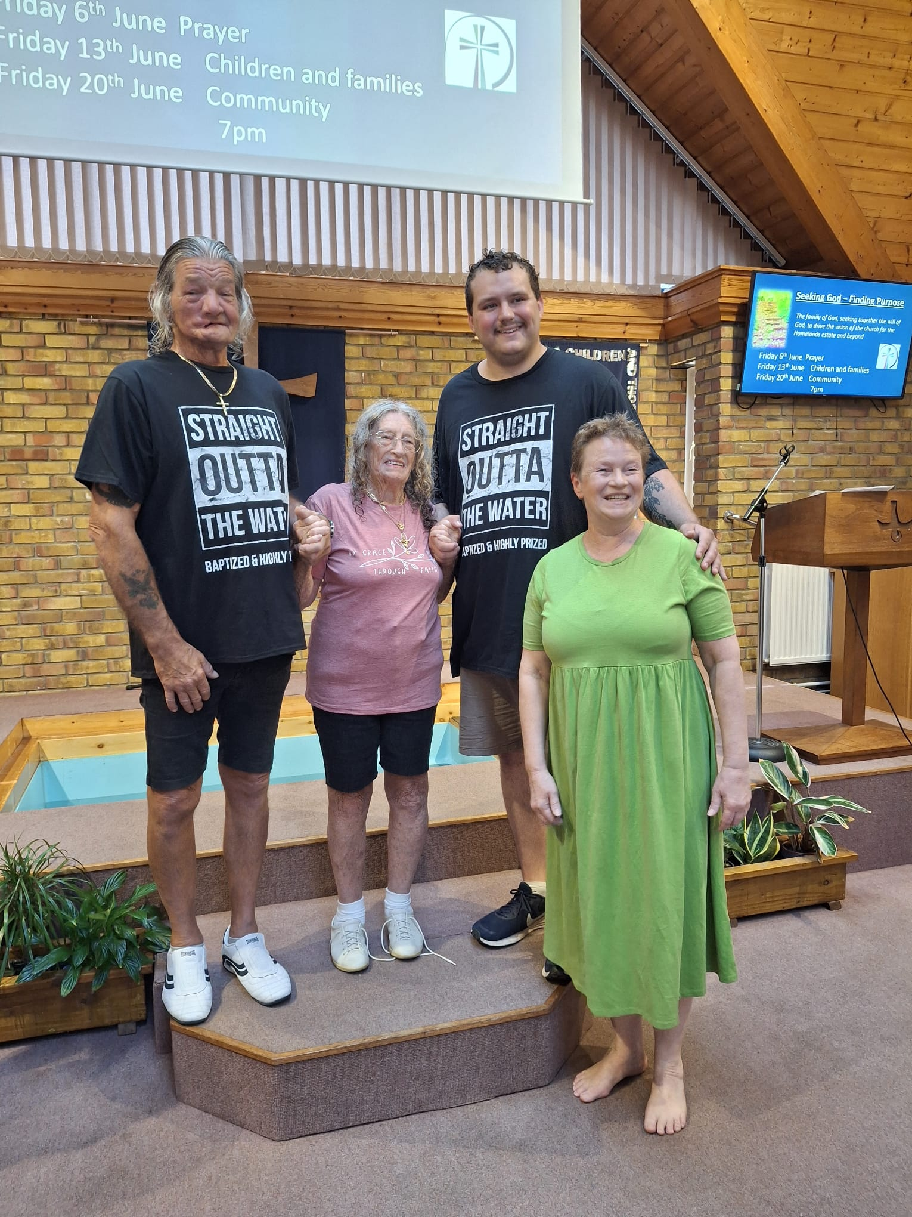
Homelands Free Church was planted from Frinton Free Church 49 years ago. Over the last nine months, Homelands has seen a real resurgence of interest of people coming to or desiring to renew their faith. Sarah, their Pastor, baptised three people last month, and four more baptisms lie ahead. This influx of newcomers brings good challenges of encompassing new needs. Plans are to run an Alpha course, a men’s group, a ladies’ breakfast and craft group aimed at parents collecting kids from school. In these exciting times, the church is also seeking to appoint either a Community or Families Worker later in the year.
Prayer Focus: Homelands Free Church

Slide 2
HFC are seeking to modify their culture to accommodate the complex needs of modern life, including working weekends. The church would value prayer for: • Connections to grow and develop with the newer people and in the community. • New families to join the church and families who are committed to Jesus. • For the process of seeking a new Family/Community worker. • Also, for the upkeep of ageing buildings. • Ultimately, that meeting all these needs will form the basis of a renewed community.
P
Prayer Focus: Homelands Free Church

