Slide 1
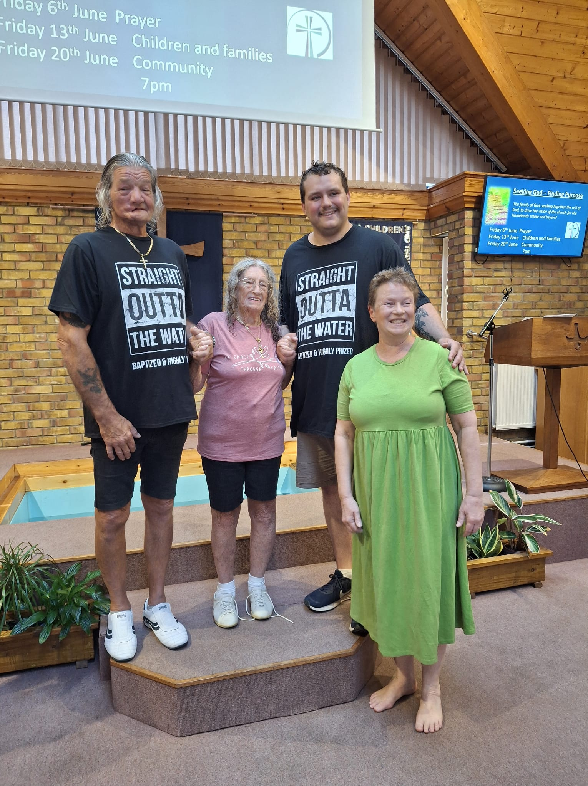
Homelands Free Church was planted from Frinton Free Church 49 years ago. It lies near older housing estates that are still being developed, and there is much potential for outreach. Over the last nine months, Homelands has seen a real resurgence of interest of people coming to or desiring to renew their faith. Sarah, their Pastor, baptised three people last month, and four more baptisms lie ahead. This influx of newcomers brings new and good challenges as to how they can encompass new needs. Plans are in place to run an Alpha course, and new activities will be starting: a men’s group, a ladies’ breakfast and a craft group aimed at parents collecting kids from school. In these exciting times, the church is also seeking to appoint either a Community or Families Worker later in the year.
Prayer Focus: Homelands Free Church

Slide 2
Looking at the larger picture, they are seeking to modify the current culture of church to accommodate those who work shifts/weekends and recognising that modern life brings complex needs and church life needs to adjust to these changes. The church would value prayer for: • Connections to grow and develop with the newer people and in the community. • New families to join the church and families who are committed to Jesus. • For the process of seeking a new Family/Community worker. • Also, for the upkeep of ageing buildings. • And ultimately, that meeting all these needs will form the basis of a renewed community.
Prayer Focus: Homelands Free Church

