Slide 1
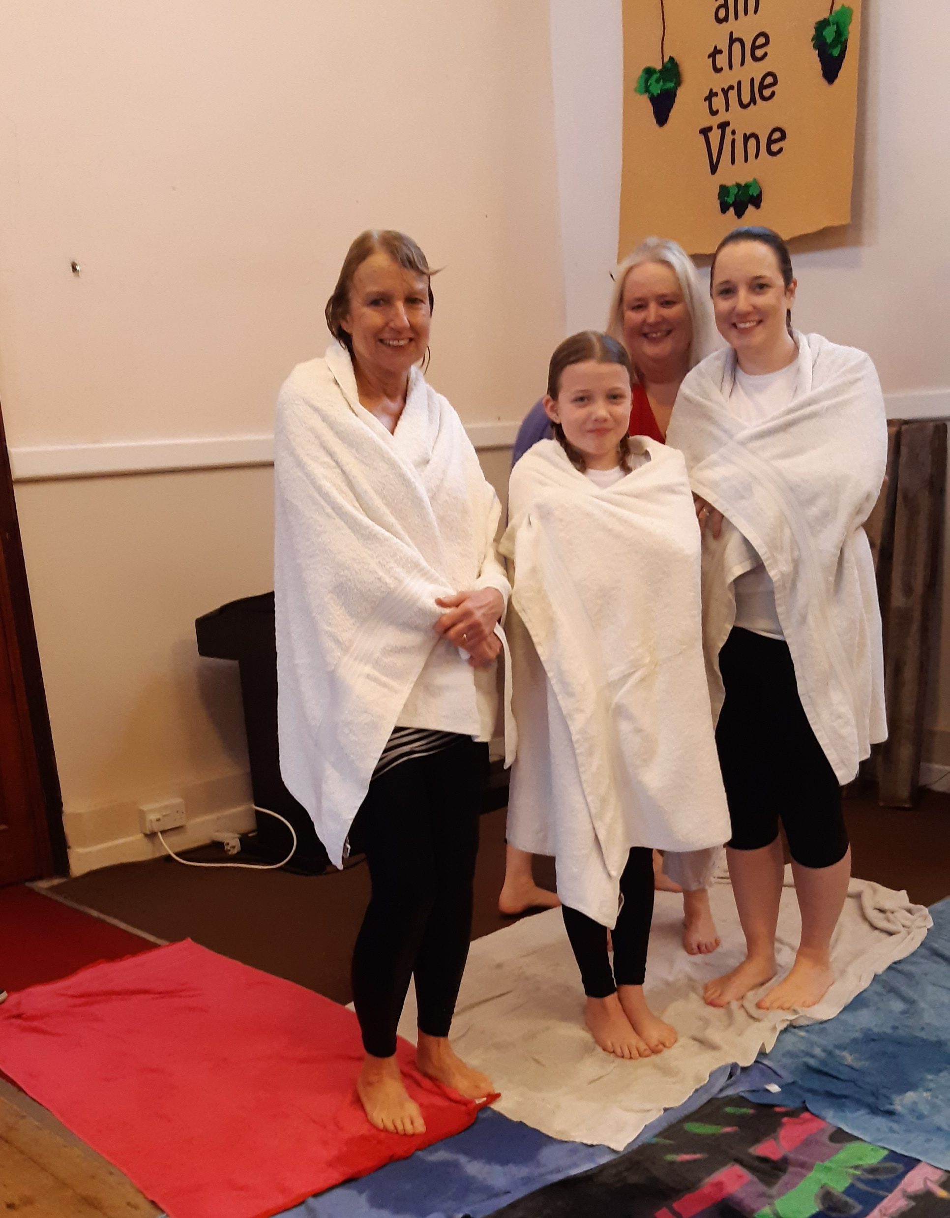
Norton is a small village near Bury St. Edmunds. Four years ago, our Pastor formed Churches Together in Norton, with a joint Christmas, Pentecost, and Easter event.
It has been our privilege to go into the village's Primary School to run "Open the Book" once a week since 2006. The three churches also operate "Lighthouse", which is an after-school group which meets weekly in the school.
The Baptist Church holds a young people's group called "The Den" on Friday nights, with up to 30 children attending.
Prayer Focus: Norton Baptist Church

Slide 2
It has been an answer to prayer to see the church grow from just 5 people in 2018 to our current size of over 25 people each week. It was a joy to see the Baptistry opened in February this year for three generations of one family. Future events for prayer:
• That the church is seen as an outreach to the village.
• For Saltmine Theatre Company as they are coming in November to present a pantomime in the Village Hall.
• For an Alpha Course is planned for the Autumn.
P
Prayer Focus: Norton Baptist Church

