Slide 1
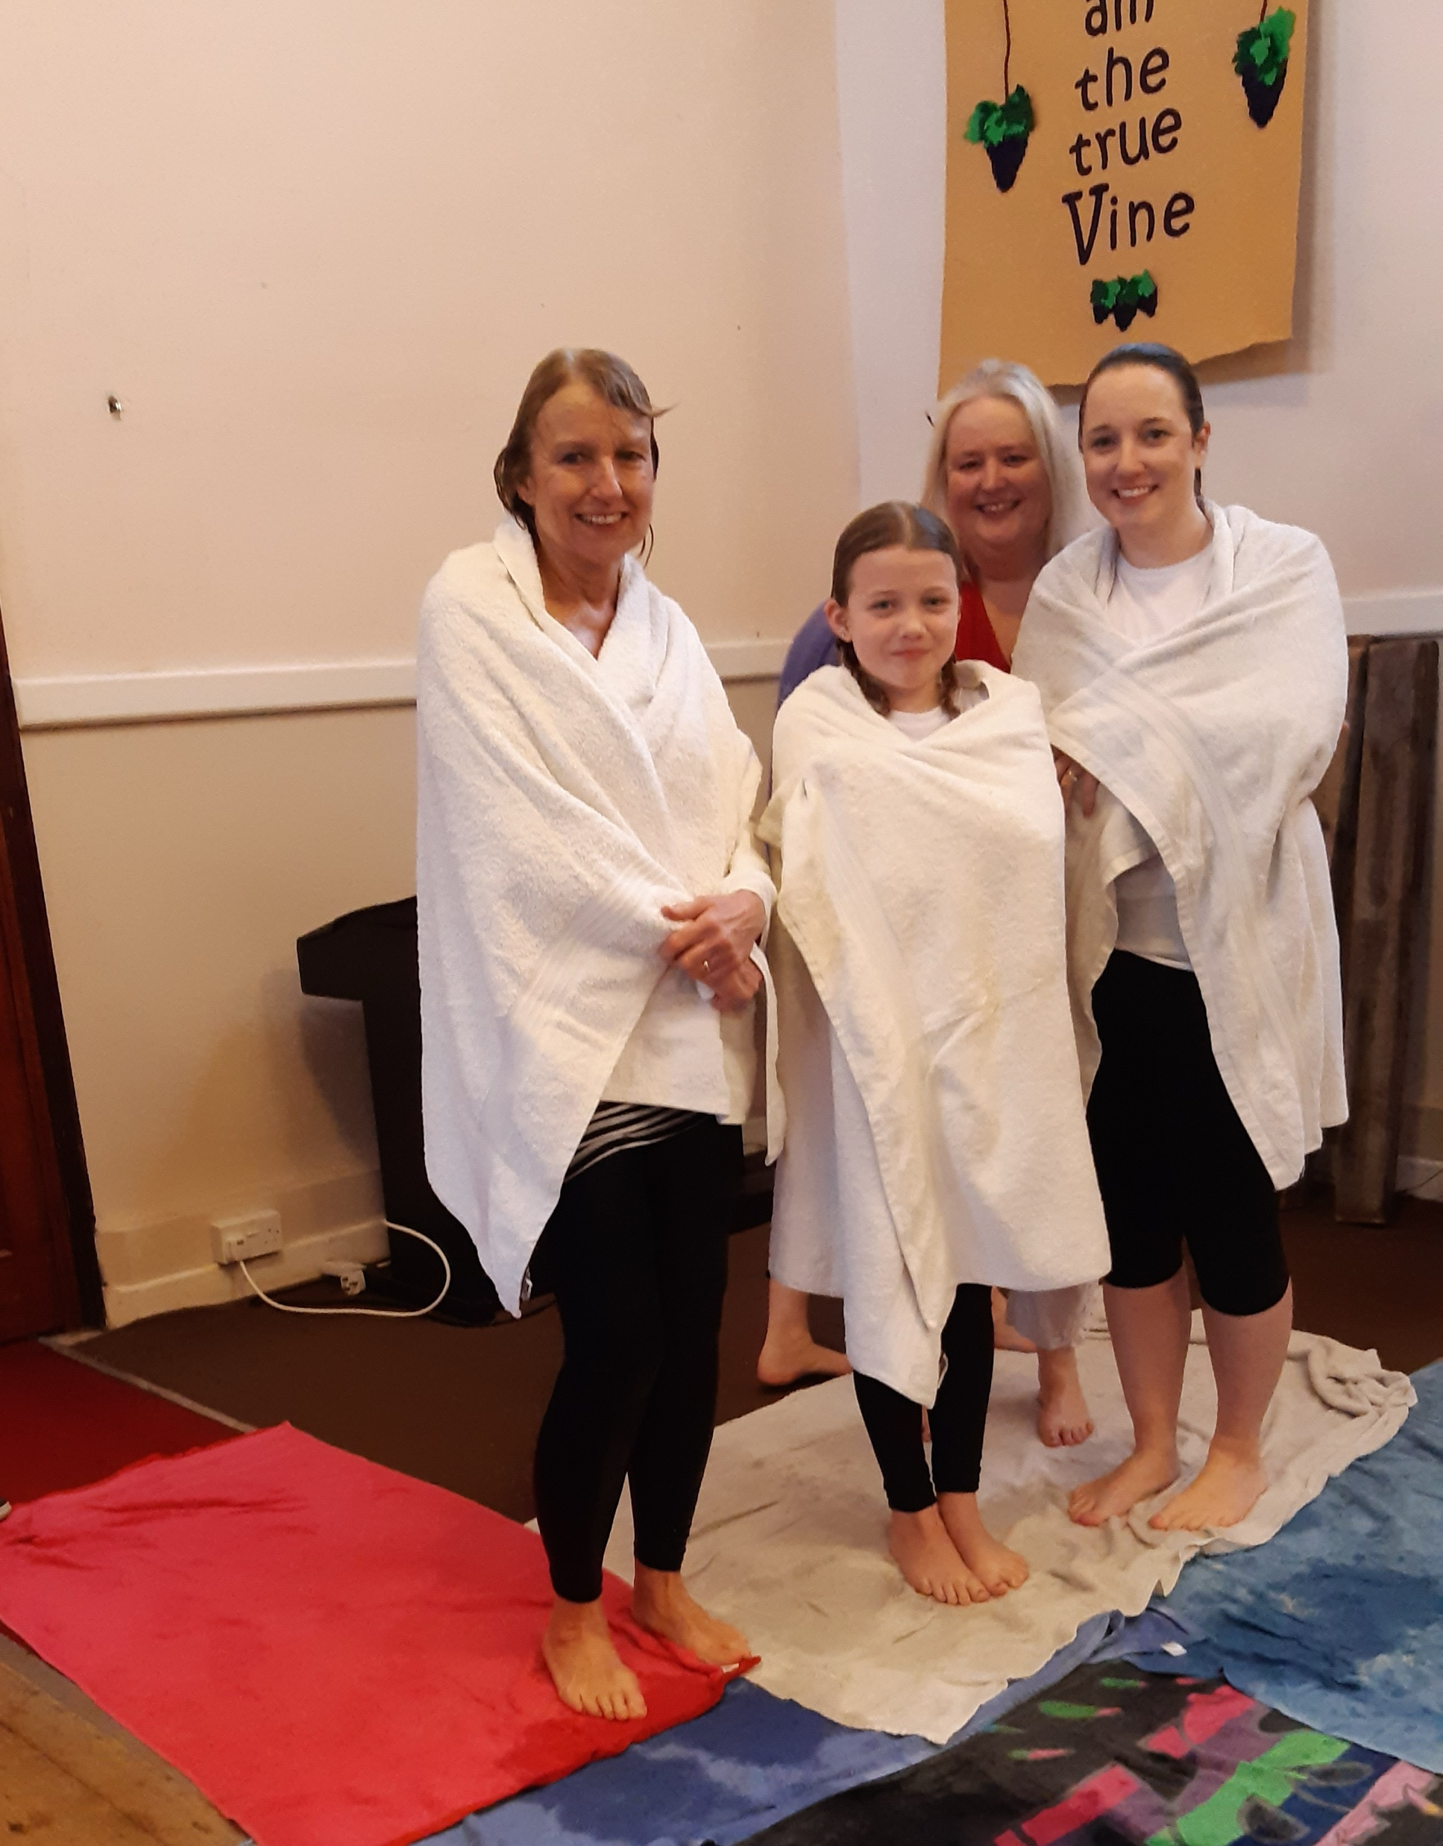
Norton is a small village ten miles from the market town of Bury St. Edmunds with three churches: The Salvation Army, Parish Church, and the Baptist Church. Four years ago, our new Pastor formed the United Churches Together in Norton, with a joint Carol Service and Pentecost Service, and an Easter event. The village's Church of England Primary School has 210 children, and it has been our privilege to go into the school to run "Open the Book" once a week since 2006. The three churches also work together to operate "Lighthouse", which is an after-school group which meets weekly in the school. The Baptist Church holds a young people's group called "The Den" on Friday nights, with up to 30 children attending.
Prayer Focus: Norton Baptist Church

Slide 2

It has been an answer to prayer to see the church grow from just 5 people in 2018 to our current size of over 25 people each week. It was a joy to see the Baptistry opened in February this year when three generations of one family were baptised. Future events for prayer: • That the church is seen as an outreach to the village. • For Saltmine Theatre Company as they are coming in November to present a pantomime in the Village Hall. • For an Alpha Course is planned for the Autumn.
Prayer Focus: Norton Baptist Church

