Slide 1
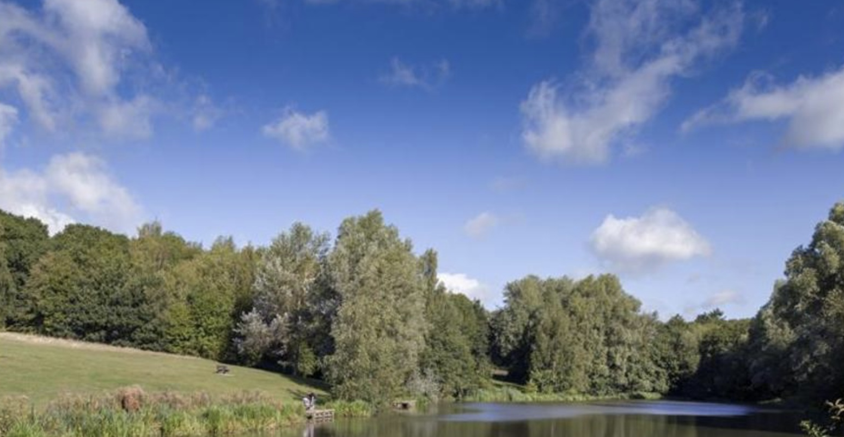
New Growth Ministry is a Pioneer Ministry that was founded eight years ago by Rev. Lynsey Heslegrave. Lynsey felt called to establish a worshipping community in the growing residential area where she lived. A small group, with a real heart for their local area, meet in homes, alongside Forest Church in the local Highwoods Country Park where Lynsey seeks to engage her local community with God through creation. The ethos of the Church is to build relationships with the local community, providing spiritual input through serving: as volunteer secondary school chaplains, fostering links with Primary Schools and a Community Pantry set up in The Well Methodist Church in Myland, providing both practical and spiritual support for local families.
P
Prayer Focus: New Growth Ministry, North Colchester

Slide 2
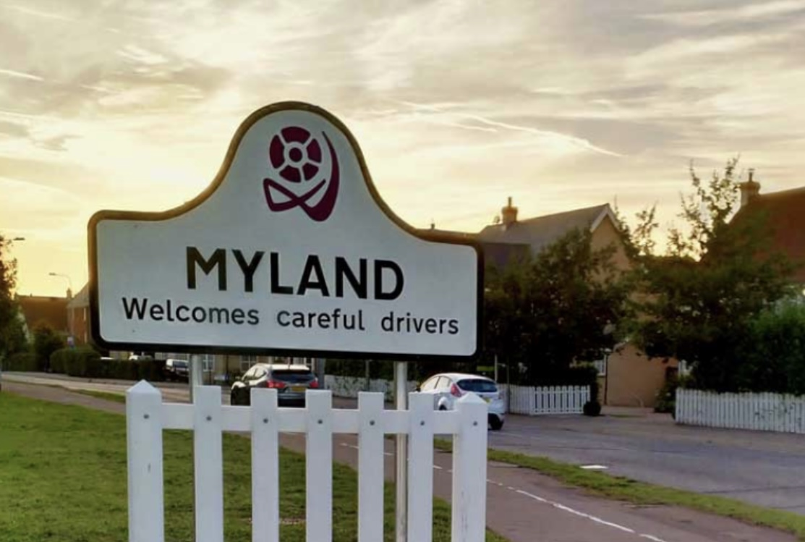
Please pray for New Growth’s continuing vision for mission in the north of Colchester, as they work ecumenically, using the established resources of local churches to launch new initiatives to serve the community in which they live. Pray also for growing acceptance, as they seek to build stronger relationships with the two local primary schools, and for emerging “Forest Retreats”, as Lynsey uses her skills as a Forest School instructor to engage her community with God through nature.
P
Prayer Focus: New Growth Ministry

