Slide 1
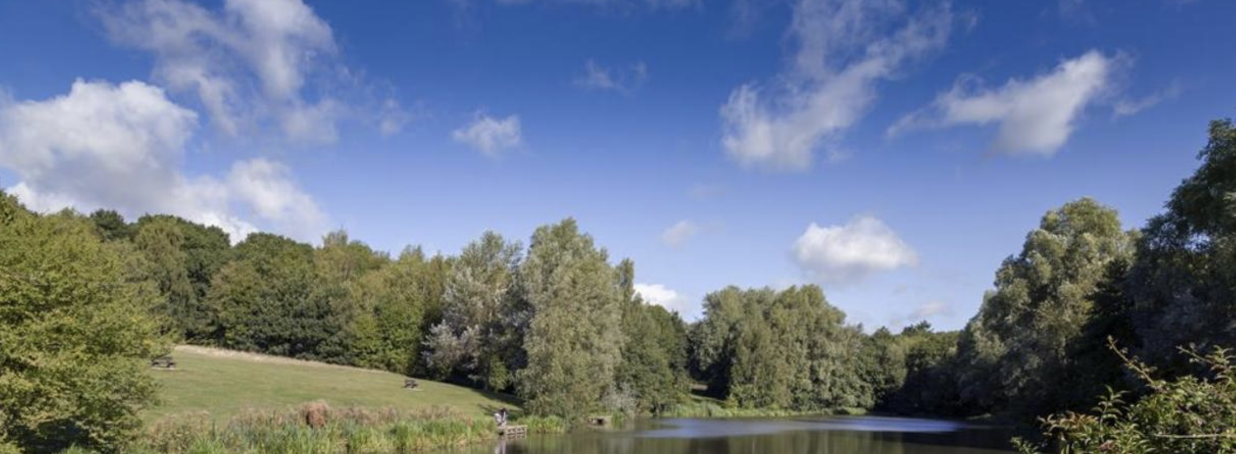
New Growth Ministry is a Pioneer Ministry that was founded eight years ago under the leadership of Rev. Lynsey Heslegrave. Lynsey felt called to establish a worshipping community in the growing residential area where she lived, in the north of Colchester. A small group, with a real heart for their local area, meet weekly in homes, and there is a monthly Forest Church in the local Highwoods Country Park where Lynsey seeks to engage her local community with God through creation. The ethos of the Church is to build relationships with the local community; two members are volunteer chaplains in a local secondary school, and links with the areas Primary Schools are being fostered.
Prayer Focus: New Growth Ministry

Slide 2
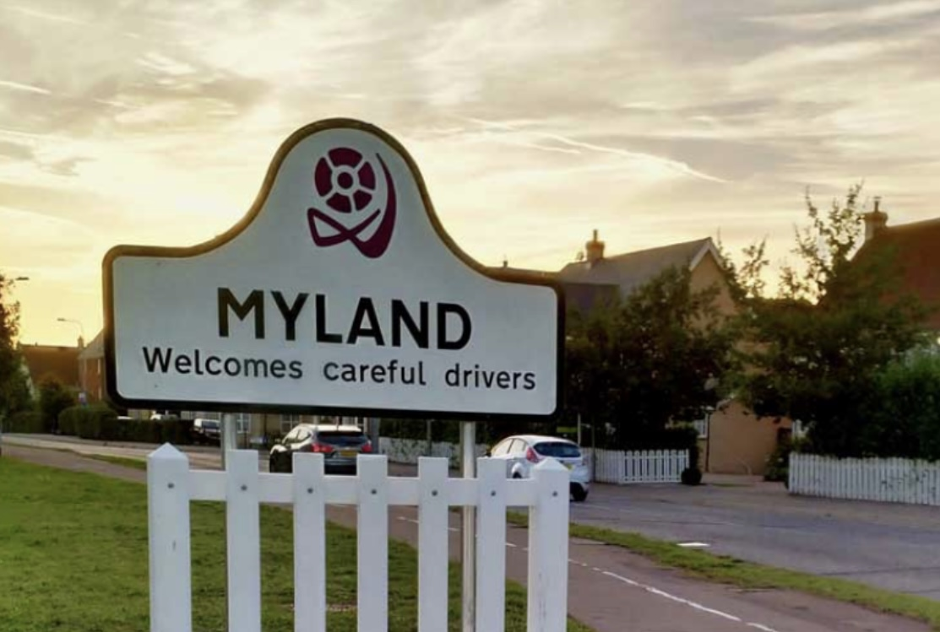
As New Growth do not have a building, they partner with local churches, providing spiritual input through serving. A Community Pantry has been set up in The Well Methodist Church in Myland, providing both practical and spiritual support for local families. Please pray for New Growth’s continuing vision for mission in the north of Colchester, as they work ecumenically, using the established resources of local churches to launch new initiatives to serve the community in which they live. Pray also for growing acceptance, as they seek to build stronger relationships with the two local primary schools, and for emerging “Forest Retreats”, as Lynsey uses her skills as a Forest School instructor to engage her community with God through nature.
Prayer Focus: New Growth Ministry

