Slide 1
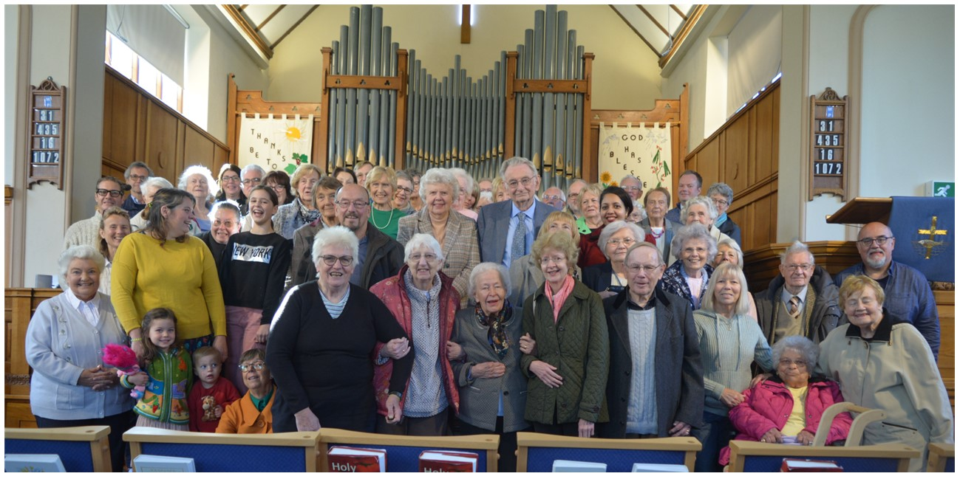
Hutton and Shenfield Union Church is a Baptist and URC Local Ecumenical Partnership. They have great community links throughout the wider area, are well known, and their building is used by many different organisations.
They have many regular activities: Sunday services, bible study and prayer times, banner making, mature ladies, coffee bar, men’s breakfast and food distribution. For families, they have Baby and Toddler groups, including Dad and baby, ‘Who Let the Dads Out’, Messy Church and Muddy Church. In the summer, they have a kids' Holiday Club and a Holiday at Home for older people.
P
Prayer Focus: Hutton and Shenfield Union Church

Slide 2
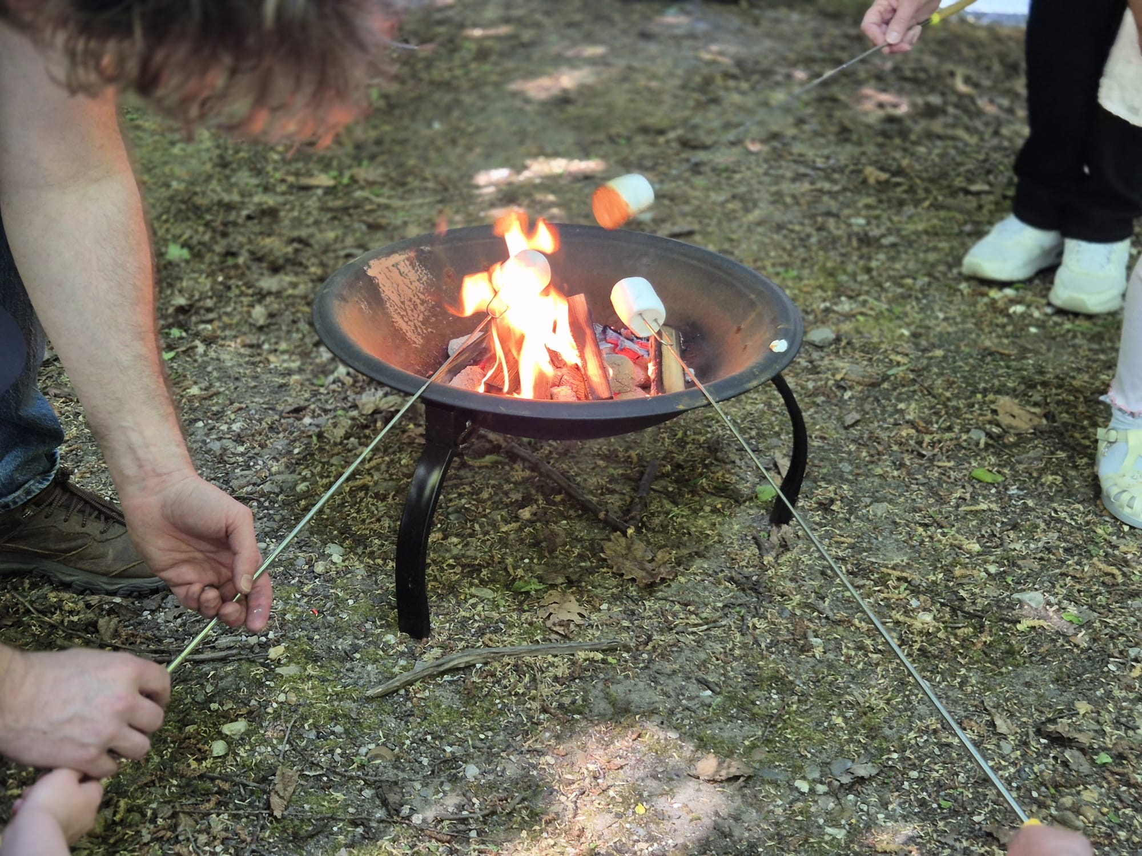
Their Minister is Alex, who, with the team of Deacons, is leading the church in a 3-year focus of walking in the same direction that Jesus did. Last year, they focused on Looking Up (worship and prayer), this year’s focus is Looking in (fellowship and discipleship), and next year, they are Looking Out (mission and evangelism).
Please pray:
• That they see fruitfulness from the 3-year focus
• For the development of new leaders over time
• For transitions as people from different ages come and join the church
P
Prayer Focus: Hutton and Shenfield Union Church

