Slide 1
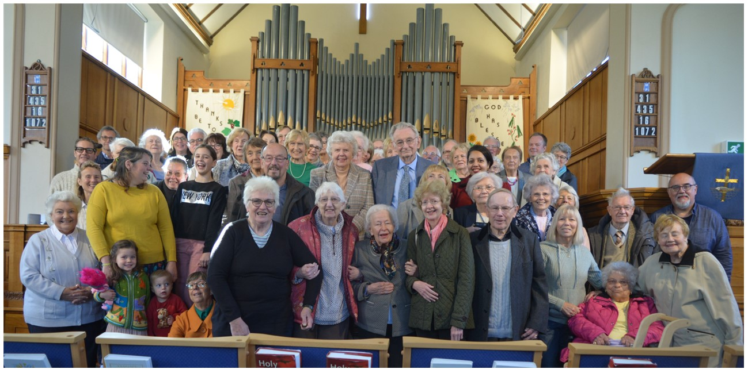
Hutton and Shenfield Union Church is a Local Ecumenical Partnership between Baptists and the United Reformed Church. The church building is located in Hutton Mount, but they seek to serve a wide community beyond that. They have great community links throughout the wider area, are well known, and their building is used by many different organisations. They have many regular activities, which include their Sunday services (in person and streamed on YouTube), bible study and prayer times, which include Lectio 365 on Facebook. Additionally, they have groups for banner making, mature ladies, coffee bar, men’s breakfast and food distribution. For families, they have Baby and Toddler groups, including Dad and baby at the weekend, Who Let the Dads Out group, Messy Church and Muddy Church, which happens in the nearby woodland. In the summer, they have a Holiday Club for the children and a Holiday at Home for older people.
Prayer Focus: Hutton and Shenfield Union Church

Slide 2
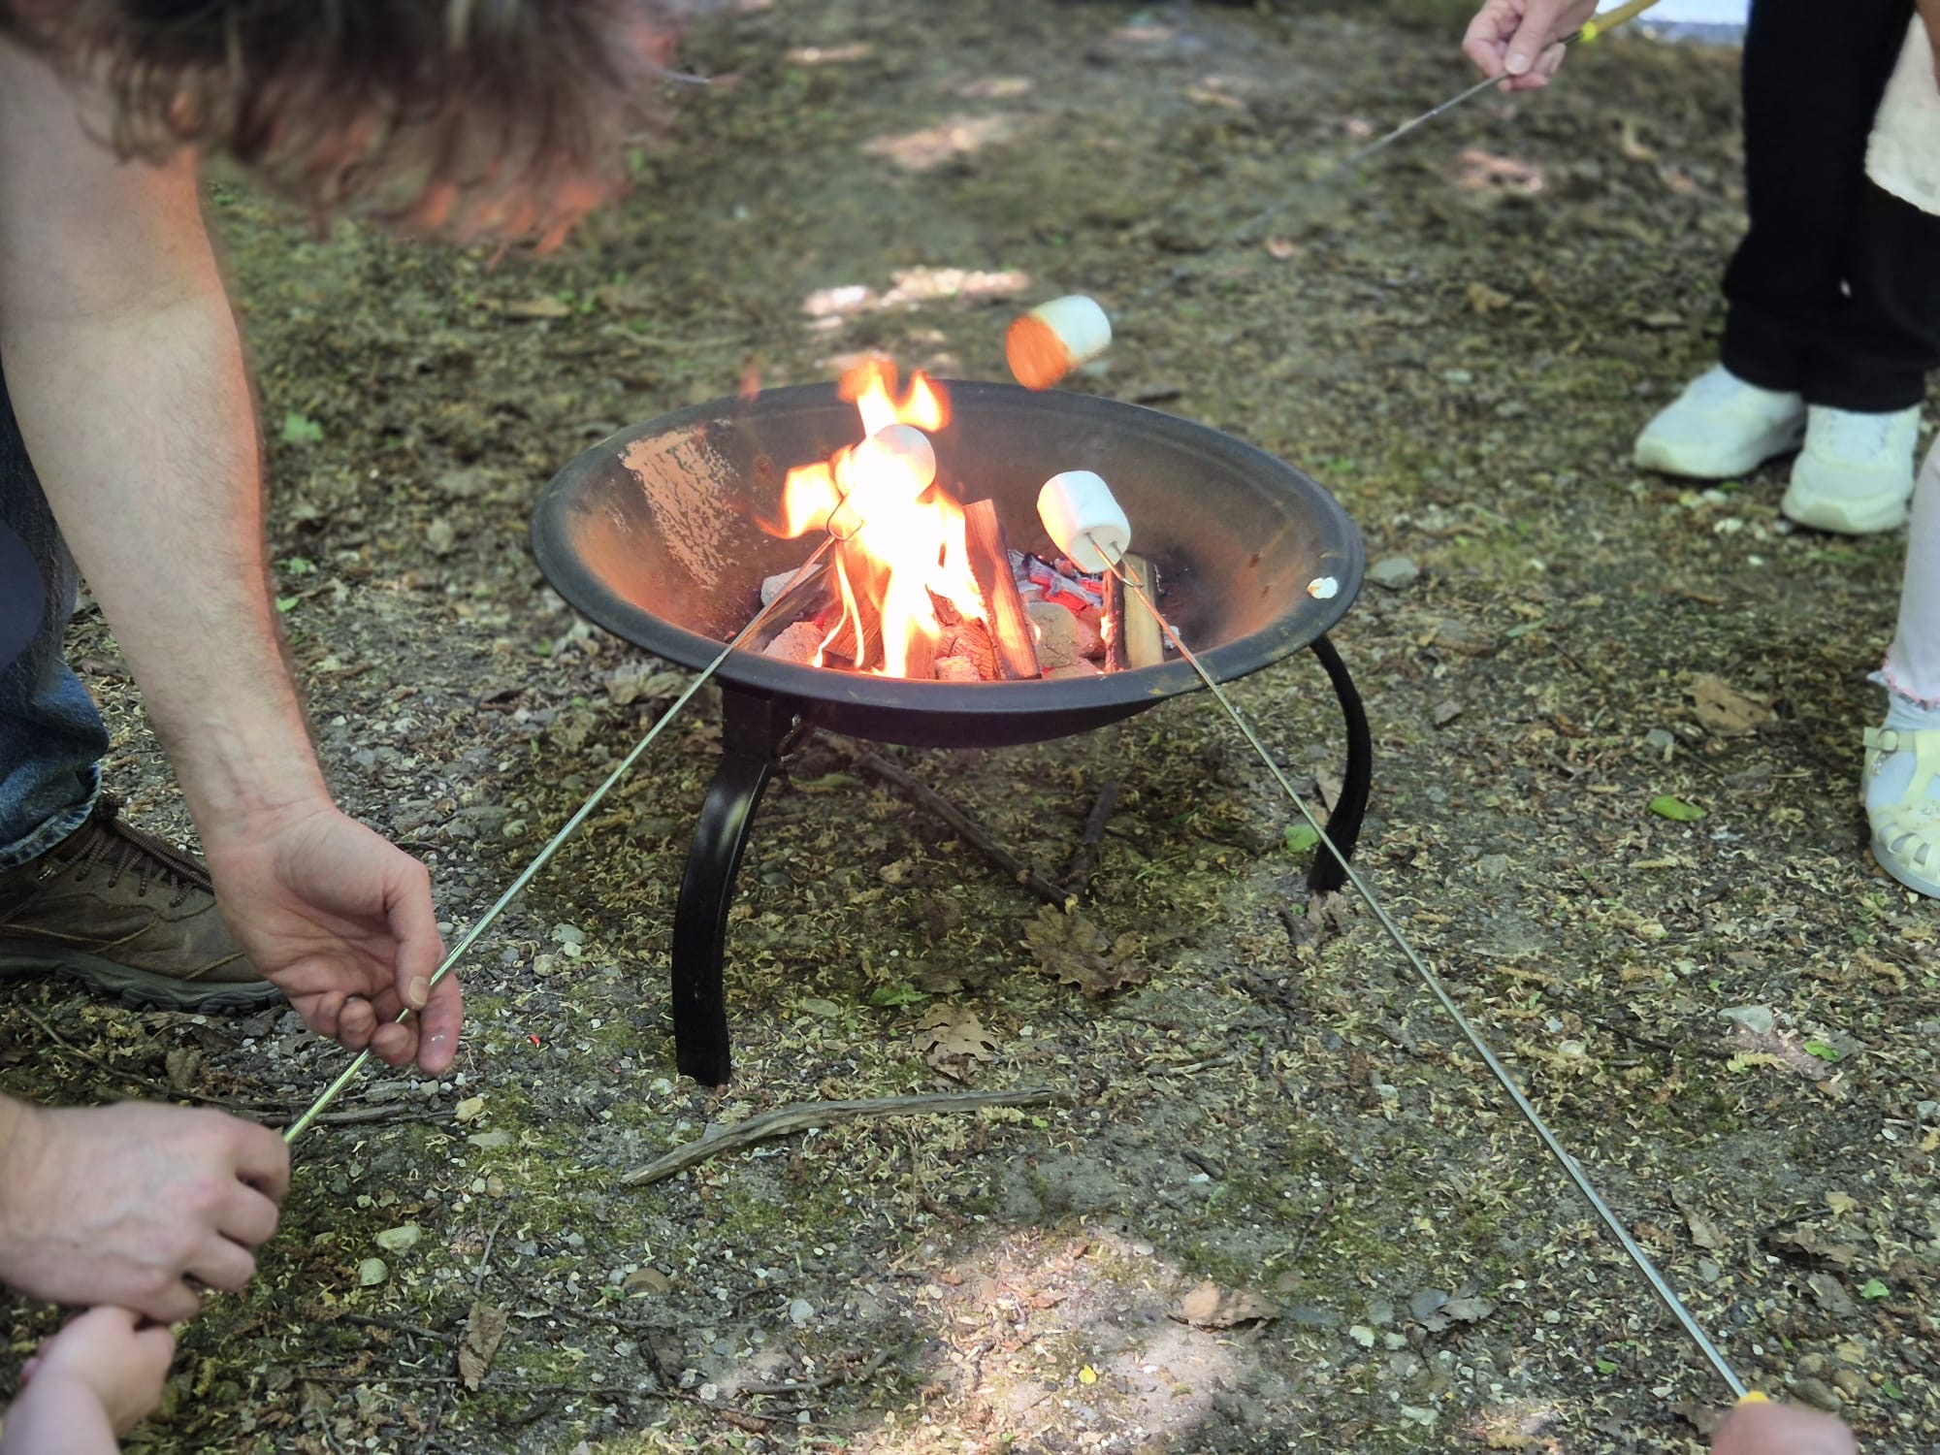
Their Minister is Alex, who is a Baptist Minister. Alex and the team of Deacons and Officers are leading the church in a 3-year focus of walking in the same direction that Jesus did. Last year, they focused on Looking Up (worship and prayer), this year’s focus is Looking in (fellowship and discipleship), and next year, they are Looking Out (mission and evangelism). They focus using sermons series’, their prayer lives, meetings and discussions, and specific initiatives. Please pray: • That they see fruitfulness from the 3-year focus • For the development of new leaders over time • For transitions as people from different ages come and join the church
Prayer Focus: Hutton and Shenfield Union Church

