Slide 1
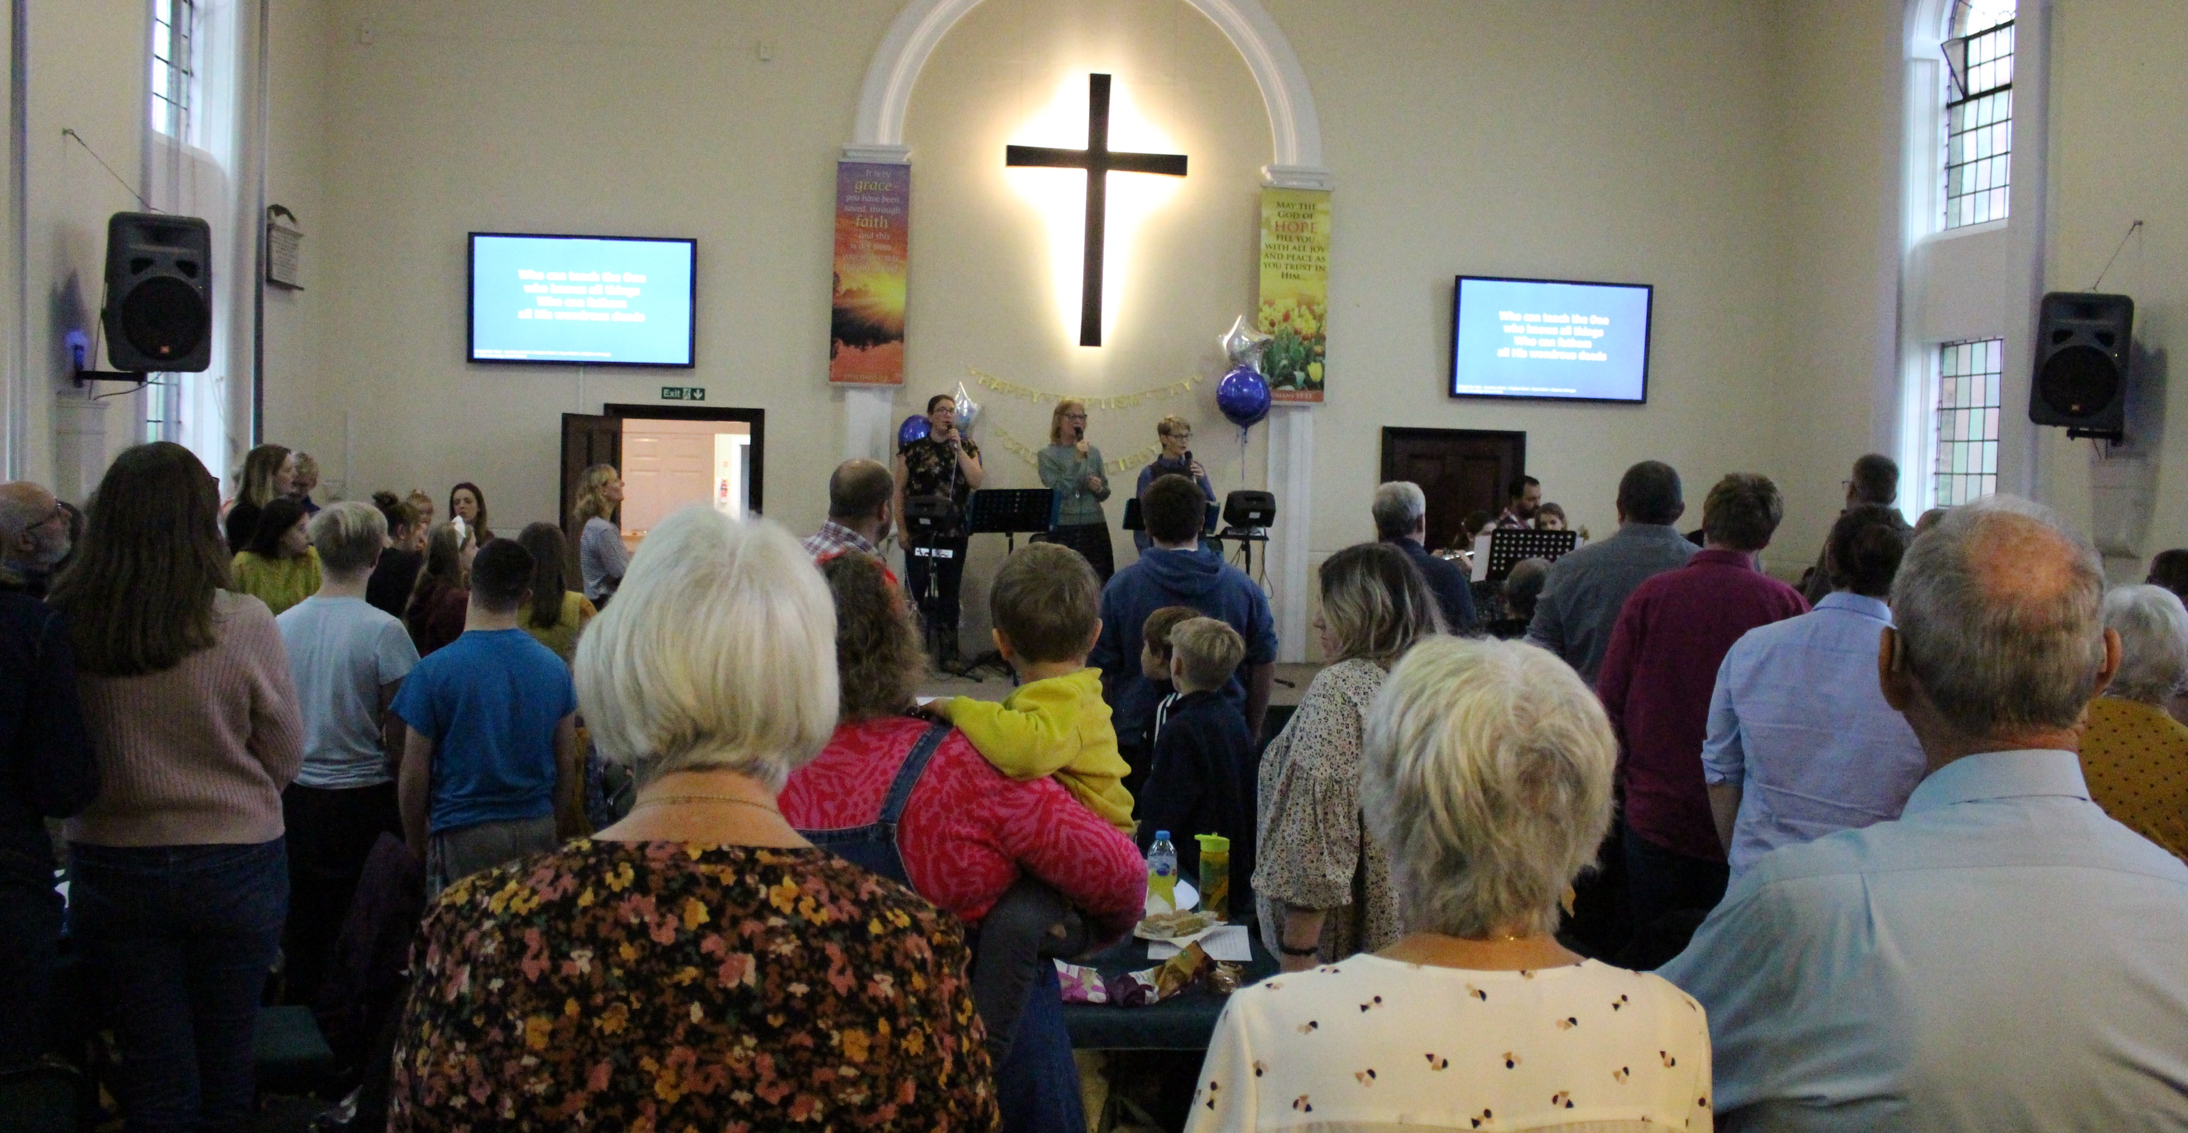
Bethel is a warm, welcoming community where people from the local villages come to feel safe and wanted. The church is active; all activities start with a member having a passion, and the fellowship discerning and joining them wholeheartedly: everything grows out of the church being themselves and loving Jesus.
In this way, lots of people with no church background have found a home and transformed: belonging, believing and behaving. This has led to a recent baptism, with more in September. Amongst other fruitful endeavours, the craft group is especially representative of the church as it sees all generations sitting down together, learning from one another, whilst doing the craft that suits them best.
P
Prayer Focus: Bethel Baptist Church, Cambridgeshire

Slide 2
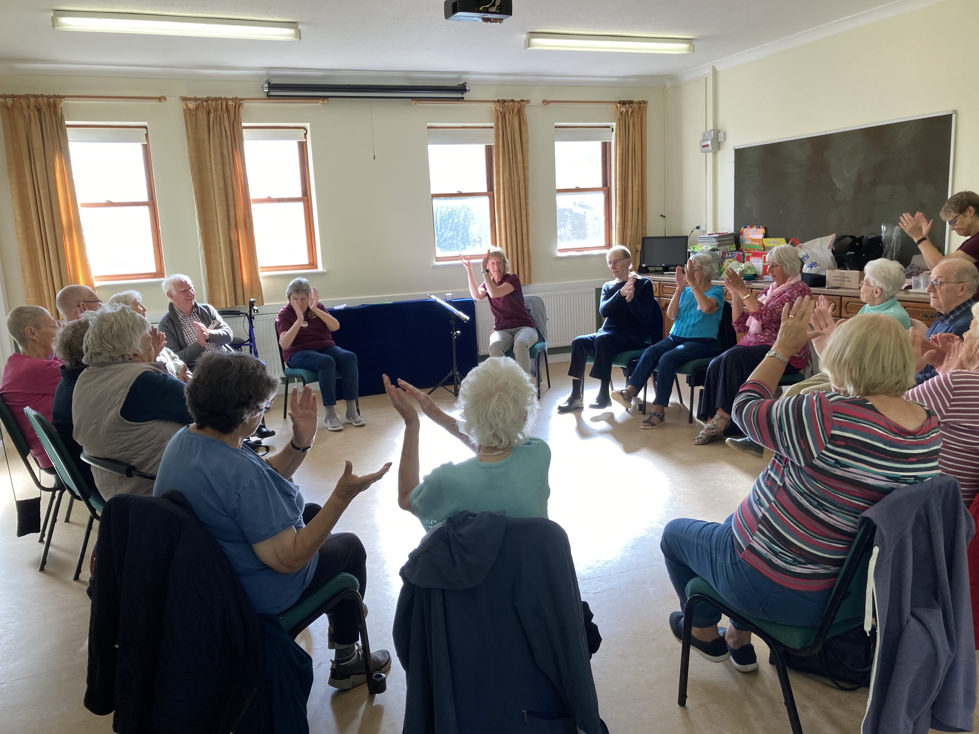
One member who serves the church is their Pastor, Bob Adams. He is also a school chaplain and governor. He’s particularly encouraged by the church youth, many of whom go to Satellites and have progressed to being on team there. They always come back energised and take a service to inspire the whole church. Please pray with them:
• That they have the strength to carry on
• That they are constantly reminded we all belong to Jesus and remember to look up!
• For all ongoing outreach, especially the Alpha course, which is happening shortly, and all the church are involved in.
P
Prayer Focus: Bethel Baptist Church

