Slide 1
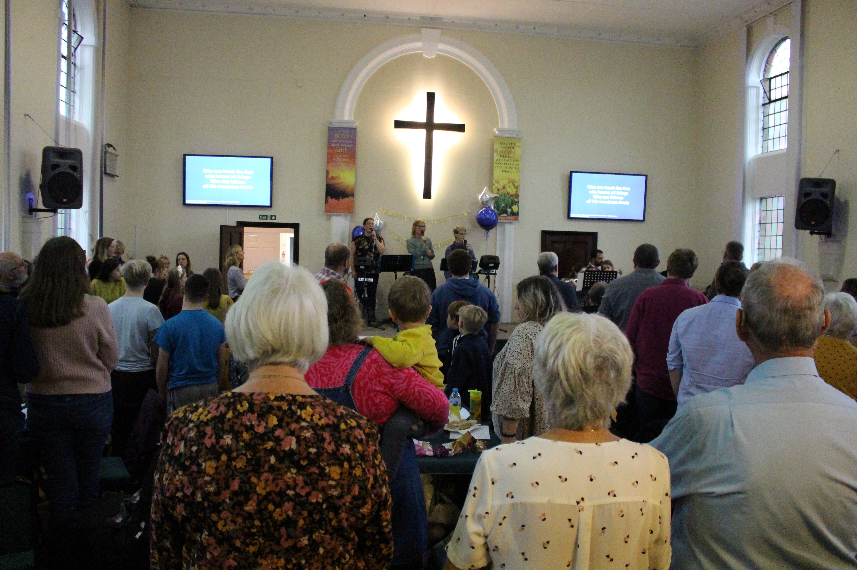
Bethel Baptist Church is a warm, welcoming community where people from the villages of Swavesey and Fen Dayton come to feel safe and wanted. The church is an active place, but all activities start with a member of the church having a passion, and the whole fellowship discerning and joining them wholeheartedly: everything grows out of the church being themselves and loving Jesus.
In this way, lots of people with no church background have found a home and transformed: belonging, believing and behaving. This has led to a recent baptism, with more in September, Sunday services, house groups, Club Vintage, Little Lights, Hub Youth and Craft Group, amongst other fruitful endeavours. The craft group is especially representative of the church as it sees all generations sitting down together, learning from one another, whilst doing the craft that suits them best.
Prayer Focus: Bethel Baptist Church

Slide 2
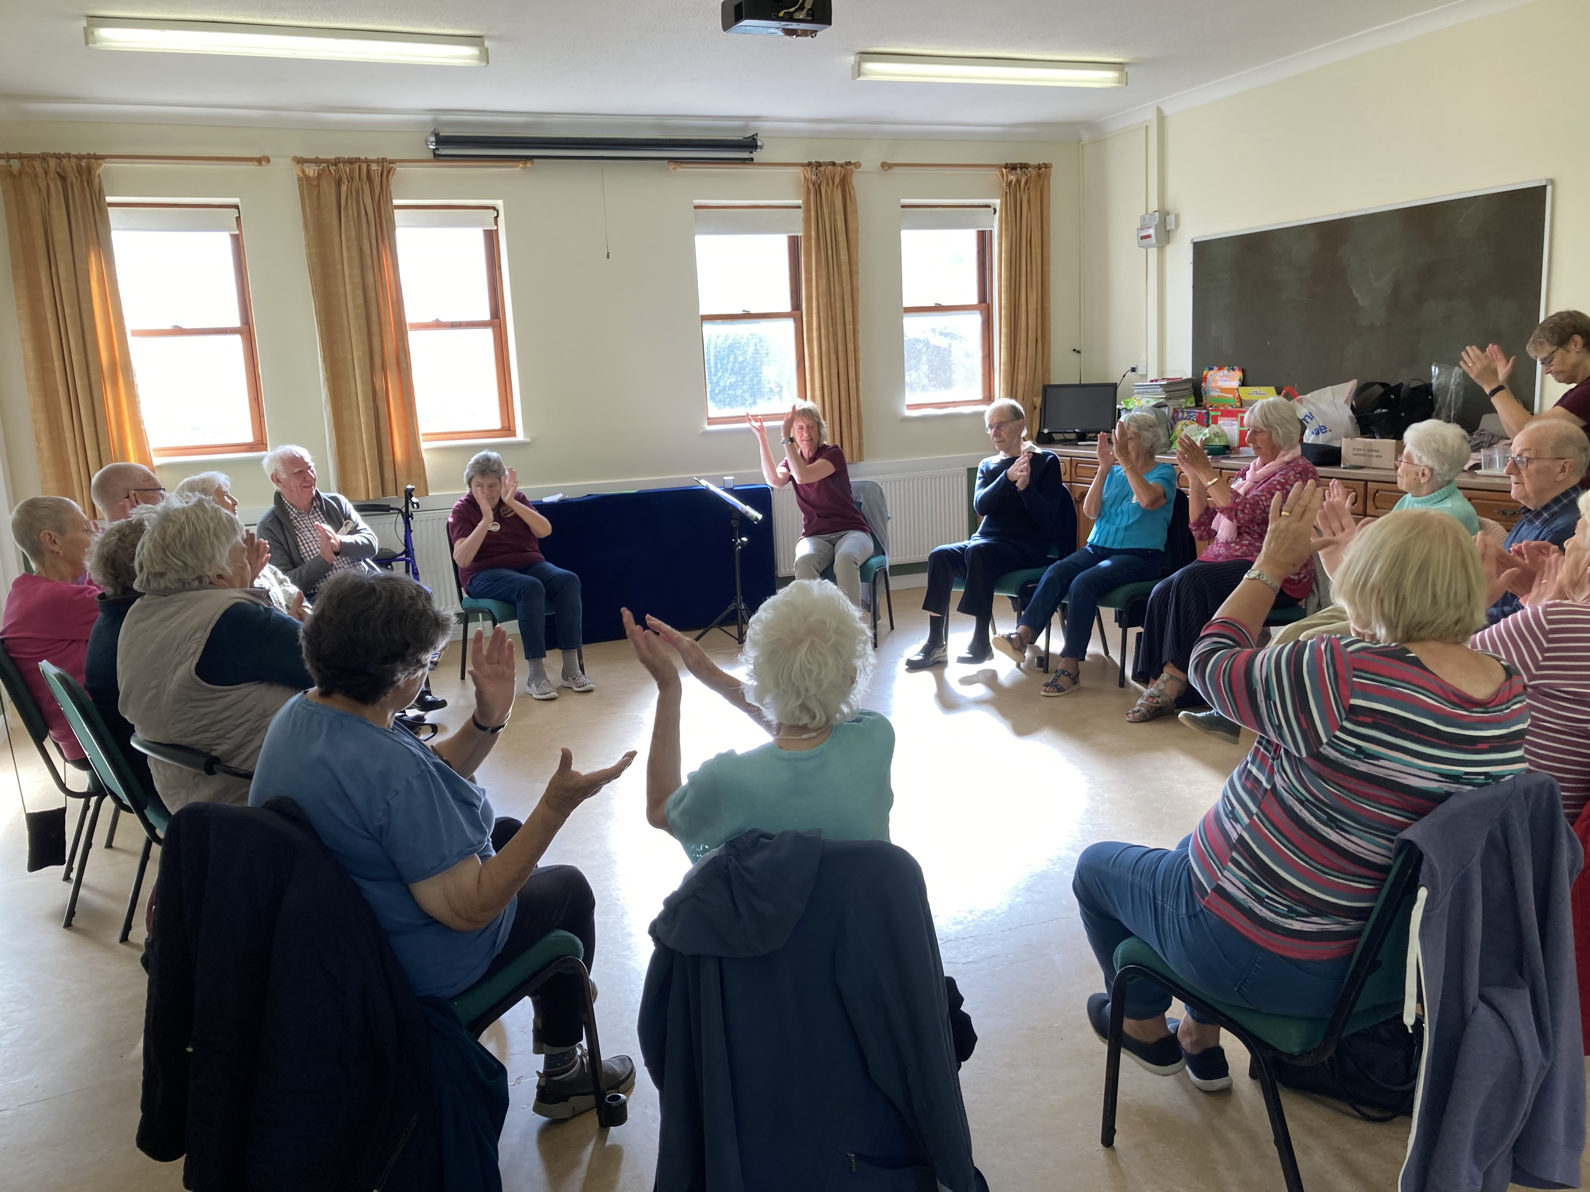
One of the members who serves the church is their Pastor, Bob Adams. He’s been with the church for 3 years and is greatly encouraged by what he sees. He is also a school chaplain and governor. He’s particularly encouraged by the church youth, many of whom go to Satellites and have progressed to being on team there. They always come back energised and take a service to inspire the whole church.
Please pray with the church:
• That they have the strength to carry on
• That they are constantly reminded that we all belong to Jesus and remember to look up!
• For all ongoing outreach, especially the Alpha course, which is happening shortly, and all the church are involved in.
Prayer Focus: Bethel Baptist Church

